Slide 1
CEIS310
Module 8
Final Presentation Template

Slide 2
Points Allocation for Final Project
Item | Points
Identify necessary process to establish improvements. | 15
Demonstrate data preparation using normalization. | 20
Demonstrate communication skills in various environments and contexts. | 25
Test/Train system utilizing Linear Regression. | 25
Build an Evaluate Model with all ML metrics. | 25
Implement Score Model for the experiment. | 20
Test a system utilizing RSS Computation. | 20
Total | 150

Slide 3

Introduction to the Problem
The Pizza delivery process is not working well, and the restaurant needs to improve the accuracy of estimated delivery times.

Slide 4
Process Identification
To gather information about the delivery process, we can implement a system to log key variables such as:
Order preparation time
Distance to the delivery location
Traffic conditions
Time of day
Weather conditions
Number of orders being processed simultaneously
Implement a system that records these variables for each delivery, both successful and delayed.

Slide 5
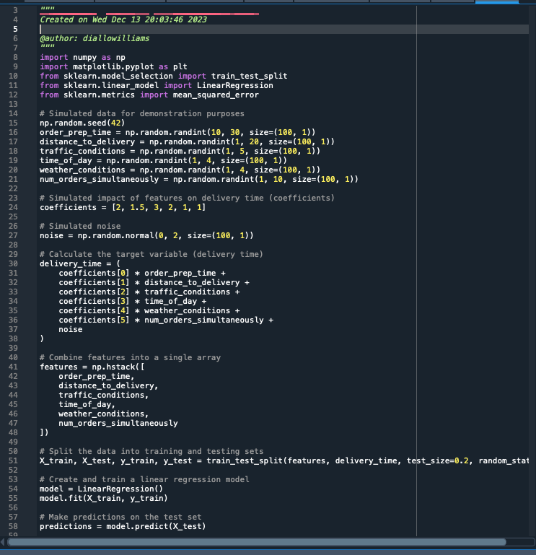
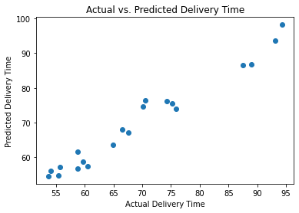
Design and Uploaded Dataset

Slide 6
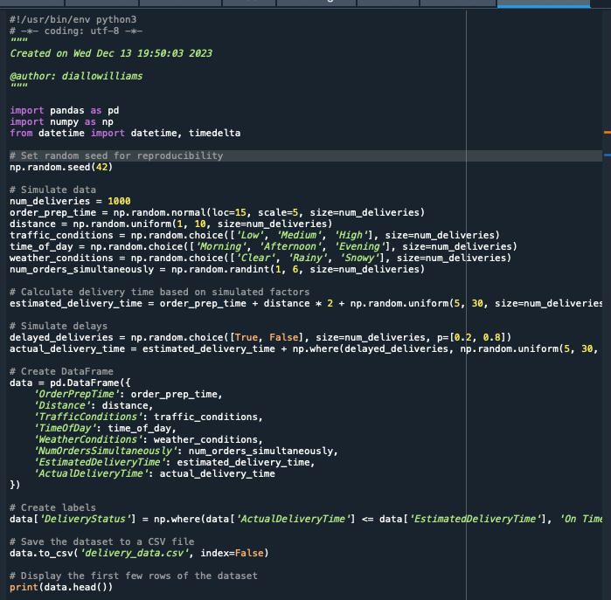
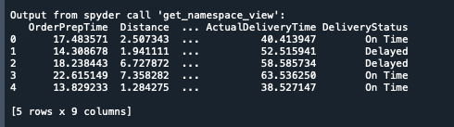
Data Preparation (Cleansing/Normalization)

Slide 7

Selecting Features
Choosing features is an important step in identifying the best regression strategy to address the pizza delivery time problem. The decision in the context of linear regression is around determining the most relevant variables that have a substantial impact on delivery time. These characteristics may include order preparation time, distance to the delivery site, traffic circumstances, time of day, weather conditions, and the number of orders processed concurrently. The nature of the interactions between these features and the delivery time influences the choice between Linear Regression and Polynomial Regression. Linear Regression presupposes a linear relationship, whereas Polynomial Regression is capable of capturing more complicated, non-linear patterns.

Slide 8
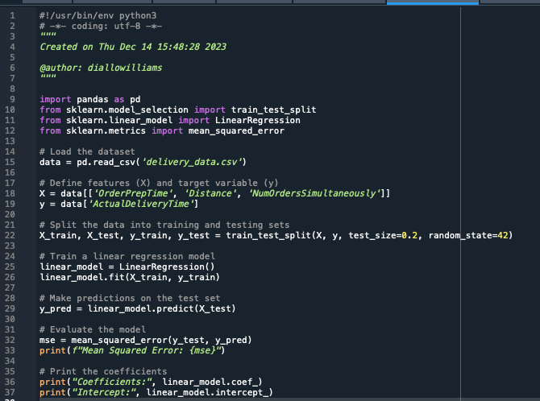

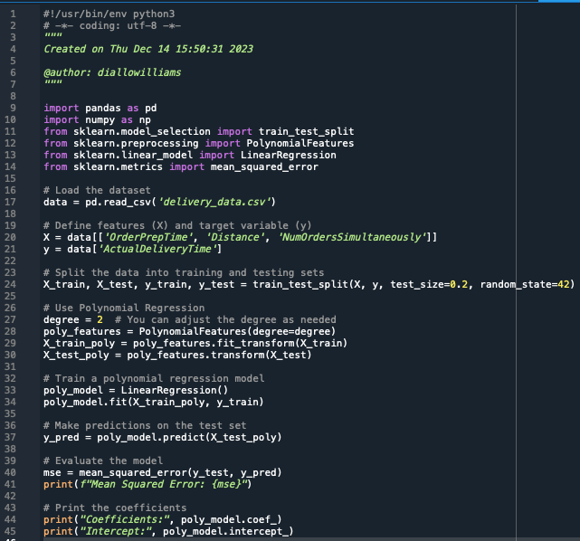

Linear Regression or Poly Regression ML Tools for Prediction
Linear Regression:
Poly Regression:

Slide 9
Training the Model
Training the model is a crucial phase in addressing the pizza delivery time issue. In this context, employing polynomial regression involves teaching the algorithm to recognize patterns and relationships within the dataset, encompassing factors such as order preparation time, distance to the delivery location, traffic conditions, time of day, weather conditions, and the number of orders being processed simultaneously. The model learns from historical data, capturing the complexities of these variables and their impact on delivery time. Through the use of the training set, the polynomial regression model refines its understanding, enabling it to make accurate predictions and ultimately contribute to optimizing and expediting the pizza delivery process.

Slide 10
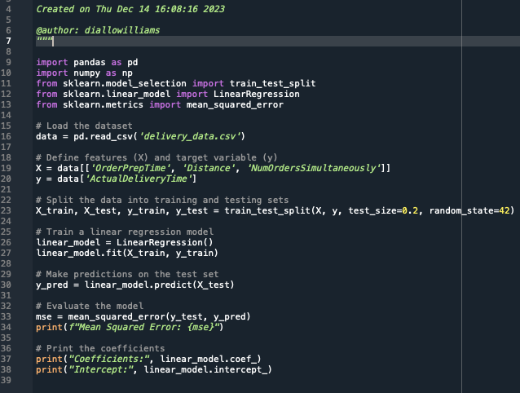
Train/Test Split

Slide 11
Examining the Model, Computing RSS

Slide 12
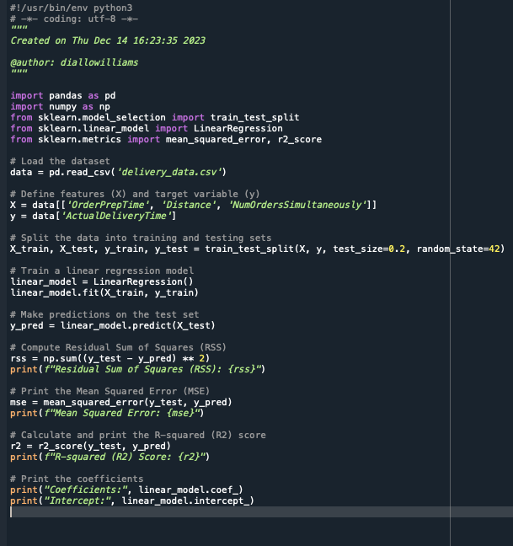

Scoring the Model – r2-Score

Slide 13
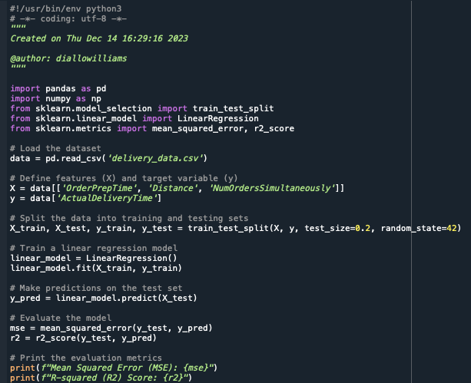

Evaluating the Model Using Test Data Set

Slide 14

Conclusion
In conclusion, the analysis and implementation of machine learning models, specifically linear regression and polynomial regression, to address the pizza delivery delay issue generated beneficial conclusions. The dataset, which included factors such as order preparation time, distance, and the number of orders handled at the same time, was used to train and evaluate the models. To predict actual delivery times, both linear regression and polynomial regression were used.
The evaluation of these models, using metrics such as Mean Squared Error (MSE) and R-squared (R2) score, proved their usefulness in capturing and interpreting the correlations between the input variables and delivery times. The features picked had a substantial impact on prediction accuracy.
While both linear and polynomial regression models predicted delivery times successfully, additional refining and optimization of feature selection should improve model performance. Additionally, constant data collection and model retraining based on real-time information would help to continuously improve pizza delivery time prediction. Overall, the use of machine learning techniques has aided in addressing and optimizing the pizza delivery process.

Slide 15

Challenges
Several obstacles were faced while tackling the pizza delivery delay issue with machine learning models. To begin, data collection and preparation were challenging, as getting a broad dataset with representative situations, such as different times of day, weather conditions, and distances, required careful planning and execution.
Another challenge was selecting relevant features for the models. A thorough investigation was required to determine which parameters had the greatest impact on delivery timeframes, and the inclusion or deletion of specific variables could affect the model's accuracy.
Implementing polynomial regression and linear regression models was also difficult. Iterative testing was necessary to discover the ideal configuration for fine-tuning hyperparameters such as the degree of the polynomial features. Also, ensuring model generalization to new data and preventing overfitting and underfitting were continuous concerns.
In conclusion, evaluating and presenting the outcomes of the machine learning models to stakeholders who may not be aware with the models' complexities proved difficult. Clear and straightforward communication was required to effectively express the models' merits, limitations, and implications.
Despite these difficulties, the event provided useful insights into the intricacies of applying machine learning to real-world business settings, emphasizing the significance of thorough data preparation, feature selection, and continual model review and modification.

Slide 16
Career Skills Obtained
Addressing the pizza delivery time issue with machine learning provided a valuable opportunity to develop and enhance various career skills. The key skills acquired include:
1. Data Collection and Preparation: Acquiring, cleaning, and preparing a diverse dataset for machine learning purposes is a fundamental skill. This involves understanding the business context, identifying relevant features, and ensuring data quality.
2. Feature Selection: Determining the most influential features that impact the target variable (delivery time) is crucial. This skill involves a combination of domain knowledge, statistical analysis, and machine learning techniques to identify and select the most relevant variables.
3. Machine Learning Model Implementation: Applying both polynomial and linear regression models to address a real-world problem provides hands-on experience in model selection and implementation. This includes hyperparameter tuning and understanding the strengths and limitations of different algorithms.
4. Model Evaluation: Assessing model performance using metrics like Mean Squared Error (MSE) and Residual Sum of Squares (RSS) helps in understanding how well the model generalizes to new data. Evaluating models ensures their reliability and effectiveness in solving the business problem.
5. Data Interpretation and Communication: Effectively communicating complex machine learning results to non-technical stakeholders is a critical skill. This involves translating technical findings into actionable insights for decision-makers and collaborators.
6. Problem-Solving: Identifying and addressing challenges throughout the machine learning process hones problem-solving skills. This includes troubleshooting data-related issues, refining models for better performance, and adapting strategies based on feedback.
7. Critical Thinking: Applying critical thinking to the entire process, from defining the problem to interpreting results, is essential. This involves questioning assumptions, considering alternative approaches, and making informed decisions.
8. Project Management: Managing a project from data collection to model implementation requires organization and project management skills. Setting timelines, prioritizing tasks, and coordinating efforts contribute to project success.
9. Continuous Learning: The field of machine learning is dynamic, and staying informed about the latest developments is crucial. This project reinforces the importance of continuous learning to stay relevant and effective in a rapidly evolving field.
10. Domain Knowledge Integration: Integrating domain knowledge with machine learning expertise is essential for success. Understanding the intricacies of the pizza delivery business allowed for more informed decisions throughout the project.

Slide 17
Website Link
https://diallowill.wixsite.com/mysite

