Slide 1

Cis355a Final Project Presentation
Diallo Williams
Cis 355a

Slide 2
introduction
Java has the ability to read and write files..
Java is used for memory management.
Java allows for a straightforward connection to databases.
Java is one of the most used programming languages in the world.
Java has excellent graphical user interface characteristics.

Slide 3
Design phase
Design is essential for saving time.
The design documents are available to the customer.
The Wireframe diagram provides us with a goal to pursue.

Slide 4
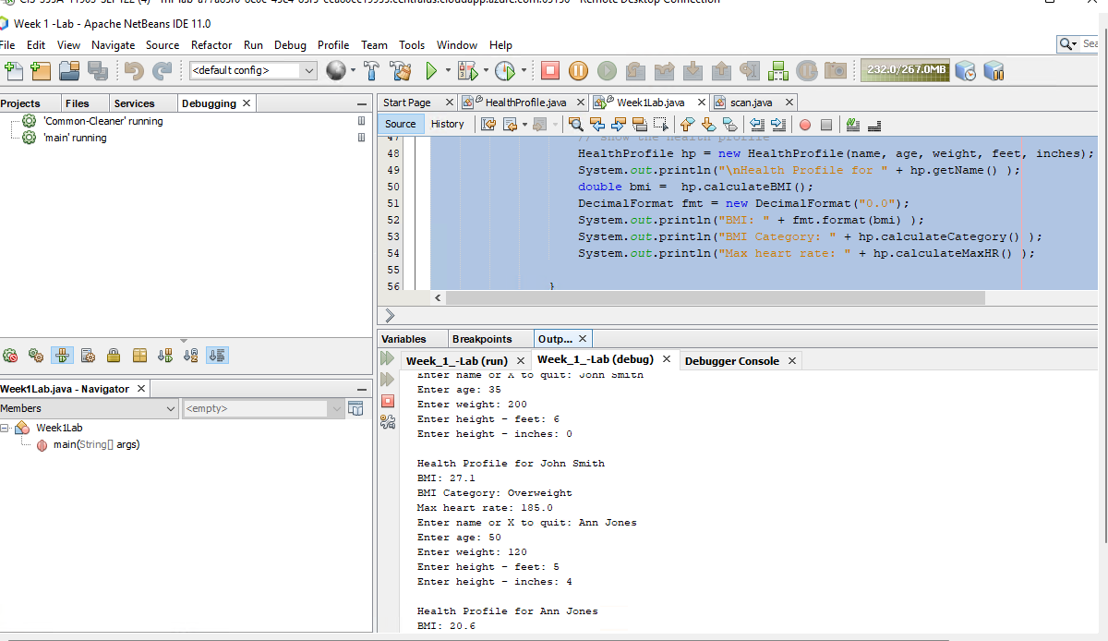
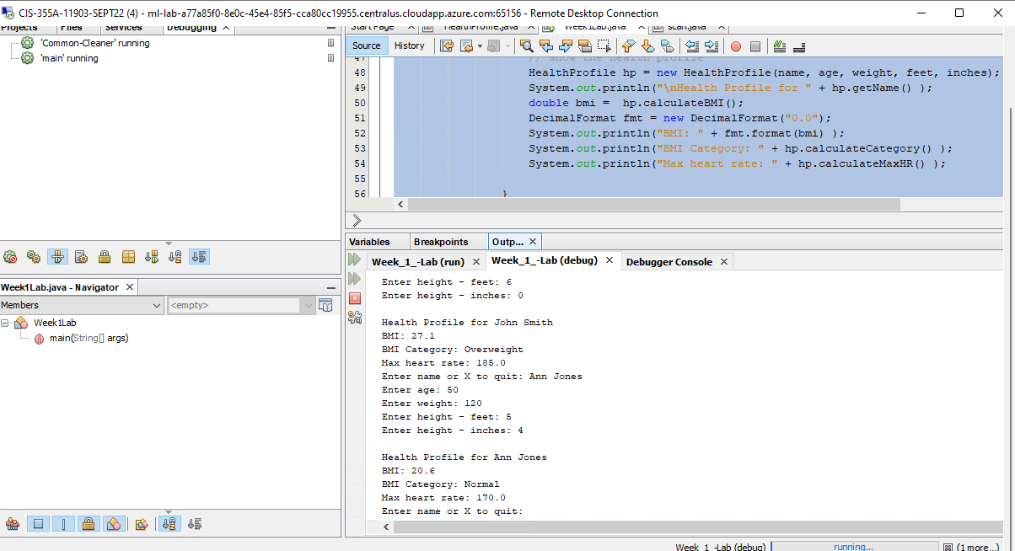
Developing an OOP Console Application
Create a class in Java with appropriate methods.
Process user input with the class using the scanner for keyboard input and console output.
The screen layout

Slide 5
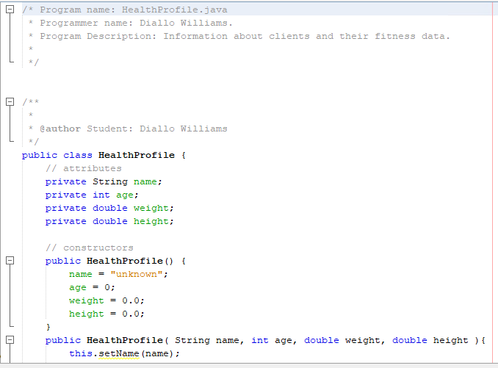
event code
Code divided into methods
Write once, run everywhere!
Pull input from text fields
Process input
Show desired output.

Slide 6
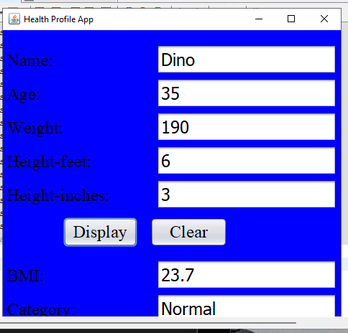
Developing a GUI Application
Health Profile GUI
Create a GUI that uses JTextField, JLabel, and JButton.
Write event handlers to process user data.

Slide 7
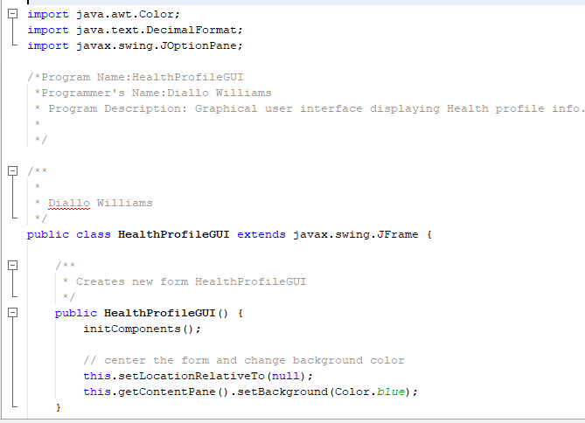
Event code
Code divided into methods
Write once, run everywhere!
Pull input from text fields
Process input
Show desired output.

Slide 8
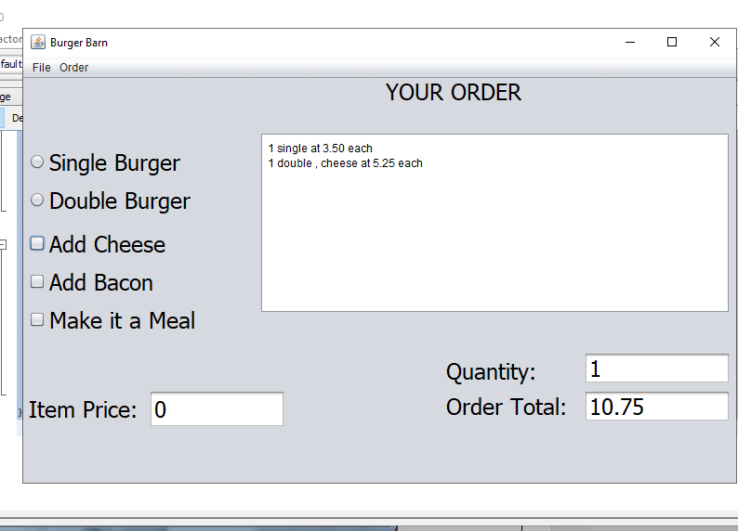
Enhanced GUI Application using Additional Swing Components
Create a GUI that uses JCheckBox, JRadioButton, JTextArea, and menus.
· Process multiple events.

Slide 9
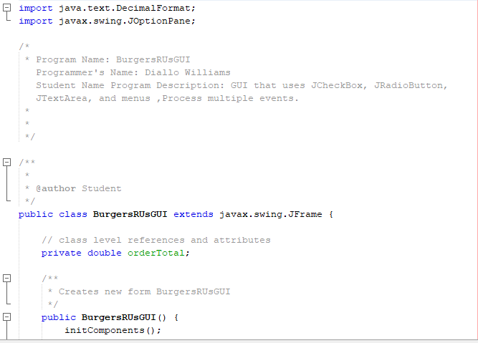
Event code
Code divided into methods
Write once, run everywhere!
Pull input from text fields
Process input
Show desired output.

Slide 10
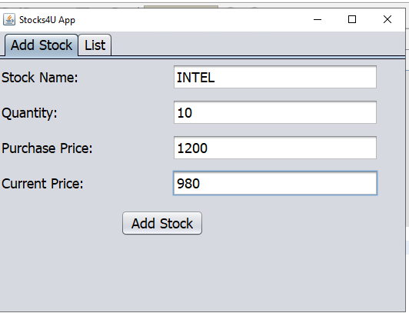
Processing Arrays of Objects
· Create a GUI that uses JList and JTabbedPanes.
· Process multiple objects in an ArrayList.
· Code event handlers for multiple events.

Slide 11
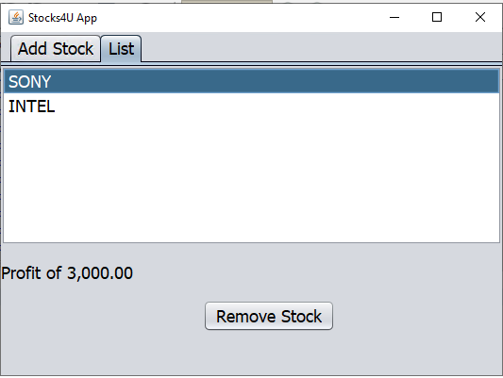
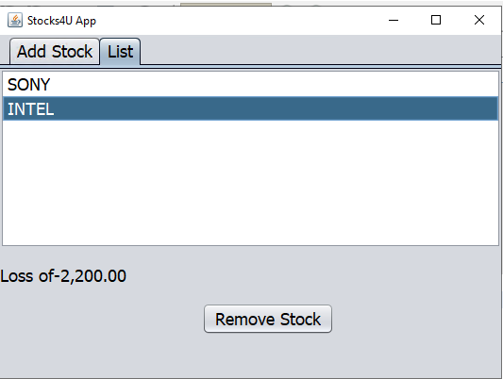
Portfolio Management System

Slide 12
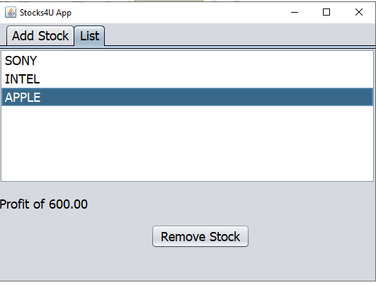
Portfolio Management System
company name
· number of shares
· purchase price
· current price

Slide 13
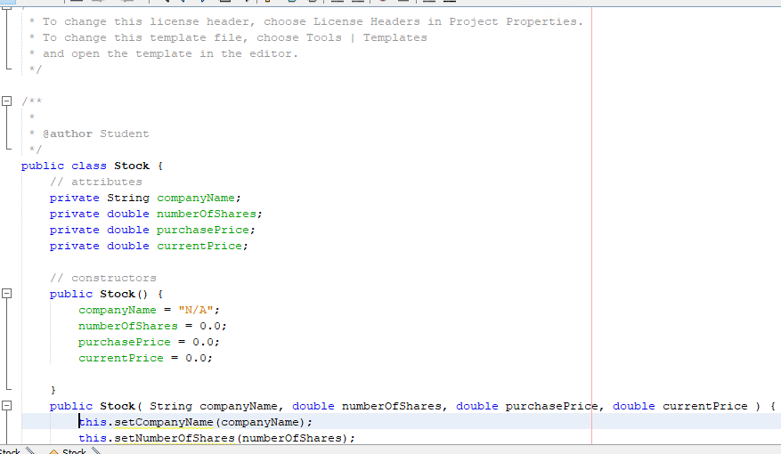
Event code
Code divided into methods
Write once, run everywhere!
Pull input from text fields
Process input
Show desired output.

Slide 14
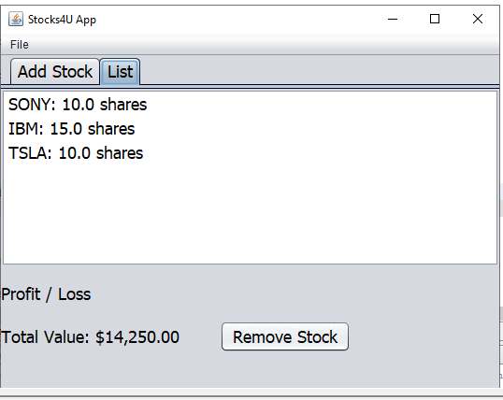
File Processing
A file menu with menu items: open, save, and exit
· A label to display the total portfolio value
getData—reads data from the file, returns data in array list of stock objects
· saveData—writes data from an array list to the file in proper format

Slide 15
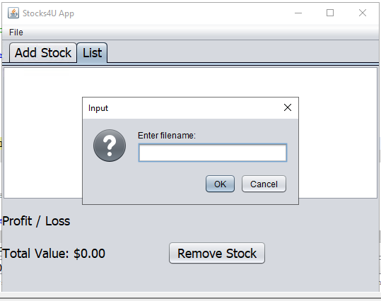
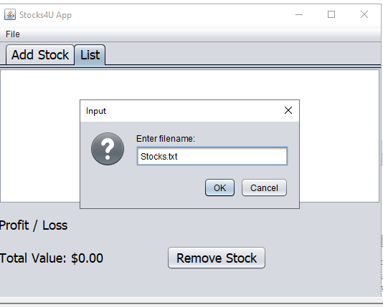
File processing

Slide 16
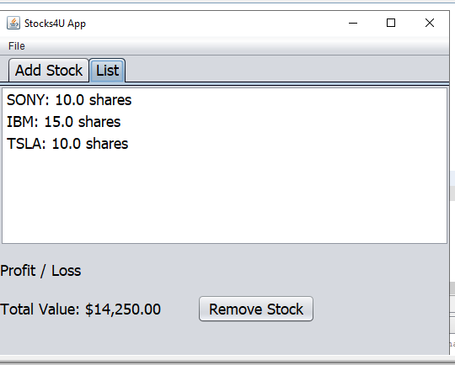
File processing

Slide 17
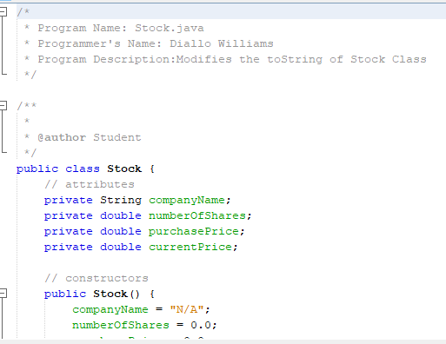
Event code
Code divided into methods
Write once, run everywhere!
Pull input from text fields
Process input
Show desired output.

Slide 18
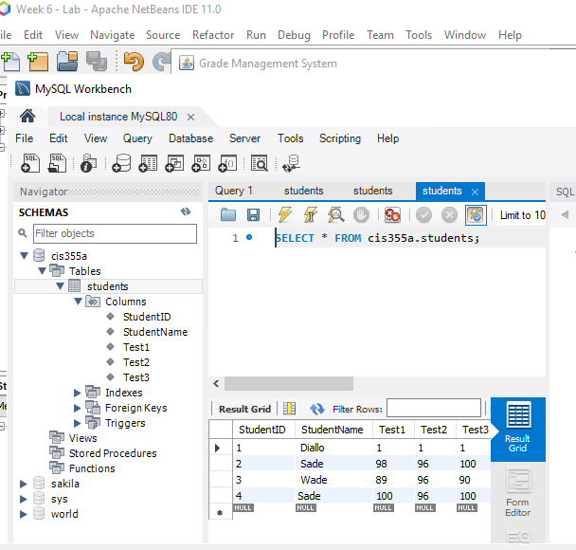
Database Connectivity
Programmatic access to a MySQL database to add and display records

Slide 19
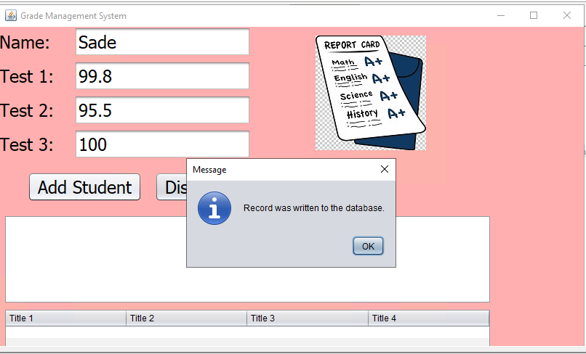
Student Management System
Student name
·Three test scores
· Average

Slide 20
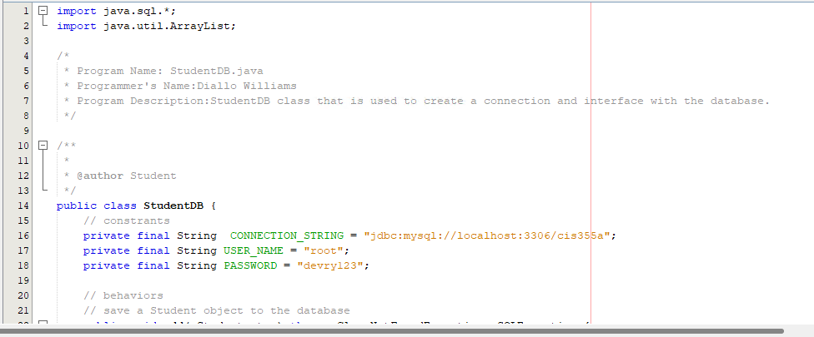
Event code
Code divided into methods
Write once, run everywhere!
Pull input from text fields
Process input
Show desired output.

Slide 21

Challenges
The code is case-sensitive.
Debugging was required for some errors
Alignment issues required trial & error.

Slide 22
career skills
Designing Software
Designing GUI’s in Java
Using three-tier development
Using Java Syntax.
Debugging Applications

Slide 23
conclusion
Java program development is exciting!
Designing GUI applications can be straight-forward
Reading and writing to files are important.
Reading and writing to the database are critical.

Slide 24

Thank You
Diallo williams

