Slide 1

CEIS295
DATA STRUCTURES AND ALGORITHMS
Diallo Williams

Slide 2

INTRODUCTION
Corporate applications work with millions of records.
Data must be accessed quickly to provide good customer service.
Algorithm can cause application speed to be fast, slow, or “horrible”.
This project measures real-world algorithm speeds.
Speeds are analyzed to determine best scenarios for data structures.

Slide 3
Speed Test for ArrayList Data Structure
Measure the speed of the process.
Measure the speed of the ArrayList data structure.
Scenario 1: Press Queue or Service Queue.
Scenario 2: Service Center.
Scenario 3: Call Center.

Slide 4
TimeProcess.py
Python Code
Including the following processes:
Test the following process speed.
Display “Hello” 1000 times
#Name: Diallo Williams
#Date: 03/05/2023
import time # use time library to time the code executions
# get current time before the process
start_time = time.time()
# run the process
for i in range(1000):
print( "Hello Everyone!" )
# get current time after the process
end_time = time.time()
# subtract start time from end time to get time used by process
total_time = end_time - start_time
# Show the result. Note: .6f means “show six decimal places”
print("\nSeconds run 1000 times: {:.6f}".format(total_time))

Slide 5
Client.py
Python Code
Including the following attributes and behaviors:
Attributes
  __client_id
  __first_name
  __last_name
  __phone
  __email
Behaviors
  __eq__
  __str__
Getters and Setters
Cod# Diallo Williams
"""
Created on Sun Mar 5 12:54:48 2023
@author: diall
"""
class Client:
def __init__(self, client_id=0, first_name="Unknown", last_name="Unknown", phone="Unknown", email="Unknown"):
self.__client_id = client_id
self.__first_name = first_name
self.__last_name = last_name
self.phone = phone
self.email = email
# classes that compare objects must implement __eq__ and __lt__ methods
# __lt__ means "less than" and it must return a boolean
# __eq__ means "equals" and it must return a boolean
def __lt__(self, other):
return self.__client_id < other.__client_id
def __eq__(self, other):
return self.__client_id == other.__client_id
#__str__() method is automatically called when you print the object
def __str__(self):
return str(self.__client_id) + ", " + self.__last_name + ", " + self._fir
# getters and setter .
def get_client_id(self):
return self.__client_id
def set_client_id(self, client_id):
self.__client_id = client_id
def get_first_name(self):
return self.__first_name
def set_first_name(self, first_name):
self.__first_name = first_name
def get_last_name(self):
return self.__last_name
def set_last_name(self, last_name):
self.__last_name = last_name
def phone(self):
return self.__phone
def set_phone(self, phone):
self.__phone = phone
def get_email(self):
return self.__email
def set_email(self, email):
self.__email = emaile:

Slide 6
ArrayListActualSpeed.py
Python Code
. Including the following processes:
Read records into the application
Test the following process speeds:
  Add records to beginning of data structure
  Add records to end of data structure
  Add records to middle of data structure
  Retrieve records from beginning of data structure
  Retrieve records from end of data structure
  Retrieve records from middle of data structure
# Name: Diallo Williams
"""
Created on Sun Mar 5 13:44:01 2023
@author: diall
"""
from ArrayList import ArrayList
from Client import Client
from Quicksort import Quicksort
from datetime import date
import time # use this library to time the code executions
import random # use to generate random numbers
import sys # use to terminate the application early
# display name and date in output
print("Name:", "Diallo Williams")
print("Date:", date.today)
print()
# create a list
clients = []
# read the records from the ClientData.csv file
# into Client objects and place the Client objects into the list
input_file_name = 'ClientData.csv'
with open(input_file_name) as infile:
for line in infile:
# split the line based in the commas
s = line.split(',')
client_id = int( s[0] ) # convert the default string to an int
f_name = s[1]
l_name = s[2]
phone = s[3]
email = s[4]
# create a client objects using the data from the file
clt = Client(client_id, f_name, l_name, phone, email)
# add the client object to the list
clients.append(clt)
#sort the clients list
Quicksort.sort(clients)
# how many client objects do we have
num_records = len(clients)
# create an ArrayList object
my_array_list = ArrayList()
# Scenario1: Printer Queue or Call Queue
section_title = "Scenario: Printer Queue or Call Queue"
print(section_title)
print("-" * len(section_title))
# how long does it take to add the client records to the ArrayList?
start_time = time.time()
for i in range(num_records):
my_array_list.append(clients[i])
end_time = time.time()
total_time = end_time - start_time
print("Seconds to add records: {:.6f}" .format(total_time))
# how long does it take to remove records from the front of the ArrayList?
start_time = time.time()
for i in range(num_records):
my_array_list.remove_at(0)
end_time = time.time()
total_time = end_time - start_time
print("Seconds to remove records from front: {:.6f}".format(total_time))
# Scenario 2: Customer Service Center
answer = input("Continue (y/n)? ")
if answer.lower() != "y":
sys.exit() # end the application
section_title = "Scenario: Customer Service Center"
print(section_title)
print("-" * len(section_title))
#add clients to the ArrayList
for i in range(num_records):
my_array_list.append(clients[i])
# how long does it take to randomly display 1000 records?
start_time = time.time()
for i in range(1000):
smallest_id = 100001
largest_id = smallest_id + num_records
random_num = random.randint(smallest_id, largest_id)
#print( my_array_list.search(Client(random_num)))
print( my_array_list.search_sorted(Client(random_num)))
end_time = time.time()
total_time = end_time - start_time
print("Seconds to display random records: {:.6f}" .format(total_time))
# Scenario 3: Call Center
answer = input("Continue (y/n)? ")
if answer.lower() != "y":
sys.exit() # end the application
section_title = "Scenario: Call Center"
print(section_title)
print("-" * len(section_title))
# how long does it take to add records, randomly display 1000 records
# and randomly remove 1000 records?
start_time = time.time()
# add records
current_id = 100001 + num_records + 1
for i in range(1000):
my_array_list.append(Client(current_id))
current_id += 1
#display random records
for i in range(1000):
smallest_id = 100001
largest_id = smallest_id + num_records
random_num = random.randint(smallest_id, largest_id)
#print( my_array_list.search(Client(random_num)))
print( my_array_list.search_sorted(Client(random_num)))
#remove random records
for i in range(1000):
smallest_id = 100001
largest_id = smallest_id + num_records
random_num = random.randint(smallest_id, largest_id)
print( my_array_list.search(Client(random_num)))
end_time = time.time()
total_time = end_time - start_time
print("Seconds to add, display, and remove records: {:.6f}" .format(total_time))

Slide 7

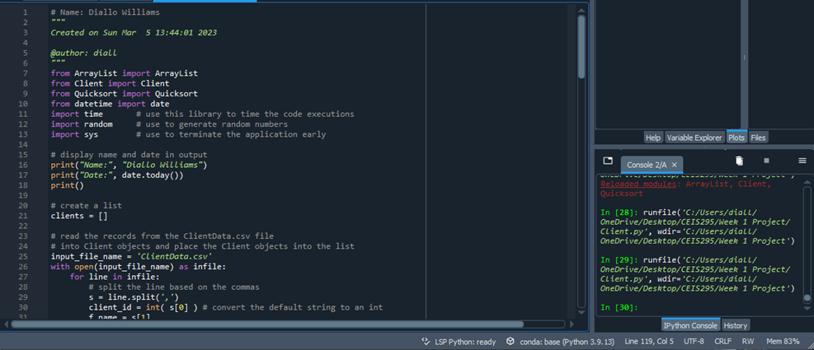
Screenshot of
Running Code
Running the ArrayListActualSpeed.py code & taking a screenshot of the output:

Slide 8
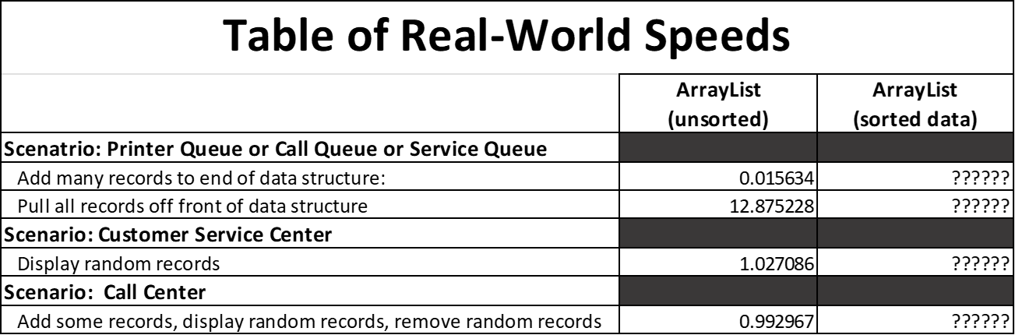
Table of Speeds
Table showing the time it takes for the following scenarios:
Printer Queue or Call Queue or Service Queue
  Add many records to end of data structure
  Pull all records off front of data structure
Customer Service Center
  Display random records
Call Center
  Add some records
  Display random records
  Remove some records

Slide 9
Speed Test for LinkedList Data Structure
Measure the speed of the process.
Measure the speed of the LinkList data structure.
Scenario 1: Printer Queue or Call Queue or Service Queue
Scenario 2: Customer Service Center.
Scenario 3: Call Center

Slide 10
LinkedListActualSpeed.py
Python Code
. Including the following processes:
Read records into application
Test the following process speeds:
  Add records to beginning of data structure
  Add records to end of data structure
  Add records to middle of data structure
  Retrieve records from beginning of data structure
  Retrieve records from end of data structure
  Retrieve records from middle of data structure
# Name: Diallo Williams
"""
Created on Fri Mar 10 13:44:01 2023
@author: diall
"""
from LinkedList import LinkedList
from Client import Client
from datetime import date
import time # use this library to time the code executions
import random # use to generate random numbers
import sys # use to terminate the application early
# display name and date in output
print("Name:", "Diallo Williams")
print("Date:", date.today())
print()
# create a list
clients = []
# read the records from the ClientData.csv file
# into Client objects and place the Client objects into the list
input_file_name = 'ClientData.csv'
with open(input_file_name) as infile:
for line in infile:
# split the line based on the commas
s = line.split(',')
client_id = int( s[0] ) # convert the default string to an int
f_name = s[1]
l_name = s[2]
phone = s[3]
email = s[4]
# create a client objects using the data from the file
clt = Client(client_id, f_name, l_name, phone, email)
# add the client object to the list
clients.append(clt)
# how many client objects do we have
num_records = len(clients)
# create an LinkedList object
my_linked_list = LinkedList()
# Scenario 1: Printer Queue or Call Queue
section_title = "Scenario: Printer Queue or Call Queue"
print(section_title)
print("-" * len(section_title))
# how long does it take to add the client records to the ArrayList?
start_time = time.time()
for i in range(num_records):
my_linked_list.add_last(clients[i])
end_time = time.time()
total_time = end_time - start_time
print("Seconds to add records: {:.6f}" .format(total_time))
# how long does it take to remove records from the front of the LinkedList?
start_time = time.time()
for i in range(num_records):
my_linked_list.remove_first()
end_time = time.time()
total_time = end_time - start_time
print("Seconds to remove records from front: {:.6f}".format(total_time))
# Scenario 2: Customer Service Center
answer = input("Continue (y/n)? ")
if answer.lower() != "y":
sys.exit() # end the application
section_title = "Scenario: Customer Service Center"
print(section_title)
print("-" * len(section_title))
#add clients to the LinkedList
for i in range(num_records):
my_linked_list.add_last(clients[i])
# how long does it take to randomly display 1000 records?
start_time = time.time()
for i in range(1000):
smallest_id = 100001
largest_id = smallest_id + num_records
random_num = random.randint(smallest_id, largest_id)
print( my_linked_list.search(Client(random_num)))
end_time = time.time()
total_time = end_time - start_time
print("Seconds to display random records: {:.6f}" .format(total_time))
# Scenario 3: Call Center
answer = input("Continue (y/n)? ")
if answer.lower() != "y":
sys.exit() # end the application
section_title = "Scenario: Call Center"
print(section_title)
print("-" * len(section_title))
# how long does it take to add records, randomly display 1000 records
# and randomly remove 1000 records?
start_time = time.time()
# add records
current_id = 100001 + num_records + 1
for i in range(1000):
my_linked_list.add_last(Client(current_id))
current_id += 1
#display random records
for i in range(1000):
smallest_id = 100001
largest_id = smallest_id + num_records
random_num = random.randint(smallest_id, largest_id)
print( my_linked_list.search(Client(random_num)))
#remove random records
for i in range(1000):
smallest_id = 100001
largest_id = smallest_id + num_records
random_num = random.randint(smallest_id, largest_id)
print( my_linked_list.search(Client(random_num)))
end_time = time.time()
total_time = end_time - start_time
print("Seconds to add, display, and remove records: {:.6f}" .format(total_time))

Slide 11
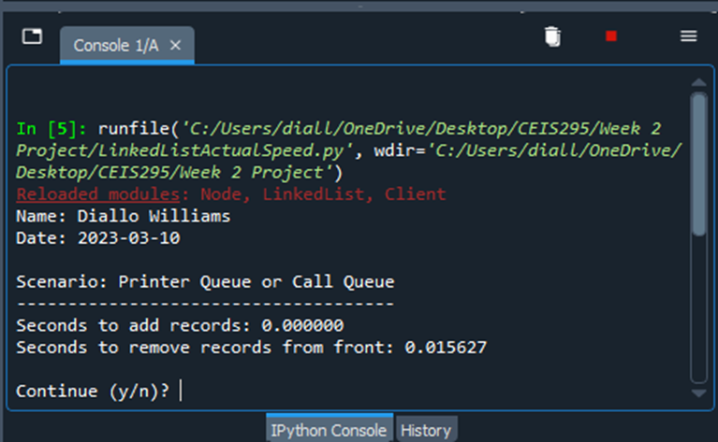
Screenshot of
Running Code
Running the LinkedListActualSpeed.py code & taking a screenshot of the output:

Slide 12
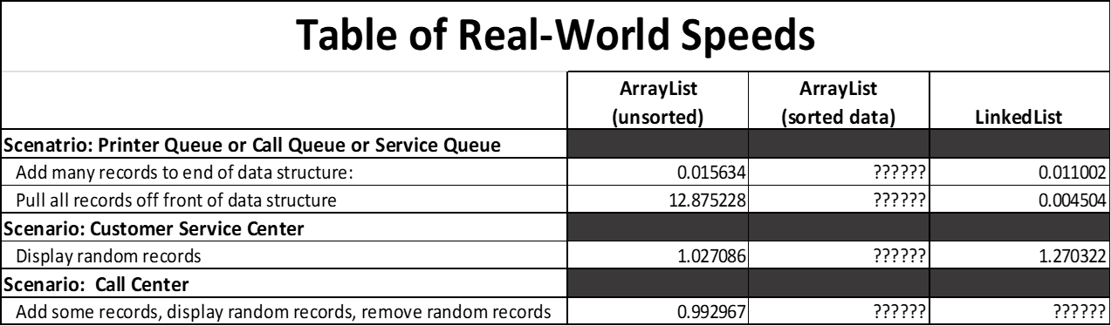
Table of Speeds
Table showing the time it takes for the following scenarios:
Printer Queue or Call Queue or Service Queue
  Add many records to end of data structure
  Pull all records off front of data structure
Customer Service Center
  Display random records
Call Center
  Add some records
  Display random records
  Remove some records

Slide 13

Speed Test for ArrayList Data Structure

Slide 14
Call.py
Python Code
Including the following attributes and behaviors:
Attributes
  call_id
  customer_name
  customer_phone
  call_date
  call_time
Behaviors
  __str__
# Name: Diallo Williams
# Date: 3/14/2023
from time import strftime # used for current date and time
class Call:
def __init__(self, client_id=0, client_name="Unknown", client_phone="Unknown"):
self.client_id = client_id
self.client_name = client_name
self.client_phone = client_phone
self.call_date = strftime("%m/%d/%Y")
self.call_time = strftime("%H:%M")
# __str__() method is automatically called when you print the object
def __str__(self):
return str(self.client_id) + ", " + self.client_name + \
"\n\tPhone: " + self.client_phone + \
"\tDate/Time: " + self.call_date + " @ " + self.call_time

Slide 15
AutomaticCallDistributor.py
Python Code
. Including the following processes:
Simulation of ADT
  Ask user how many times to repeat
  On each loop:
    Randomly generate a number from 1 to 3
    If 1, add call to queue
    If 2, remove call from queue
    If 3, do nothing
# Name: Diallo Williams
# Date: 3/14/2023
from Queue import Queue
from Call import Call
from datetime import date
import time # use to pause the application
import random # use to generate random numbers
# display author's name and the date in the output
print("Name:", "Diallo Williams")
print("Date:", date.today())
print()
# create a list
calls = []
# read call records into the list
input_file_name = "ClientData.csv"
with open(input_file_name) as infile:
for line in infile:
# split the line based on the commas
s = line.split(',')
client_id = int( s[0] )
client_name = s[1]
client_phone = s[2]
# create a Call object based on the data from the file
a_call = Call(client_id, client_name, client_phone)
# add the Call object to the list
calls.append(a_call)
# Queue object for our calls
calls_waiting = Queue()
call_number = 0
# how long is the simulation?
seconds = int( input("How many seconds do you want to simulate? "))
# run the simulation for the given number of seconds
for i in range(seconds):
print("-" * 40)
time.sleep(1) # pause application for given number of seconds
random_event = random.randint(1, 4)
# do event based on the random number generated
if random_event == 1 or random_event == 4:
print("Call received. Caller added to queue. ")
calls_waiting.enqueue( calls[call_number] )
call_number += 1 # set up the next call
print("\tNumber of calls waiting in queue:", calls_waiting.get_length())
elif random_event == 2:
print("Call sent to representative for service. ")
if calls_waiting.get_length() > 0:
print("Caller information:")
print(calls_waiting.dequeue())
else:
print("The call waiting queue is empty.")
print("\tNumber of calls waiting in queue:", calls_waiting.get_length())
else:
print("Nothing happened during this second in time.")
print("\tNumber of calls waiting in queue:", calls_waiting.get_length())
print("\nThe 'Automatic Call Distributor' simulation has completed.")

Slide 16
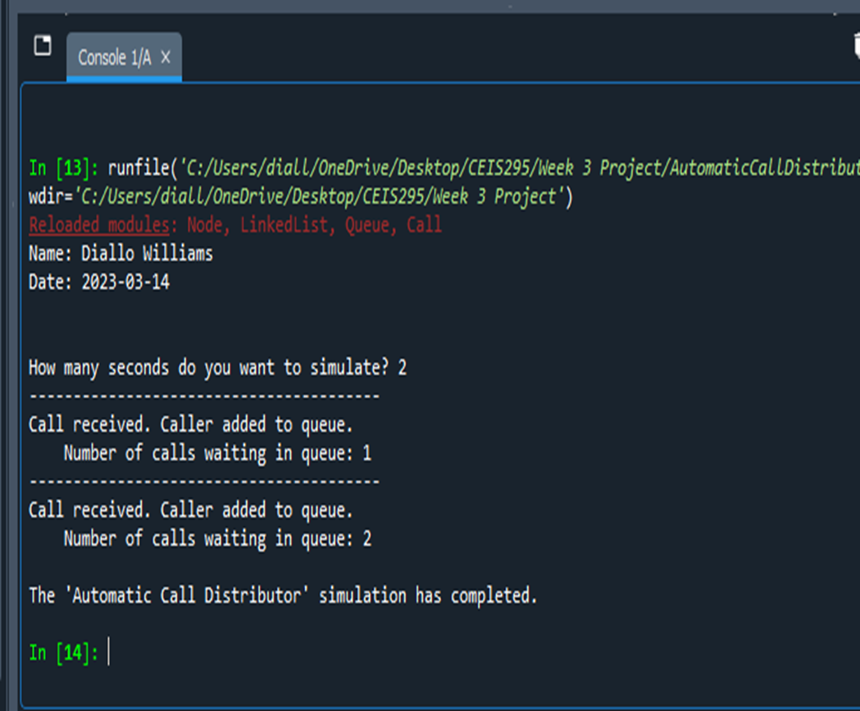
Screenshot of
Running Code
Running the AutomaticCallDistributor.py code and taking a screenshot of the output:

Slide 17
Speed Test for Sorting Algorithms
Measure the speed of the process.
Test the Sort Algorithm Speeds.
Scenario 1: Bubble Sort
Scenario 2: Selection Sort
Scenario 3: Insertion Sort
Scenario 4: Shell Sort
Scenario 5: Quick Sort
Scenario 6: Merge Sort

Slide 18
Client.py
Python Code
Including the following attributes and behaviors:
Attributes
  __client_id
  __first_name
  __last_name
  __phone
  __email
Behaviors
  __lt__
  __le__
  __eq__
  __str__
Getters and Setters
Code
# Name: Diallo Williams
"""
Created on Tue. Mar 21 12:54:48 2023
@author: diall
"""
class Client:
def __init__(self, client_id=0, first_name="Unknown", last_name="Unknown", phone="Unknown", email="Unknown"):
self.__client_id = client_id
self.__first_name = first_name
self.__last_name = last_name
self.__phone = phone
self.__email = email
# classes that compare objects must implement __eq__ and __lt__ methods
# __lt__ means "less than" and it must return a boolean
# __le__ means "less than or equal to" and it must return a boolean
# __eq__ means "equals" and it must return a boolean
def __lt__(self, other):
this_full_name = self.__last_name + " " + self.__first_name
other_full_name = other.__last_name + " " + other.__first_name
return this_full_name < other_full_name
def __le__(self, other):
this_full_name = self.__last_name + " " + self.__first_name
other_full_name = other.__last_name + " " + other.__first_name
return this_full_name <= other_full_name
def __eq__(self, other):
return self.__client_id == other.__client_id
# Implement the __gt__() method for sorting
def __gt__(self, other):
this_full_name = self.__last_name + " " + self.__first_name
other_full_name = other.__last_name + " " + other.__first_name
return this_full_name < other_full_name
# __str__() method is automatically called when you print the object
def __str__(self):
return self.__last_name + ", " + self.__first_name
# getters and setter
def get_client_id(self):
return self.__client_id
def set_client_id(self, client_id):
self.__client_id = client_id
def get_first_name(self):
return self.__first_name
def set_first_name(self, first_name):
self.__first_name = first_name
def get_last_name(self):
return self.__last_name
def set_last_name(self, last_name):
self.__last_name = last_name
def phone(self):
return self.__phone
def set_phone(self, phone):
self.__phone = phone
def get_email(self):
return self.__email
def set_email(self, email):
self.__email = email
:

Slide 19
SortingActualSpeed.py
Python Code
Code
:# Name: Diallo Williams
"""
Created on Tue. Mar 21 13:44:01 2023
@author: diall
"""
from MergeSort import MergeSort
from Client import Client
from datetime import date
import time # use to time the code executions
# display name and date in output
print("Name:", "Diallo Williams")
print("Date:", date.today())
print()
#input_file_name = 'ClientData100.csv'
#input_file_name = 'ClientData1000.csv'
#input_file_name = 'ClientData10000.csv'
input_file_name = 'ClientData100000.csv'
# create a list
clients = []
# read the records from the ClientData.csv file
# into Client objects and place the Client objects into the list
with open(input_file_name) as infile:
for line in infile:
# split the line based on the commas
s = line.strip().split(',')
client_id = int( s[0] ) # convert the default string to an int
f_name = s[1]
l_name = s[2]
phone = s[3]
email = s[4]
# create a client objects using the data from the file
clt = Client(client_id, f_name, l_name, phone, email)
# add the client object to the list
clients.append(clt)
# how many client objects do we have
num_records = len(clients)
# Scenario: Sorting records from a datafile
section_title = "Scenario: Sorting " + str(num_records) + " Records"
print(section_title)
print("-" * len(section_title))
# how long does it take to sort the records?
start_time = time.time()
#call the static sort method in the class
MergeSort.sort(clients)
end_time = time.time()
total_time = end_time - start_time
print("Seconds to sort {0} records: {1:.6f}".format(num_records, total_time))
#display the sorted list
#for clt in clients:
# print(clt)

Slide 20
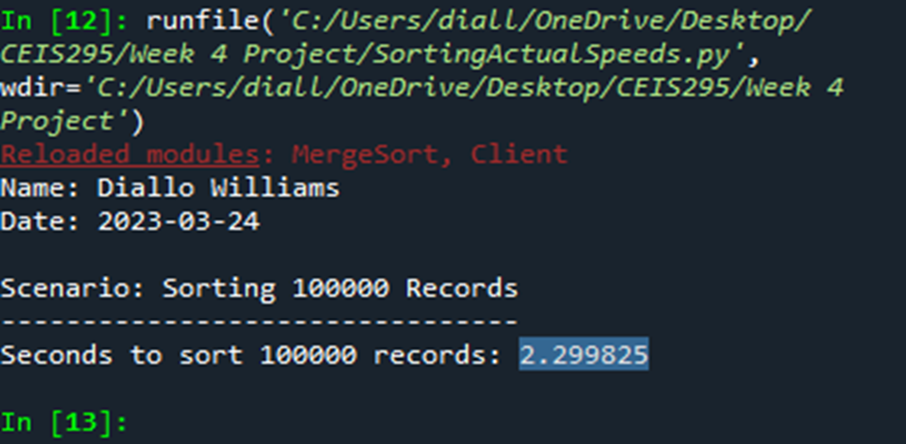
Screenshot of
Running Code
Running the SortingSpeed.py code and taking a screenshot of the output:

Slide 21
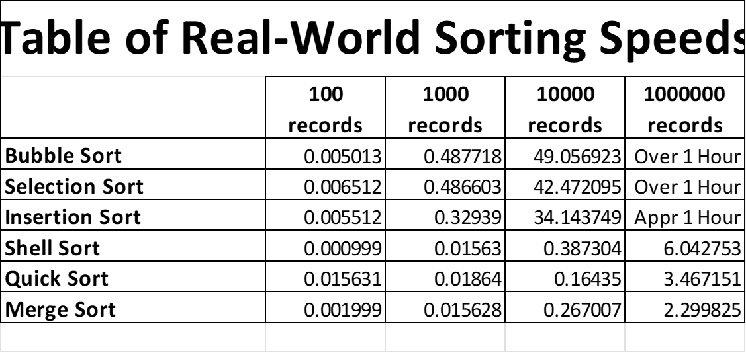
Table of Sorting Speeds
Table showing the time that it takes for the following sorting algorithms using different data sizes:
Bubble Sort
Selection Sort
Insertion Sort
Shell Sort
Quicksort
Merge Sort

Slide 22
Speed Test for Searching Algorithms
Measure the speed of the process.
Measure the search algorithm speeds.
Scenario 1: Linear Search.
Scenario 2: Binary Search.

Slide 23

Client.py
Python Code
Including the following attributes and behaviors:
Attributes
  __client_id
  __first_name
  __last_name
  __phone
  __email
Behaviors
  __lt__
  __eq__
  __str__
Getters and Setters
Code
# Name: Diallo Williams
"""
Created on Tue. Mar 28 12:54:48 2023
@author: diall
"""
class Client:
def __init__(self, client_id=0, first_name="Unknown", last_name="Unknown", phone="Unknown", email="Unknown"):
self.__client_id = client_id
self.__first_name = first_name
self.__last_name = last_name
self.__phone = phone
self.__email = email
# classes that compare objects must implement __eq__ and __lt__ methods
# __lt__ means "less than" and it must return a boolean
# __le__ means "less than or equal to" and it must return a boolean
# __eq__ means "equals" and it must return a boolean
def __lt__(self, other):
return self.__client_id < other.__client_id
def __le__(self, other):
return self.__client_id <= other.__client_id
def __eq__(self, other):
return self.__client_id == other.__client_id
# Implement the __gt__() method for sorting
def __gt__(self, other):
this_full_name = self.__last_name + " " + self.__first_name
other_full_name = other.__last_name + " " + other.__first_name
return this_full_name < other_full_name
# __str__() method is automatically called when you print the object
def __str__(self):
return str(self.__client_id) + ", " + self.__last_name + ", " + self.__first_name
# getters and setter
def get_client_id(self):
return self.__client_id
def set_client_id(self, client_id):
self.__client_id = client_id
def get_first_name(self):
return self.__first_name
def set_first_name(self, first_name):
self.__first_name = first_name
def get_last_name(self):
return self.__last_name
def set_last_name(self, last_name):
self.__last_name = last_name
def phone(self):
return self.__phone
def set_phone(self, phone):
self.__phone = phone
def get_email(self):
return self.__email
def set_email(self, email):
self.__email = email
:

Slide 24
SearchingActualSpeed.py
Python Code
Including the following processes:
Read records into application
Test the following searching algorithm speeds:
  Linear Search
  Binary Search
Test these two algorithms against different-size datasets
  100 records
  1,000 records
  10,000 records
  100,000 records
Code
# Name: Diallo Williams
"""
Created on Tue. Mar 28 13:44:01 2023
@author: diall
"""
from LinearSearch import LinearSearch
from BinarySearch import BinarySearch
from Quicksort import Quicksort
from Client import Client
from datetime import date
import random # use to generate random numbers
import time # use to time the code executions
import sys # use to exit the application early
# display name and date in output
print("Name:", "Diallo Williams")
print("Date:", date.today())
print()
#input_file_name = 'ClientData100.csv'
#input_file_name = 'ClientData1000.csv'
#input_file_name = 'ClientData10000.csv'
input_file_name = 'ClientData100000.csv'
# create a list
clients = []
# read the records from the ClientData.csv file
# into Client objects and place the Client objects into the list
with open(input_file_name) as infile:
for line in infile:
# split the line based on the commas
s = line.strip().split(',')
client_id = int( s[0] ) # convert the default string to an int
f_name = s[1]
l_name = s[2]
phone = s[3]
email = s[4]
# create a client objects using the data from the file
clt = Client(client_id, f_name, l_name, phone, email)
# add the client object to the list
clients.append(clt)
# how many client objects do we have
num_records = len(clients)
# Scenario: Search for 1000 records from a datafile
section_title = "Scenario: Searching Through " + str(num_records) + " Records"
print(section_title)
print("-" * len(section_title))
# MUST SORT THE DATA TO DO A BINARY SEARCH
Quicksort.sort(clients)
# start and end record numbers
start_record = 100001
end_record = start_record + num_records
# how long does it take to sort the records?
start_time = time.time()
# how long does it take to do a random linear search through the records?
for i in range(1000):
client_id = random.randint(start_record, end_record)
clt = Client(client_id)
result = BinarySearch.search(clients, clt)
if result is None:
print(clt, "was not found.")
else:
print(result)
end_time = time.time()
total_time = end_time - start_time
print("Seconds to linear search for 1000 random records: {0:.6f}".format(total_time))
:

Slide 25
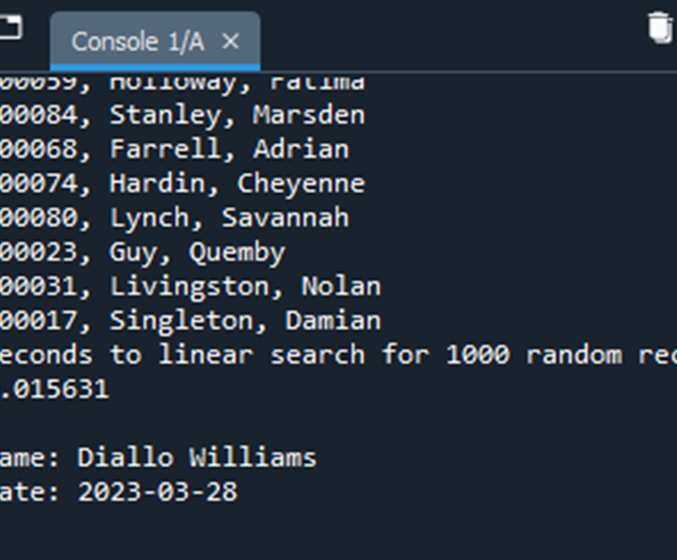
Screenshot of
Running Code
Running SearchingSpeed.py code and taking a screenshot of the output:

Slide 26
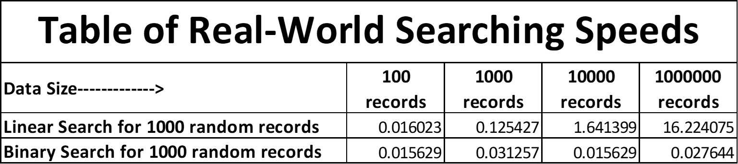
Table of Searching Speeds
Table showing the time that it takes for the following searching algorithms using different data sizes:
Linear Search
Binary Search

Slide 27
Speed Test for ArrayList Data Structure
BinarySearchTreeActualSpeed.py Code
Measure the speed of the process.
Measure the speed of the BinarySearchTreeActualSpeed.
Scenario 1: Printer Queue or Call Queue or Service Queue.
Scenario 2: Customer Service Center.
Scenario 3: Call Center.

Slide 28
BinarySearchTreeActualSpeed.py
Python Code
Including the following processes:
Read records into application
Test the following process speeds:
  Add records to beginning of data structure
  Add records to end of data structure
  Add records to middle of data structure
  Retrieve records from beginning of data structure
  Retrieve records from end of data structure
  Retrieve records from middle of data structure
Code:
# Name: Diallo Williams
# Date: 4/05/2023
from BinarySearchTree import BinarySearchTree
from Client import Client
from datetime import date
import time #use to time the code executions
import random
import sys
# display authors name and the date in the output
print("Name:", "Diallo Williams")
print("Date:", date.today())
print()
# create a list
clients = []
# read records into the list
input_file_name = "ClientData.csv"
with open(input_file_name) as infile:
for line in infile:
# split the line based on the commas
s = line.split(',')
client_id = int( s[0] ) # convert the default string to an int
f_name = s[1]
l_name = s[2]
phone = s[3]
email = s[4]
# creat client object using the data from the line
clt = Client(client_id, f_name, l_name, phone, email)
# add the client object to the list
clients.append(clt)
# how many client objects do we have?
num_records = len(clients)
# create the Binary Search tree to test real-world speeds
my_bst = BinarySearchTree()
# Scenario 1: Printer Queue or Call Queue or Service Queue
section_title = "Scenario: Printer Queue or Call Queue or Service Queue"
print(section_title)
print("-" * len(section_title))
# how long does it take to add the client records to the BST?
start_time = time.time()
for i in range(num_records):
my_bst.insert(clients[i])
end_time = time.time()
total_time = end_time - start_time
print("Seconds to add records: {0:.6f}".format(total_time)) # .6f means six decimal places
# how long does it take to remove records from the front (smallest) of the BST?
start_time = time.time()
for i in range(num_records):
my_bst.remove_minimum()
end_time = time.time()
total_time = end_time - start_time
print("Seconds to remove records: {0:.6f}".format(total_time)) # .6f means six decimal places
# Scenario 2: Customer Service Center
answer = input("Continue (y/n)? ")
if answer.lower() != "y":
sys.exit() # end the application
section_title = "Scenario: Customer Service Center"
print(section_title)
print("-" * len(section_title))
# add clients to the BinarySearchTree
for i in range(num_records):
my_bst.insert(clients[i])
# how long does it take to randomly display 1000 client records to the BST?
start_time = time.time()
for i in range(1000):
smallest_id = 100001
largest_id = smallest_id + num_records
random_num = random.randint(smallest_id, largest_id)
print( my_bst.search(Client(random_num)))
end_time = time.time()
total_time = end_time - start_time
print("Seconds to display 1000 random records: {0:.6f}".format(total_time)) # .6f means six decimals
# Scenario 3: Call Center
answer = input("Continue (y/n)? ")
if answer.lower() != "y":
sys.exit() # end the application
section_title = "Scenario: Call Center"
print(section_title)
print("-" * len(section_title))
# add clients to the BinarySearchTree
for i in range(num_records):
my_bst.insert(clients[i])
# how long does it take to add more client records,
# randomly display 1000 records, and randomly remove 1000 records from the BST?
start_time = time.time()
# add records
current_id = 100001 + num_records + 1
for i in range(1000):
my_bst.insert(Client(current_id))
current_id += 1
#display records
for i in range(1000):
smallest_id = 100001
largest_id = smallest_id + num_records
random_num = random.randint(smallest_id, largest_id)
print( my_bst.search(Client(random_num)))
# remove 1000 random records
for i in range(1000):
smallest_id = 100001
largest_id = smallest_id + num_records
random_num = random.randint(smallest_id, largest_id)
my_bst.remove(Client(random_num))
end_time = time.time()
total_time = end_time - start_time
print("Seconds to add records,")
print(" display 1000 random records,")
print(" and remove 1000 random records: {0:.6f}".format(total_time)) # .6f means six decimals

Slide 29
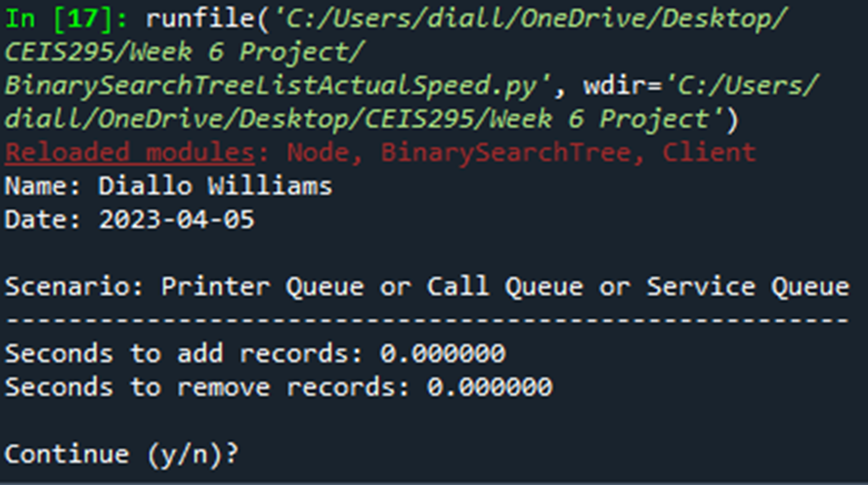
Screenshot of
Running Code
Running BinarySearchTreeActualSpeed.py code and taking a screenshot of the output:

Slide 30
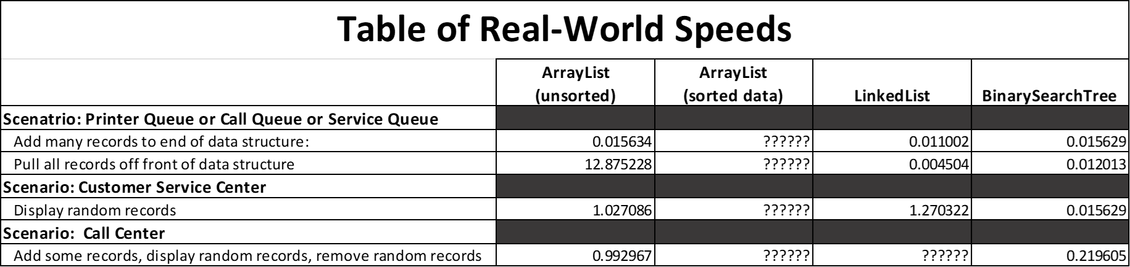
Table of Real-World Speeds
Table showing the times for the time it takes for the following scenarios:
Printer Queue or Call Queue or Service Queue
  Add many records to end of data structure
  Pull all records off front of data structure
Customer Service Center
  Display random records
Call Center
  Add some records
  Display random records
  Remove some records

Slide 31

Final Analysis
Data structures have pros and cons
  ArrayList
    Fast for accessing data
    Slow for removing data
    Scenario to use it: Service Center
  Linked List
    Fast for adding and removing data on the front and back end.
    Slow for accessing data from the middle.
    Scenario to use it: Printer Queue or Service Queue
  Binary Search Tree
    Reasonably fast for adding and removing data if tree is balanced.
    Reasonably fast for retrieving data if tree is balanced.
    Scenario to use it: Call Center.

Slide 32
Challenges
Learning techniques to measure algorithm speeds
Determining best scenarios for different data structures
Typos with Python Code.

Slide 33

Career Skills
Troubleshooting errors in the code.
Programming with Python
Communication
  Excel table for analysis
  PowerPoint Presentation

Slide 34
Conclusion
Project covered fundamental topics in Data Structures.
Project covered algorithm speeds and analysis.
Project-provided practice:
  Python programming.
  Object Oriented Programming (OOP)
    Importing classes
    Client Class

