Slide 1
TECH460 Final Project:
New Technology From Concept To Operations
Diallo Williams
February 2024
2/23/2024

Slide 2


Introduction
This project covers Samsung, a South Korean multinational company known for its significant contribution to the electronics industry. This project will cover several aspects of Samsung's organizational landscape, goods, and services, with a focus on wearables like smartwatches. The project's goal is to discover areas for improvement in Samsung's technical products, focusing on specific aspects such as smartwatches but also expanding to larger issues in mobile devices. The project's major sections include an overview of Samsung's organizational profile, an examination of its diverse products and services, an assessment of areas for technological advancement, and a strategic focus on refining wearables, specifically smart watches, to align with changing market demands. The recommended improvements for Samsung focus on enhancing battery durability and refining marketing strategies. Throughout the project, a consistent emphasis is placed on Samsung's commitment to innovation, market trends, and meeting consumer needs for sustained success in the ever-evolving technology landscape.

Slide 3
Executive Summary
This project is focused on improving Samsung's connectivity solutions, with a major goal of giving different LTE alternatives and expanding into new wearables markets. The main purpose is to address difficulties connected to connectivity and innovation in the technology industry. By boosting connectivity options and expanding into emerging wearables sectors, Samsung hopes to demonstrate its commitment to innovation and staying current with market trends. The initiative aims to investigate strategic ways to meet customer expectations, adapt to changing market dynamics, and sustain Samsung's position as an industry leader in the long run. The solution involves carrying out an in-depth analysis of Samsung's recent projects, consumer feedback, and strategic insights to develop a plan for expanding connection possibilities and embracing innovation within the company's wearable technology portfolio.

Slide 4
Organization Profile and Problem Statement

Slide 5

The Organization
Samsung, a South Korean corporation, is globally recognized as a major manufacturer of electronic equipment. The company's diverse product line encompasses appliances, digital media devices, semiconductors, memory chips, integrated systems, and wearables. Samsung's prominence in technology makes a substantial contribution, accounting for around one-fifth of South Korea's total exports.

Slide 6

Problem Statement
Samsung's strategic initiatives to improve connectivity by providing separate LTE options and entering new wearables markets indicate the company's commitment to innovation. Adapting to market trends, meeting consumer needs, and embracing innovation remains critical to Samsung's long-term success.

Slide 7
Technology Selection and Design

Slide 8

Alternative Technology Approaches
1) Battery Technology Enhancement: Invest in research and development to enhance battery technology, improving durability and performance. Implementing creative solutions such as extended battery life, faster charging, and more energy efficiency can solve the specific problems expressed by survey respondents. It will be critical to collaborate with subject matter experts and remain on top of technology changes.
2) Transparent Communication and Customer Support: Establish open communication channels with users about battery improvements. Provide regular updates on technology advancements, software changes, and practical advice for extending battery life. Furthermore, it improves customer support services by ensuring that users have simple access to information, troubleshooting assistance, and rapid fixes for any battery-related concerns. This proactive strategy can increase trust and satisfaction among Samsung mobile consumers.

Slide 9

Recommended Solution
Encouraging users to apply power-saving measures is an appropriate solution for improving battery durability in Samsung mobile devices. This includes teaching people how to make practical efforts to extend the battery life of their smartphones. The suggestions made, such as reducing screen brightness, utilizing dark themes, and regulating power-draining apps, are practical and easy for consumers to implement.
User Empowerment: Educating consumers allows them to take control of their device's power use, resulting in a more favorable user experience.
Ease of Implementation: The supplied recommendations are straightforward and may be implemented by users without the requirement for technical knowledge.
Preservation of Functionality: Unlike some extreme solutions, such as turning off important services, the offered tips allow users to keep essential functions while saving battery life.

Slide 10
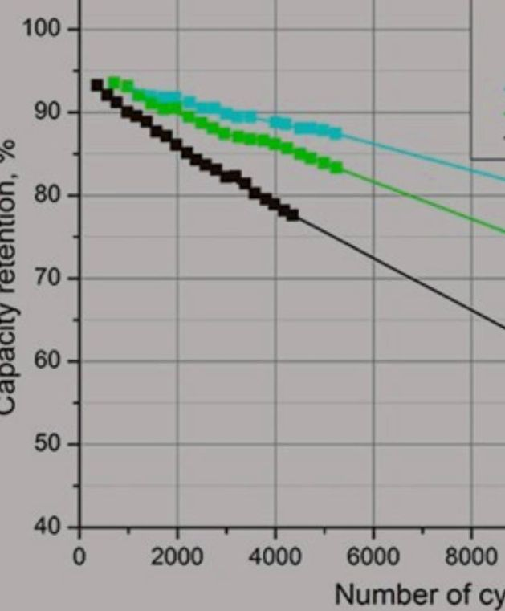
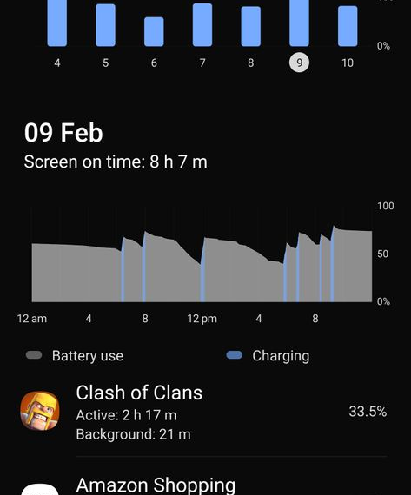
High-Level Design
Battery Life Optimization and Health Tips
Battery Life (SoT - Screen-on-Time):
Extending battery life involves minimizing power usage for optimal Screen-on-Time (SoT). Key tips include:
1. Screen Brightness: Keep it at 50-60%, especially indoors.
2. Deep Sleep Unused Apps: Set apps do not need notifications to deep sleep.
3. App Permissions: Review and deny unnecessary permissions to save power and enhance privacy.
4. Firewall Usage: Block internet access for apps not essential for functionality.
5. Close Background Apps: Prevent unnecessary apps from running in the background.
6. Usage Analysis: Regularly check battery and data usage through device settings.
7. Temperature Management: Avoid excessive heat, as it increases power consumption.
8. Automation with Macros: Use macro apps for automating repetitive tasks.

Slide 11
High-Level Design
Battery Life Optimization and Health Tips
Battery Health (Charge Cycles):
Understanding lithium battery limitations and charge cycles is essential. Tips to enhance battery health include:
1. Voltage Management (High): Avoid keeping the battery at maximum voltage, and limit overnight charging.
2. Voltage Management (Low): Prevent deep discharge, as it damages the battery.
3. Optimal Charge Levels: Aim for a charge range of 30%-85% for optimal battery health.
4. Temperature Considerations: Maintain battery temperature between 5°C and 30°C during usage, avoiding extremes.
5. Charging Temperature: Charge in a temperature range of 5°C to 30°C, avoiding dangerous levels above 45°C.
6. Depth of Discharge: Opt for many small charges and discharges around the 70% charge area.
Minimizing background activity (steps 1, 2, and 3) is critical for increasing battery life. Other suggestions are optional but help to more efficient power consumption. Additionally, maintaining proper charge levels and temperature is critical to battery health, with the potential to double or quadruple charge cycles.

Slide 12
Implementation Plan

Slide 13
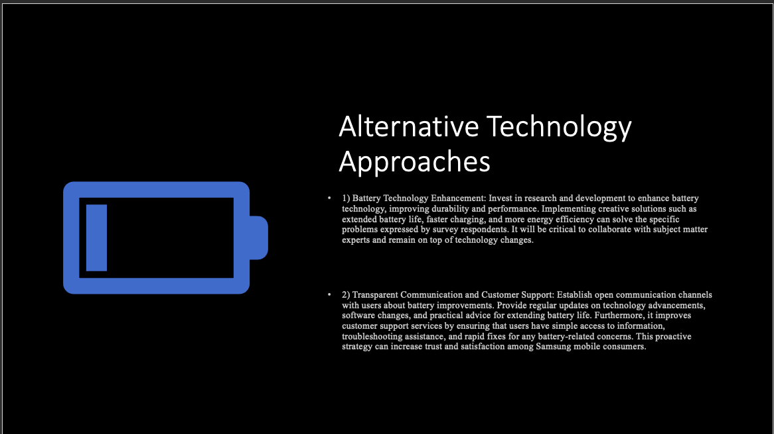
Problem Statement
Enhance customer experience through transparent communication regarding battery improvements.
Provide regular updates on technology advancements and software changes.
Offer practical tips for extending battery life.

Slide 14
Recommended Solution
Prioritize "Transparent Communication and Customer Support" over "Battery Technology Enhancement.”
Base the decision on user involvement and happiness.
Emphasize open communication and assistance to address consumer concerns.
Build confidence and offer real answers to existing problems.
Align with customer-centric ideals by creating open channels and providing regular updates.
Assure simple access to information and assistance, potentially improving the overall experience and loyalty of Samsung mobile users.

Slide 15
Validation
Thorough validation process before deployment.
Test fast fixes protocols, troubleshooting assistance tools, and communication tools for accurate and timely support.
Examine information distribution plans and frequent updates for clarity and alignment with user needs.
Enhance robustness through evaluation of training programs and collaboration with subject matter experts.
Real-time data gathering for monitoring tools and iterative modifications based on continual stakeholder feedback.
Examination of documentation of communication protocols, training materials, and audits to ensure specified rules are followed.
Pilot deployments, rollout evaluations, and efficiency analysis of user training initiatives.

Slide 16

Legal, Ethical and Cultural Considerations
Legally:
Strict compliance with data privacy regulations, consumer protection laws, and intellectual property rights.
Ethically:
- Transparency in communication.
- Honest information dissemination.
- Equitable support services.
- Culturally:
- Adapting communication content and support services to diverse languages and cultural norms.
- Ensuring accessibility and fostering cultural sensitivity for inclusivity.
- Obtaining user consent and providing cultural competency training.
- Implementing robust security measures to safeguard user information and maintain fair practices.
- Continuous assessment and improvement mechanisms, alongside regular audits, to sustain legal, ethical, and culturally sensitive practices.

Slide 17
Incorporation of Feedback
The feedback on the project was mainly positive, and I made a few adjustments for better clarity. I focused on improving customer satisfaction and received positive remarks on the graphics, particularly the circuit card. Incorporating an alternative technology slide and using data to support points were key suggestions. The implementation plan was well-received, with recommendations to present key sections using bullet points for clarity. Addressing some formatting quirks, likely due to the forum, was also part of the adjustments. Overall, I appreciate the constructive feedback and will maintain the positive momentum of the project.

Slide 18
Career Readiness
Completing this project has significantly enhanced my readiness for my chosen career by providing hands-on experience in project management, problem-solving, and communication. The project required a comprehensive understanding of customer needs, technological solutions, and effective communication strategies. I honed my skills in structuring a project plan, developing clear problem statements, and proposing practical solutions. The incorporation of alternative technology approaches and the emphasis on transparent communication and customer support showcased my ability to think critically and strategically. Additionally, the validation and consideration of legal, ethical, and cultural aspects underscored the importance of holistic thinking in professional endeavors. This project serves as a tangible demonstration of my abilities and will be a valuable asset in my career portfolio. I plan to showcase this project during job interviews and include it in my portfolio to highlight my practical skills in project management, problem-solving, and strategic thinking. It will serve as a concrete example of my capability to address complex challenges and deliver impactful solutions in a professional setting.

Slide 19
Conclusion
In conclusion, the project demonstrates a strategic focus on improving customer satisfaction for Samsung Mobile by prioritizing transparent communication and efficient customer support. The decision to emphasize these aspects over alternative technological enhancements is driven by a user-centric approach. The validation process ensures the effectiveness of support protocols and communication tools, while legal, ethical, and cultural considerations underscore the commitment to compliance and inclusivity. The project concludes with a holistic strategy that aims to foster trust, satisfaction, and long-term loyalty among Samsung Mobile consumers through enhanced communication and support services.

Slide 20
References
Samsung. (2015, September 9). Encyclopedia Britannica. https://www.britannica.com/topic/Samsung-Electronics
Samsung for Business. (2023, February 16). 8 tips for maximizing your smartphone's battery life. Samsung Business Insights. https://insights.samsung.com/2023/02/09/8-tips-for-maximizing-your-smartphones-battery-life-3/
Tips to prolong battery life and battery health. (2022, February 11). Samsung Community. https://eu.community.samsung.com/t5/galaxy-note10-series/tips-to-prolong-battery-life-and-battery-health/td-p/2928520

