Slide 1



SEC285 Course project
The Fundamentals of Internet security
Presented by diallo williams

Slide 2
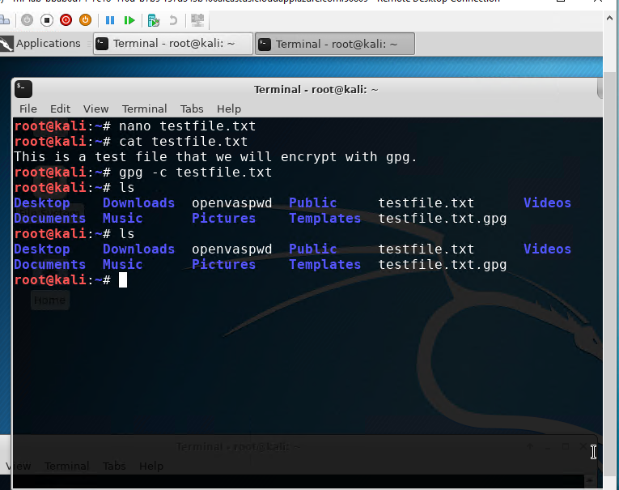
Asymmetric Key Encryption
Implement asymmetric key encryption using gnu privacy guard, (GPG)

Slide 3
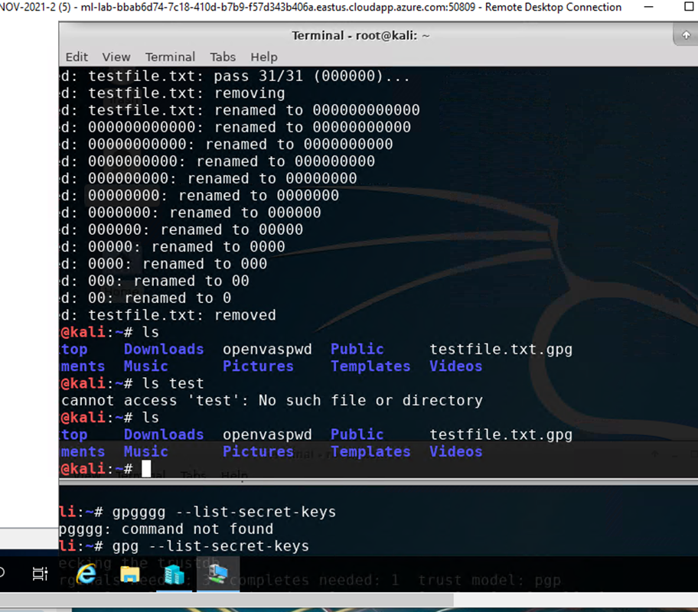
Asymmetric Key Encryption
File Decryption
The encrypted file being listed by itself
The decrypting process
Both the encrypted file and the original plaintext file being listed

Slide 4
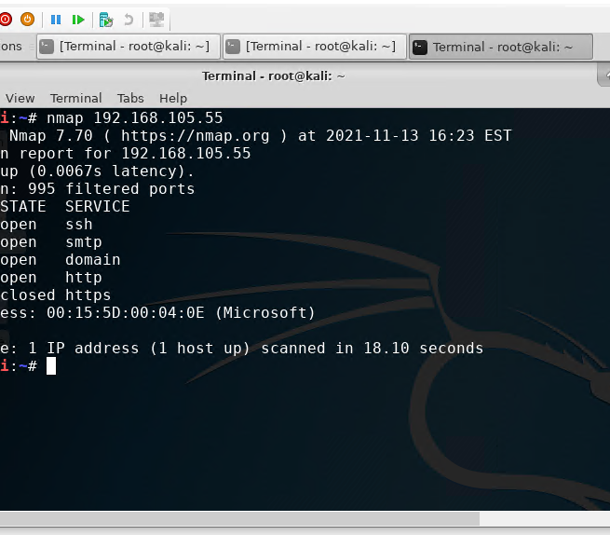
Stateful Firewall
Nmap Scan result of the Linux Server
Harden a Linux server by setting up a stateful firewall with iptable

Slide 5
Stateful Firewall
Q & A
What effect does the sudo iptables --policy INPUT DROP command have on the access to computing resources?
“sudo iptables -P INPUT DROP The ‘ -P ‘ indicates that we will be making a change to the overall policy, ‘ INPUT ‘ is the particular chain to edit, and ‘ DROP ‘ is the default policy target. ”
References : https://www.atlantic.net/vps-hosting/how-to-linux-general-basic-iptables/

Slide 6
Bring Your Own Device (BYOD) Security Policy
Complete the BYOD security policy for ABC Corporation
Complete three categories of security policies: program policy, issue-specific policy, and system-specific policy.

Slide 7
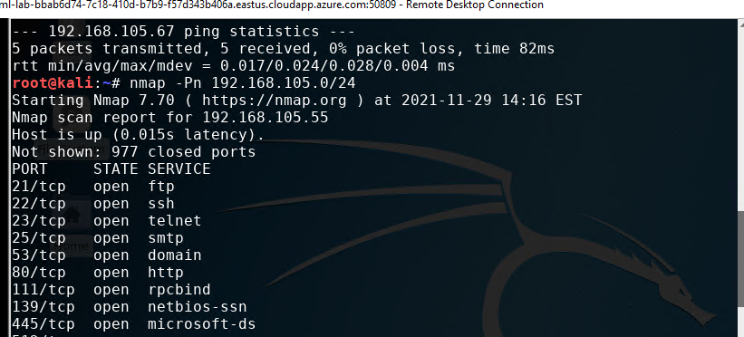
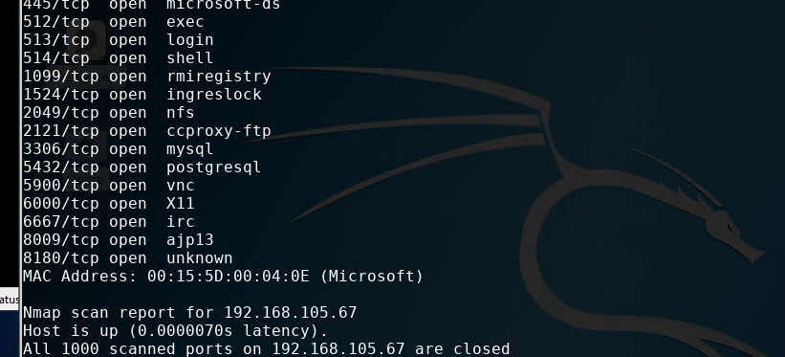
Vulnerability Assessment
Nmap
Kali & Linux Server Virtual Machines

Slide 8
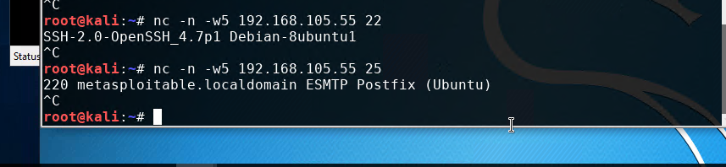
Vulnerability Assessment
NetCat
SMTP application running on the Linux Sever VM

Slide 9
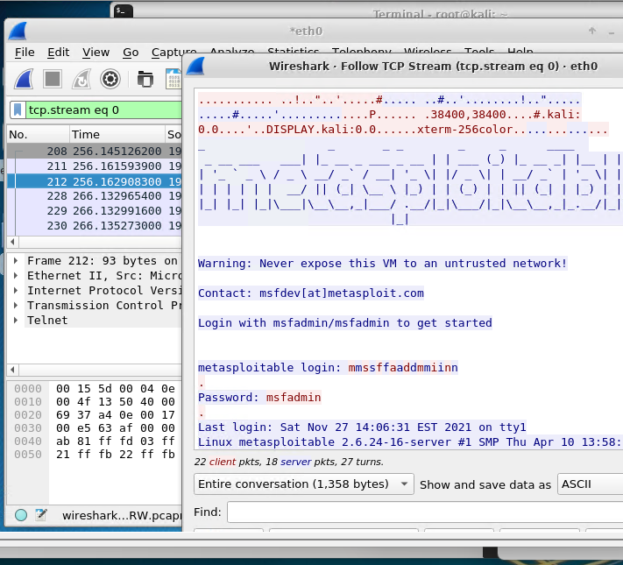
Vulnerability Assessment
Wireshark
Wireshark – Follow TCP Steam – eth0 window

Slide 10
Challenges
. Encrypting Files using GPG (gnu privacy guard): I misplaced the passphrase I created after I typed the gpg --generate-key command in the terminal window to generate a new public and private key pair. Once I found where I misplaced my passphrase I was able to continue with the Asymmetric Key Encryption.

Slide 11
Career Skills Acquired
Implement asymmetric key encryption using GPG.
Create the bring your own device (BYOD) security policy
Permanently delete files using the shred command.
Harden a Linux server by setting up a stateful firewall with iptables.
Conduct a vulnerability assessment on the Kali VM to assess the security posture of the Linux Server VM.
Identify social engineering attacks.
Differentiate cryptographic algorithms and their applications.
Survey network security devices and protocols.
Explain wireless network security solutions.
Interpret application security, device security, and physical security.
Examine authentication and access control techniques.
Assess business continuity and risk management strategies.
Explore the evolving job market in the digitized world.

Slide 12
Conclusion
This Project was an enriching experience rewarding me with a greater understanding in the fundamentals of information security attacks and defense mechanisms.
Security issues related to people, data, networks, and devices are surveyed to provide insight into designing security solutions and policies.
In this project I had to follow many steps to produce a secure network.
I gained a new set of skills and a greater understanding in wireless network security solutions and network security devices and protocols.
I learned how to describe different types of malware.
Identify social engineering attacks.
I learned how to differentiate cryptographic algorithms and their applications and now I’m one step closer to my career in Cybersecurity.

