Slide 1
Phsyics
Fundamental Laws Of Mechanics
By Diallo WIlliams

Slide 2

Physics is a branch of science whose primary objects of study are matter and energy.

Slide 3
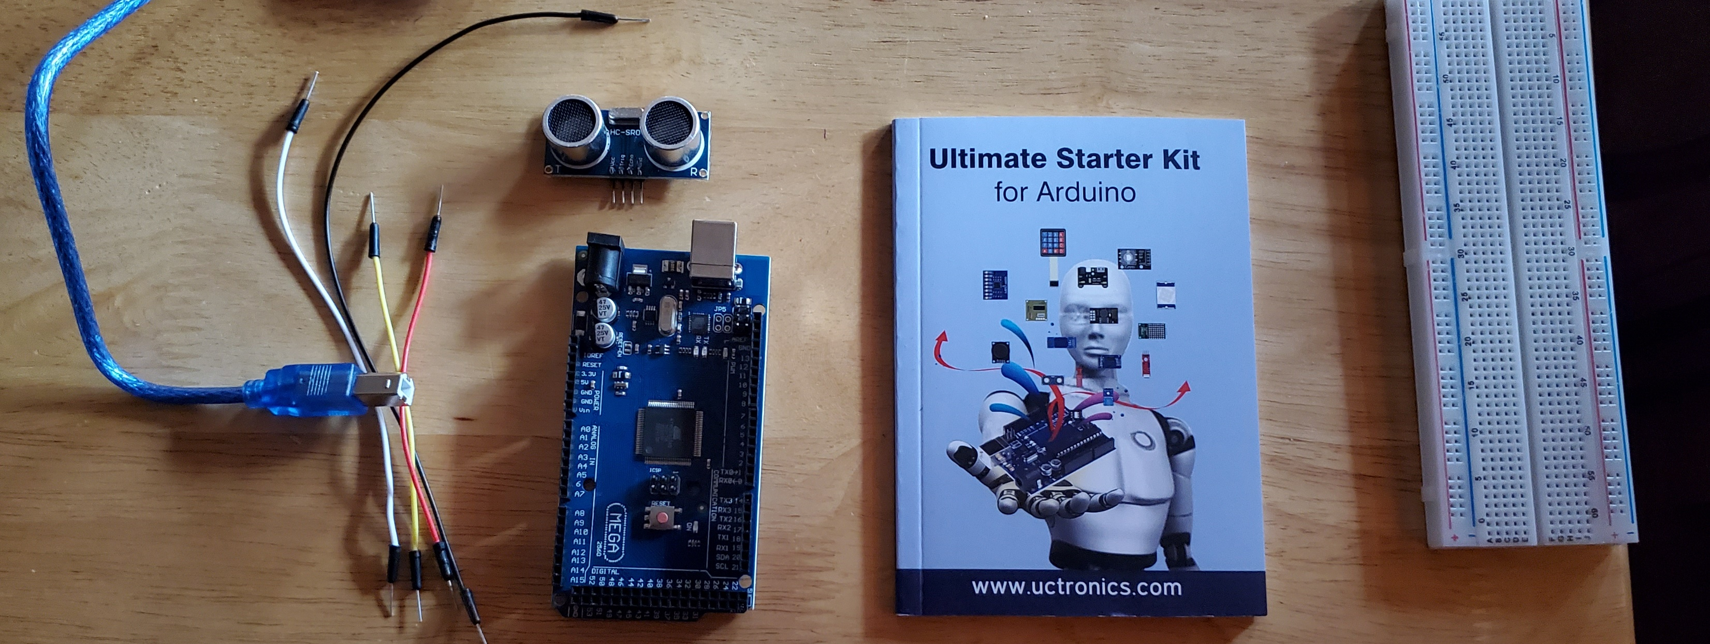
Materials List 1 (For Experiments)
Mega 2560 Board
Ultrasonic sensor HC-SR04
Male to Male Wires
Breadboard
USB cable
Ruler or tape measurer
Object to act as obstacle and/or undergo free-fall

Slide 4
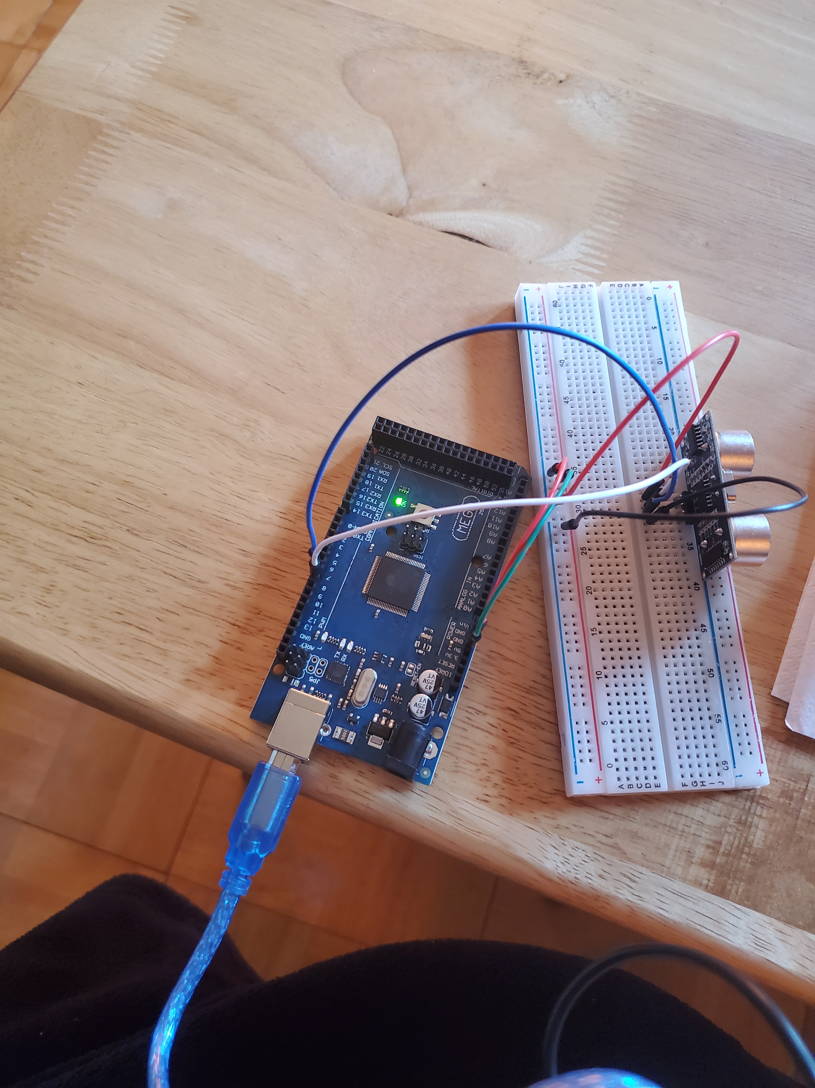

Slide 5
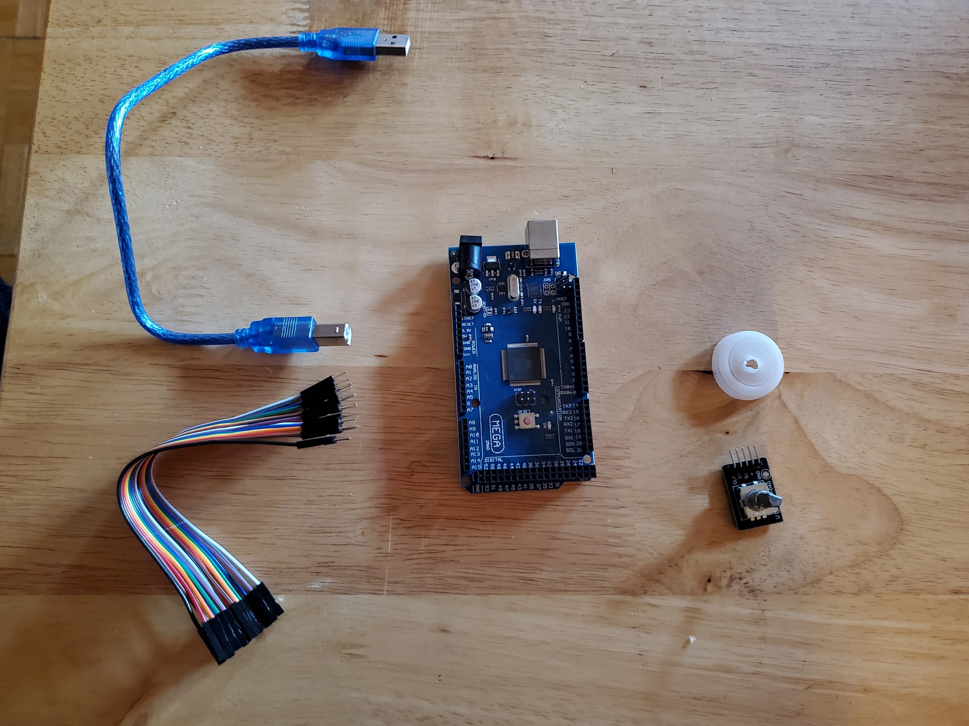
Materials List (Picture)
Materials List 2
Mega 2560 Board
Rotary Encoder Module KY-040
Male to Female Wires
USB cable
Object to attach onto rotary encoder
Ruler or tape measurer

Slide 6
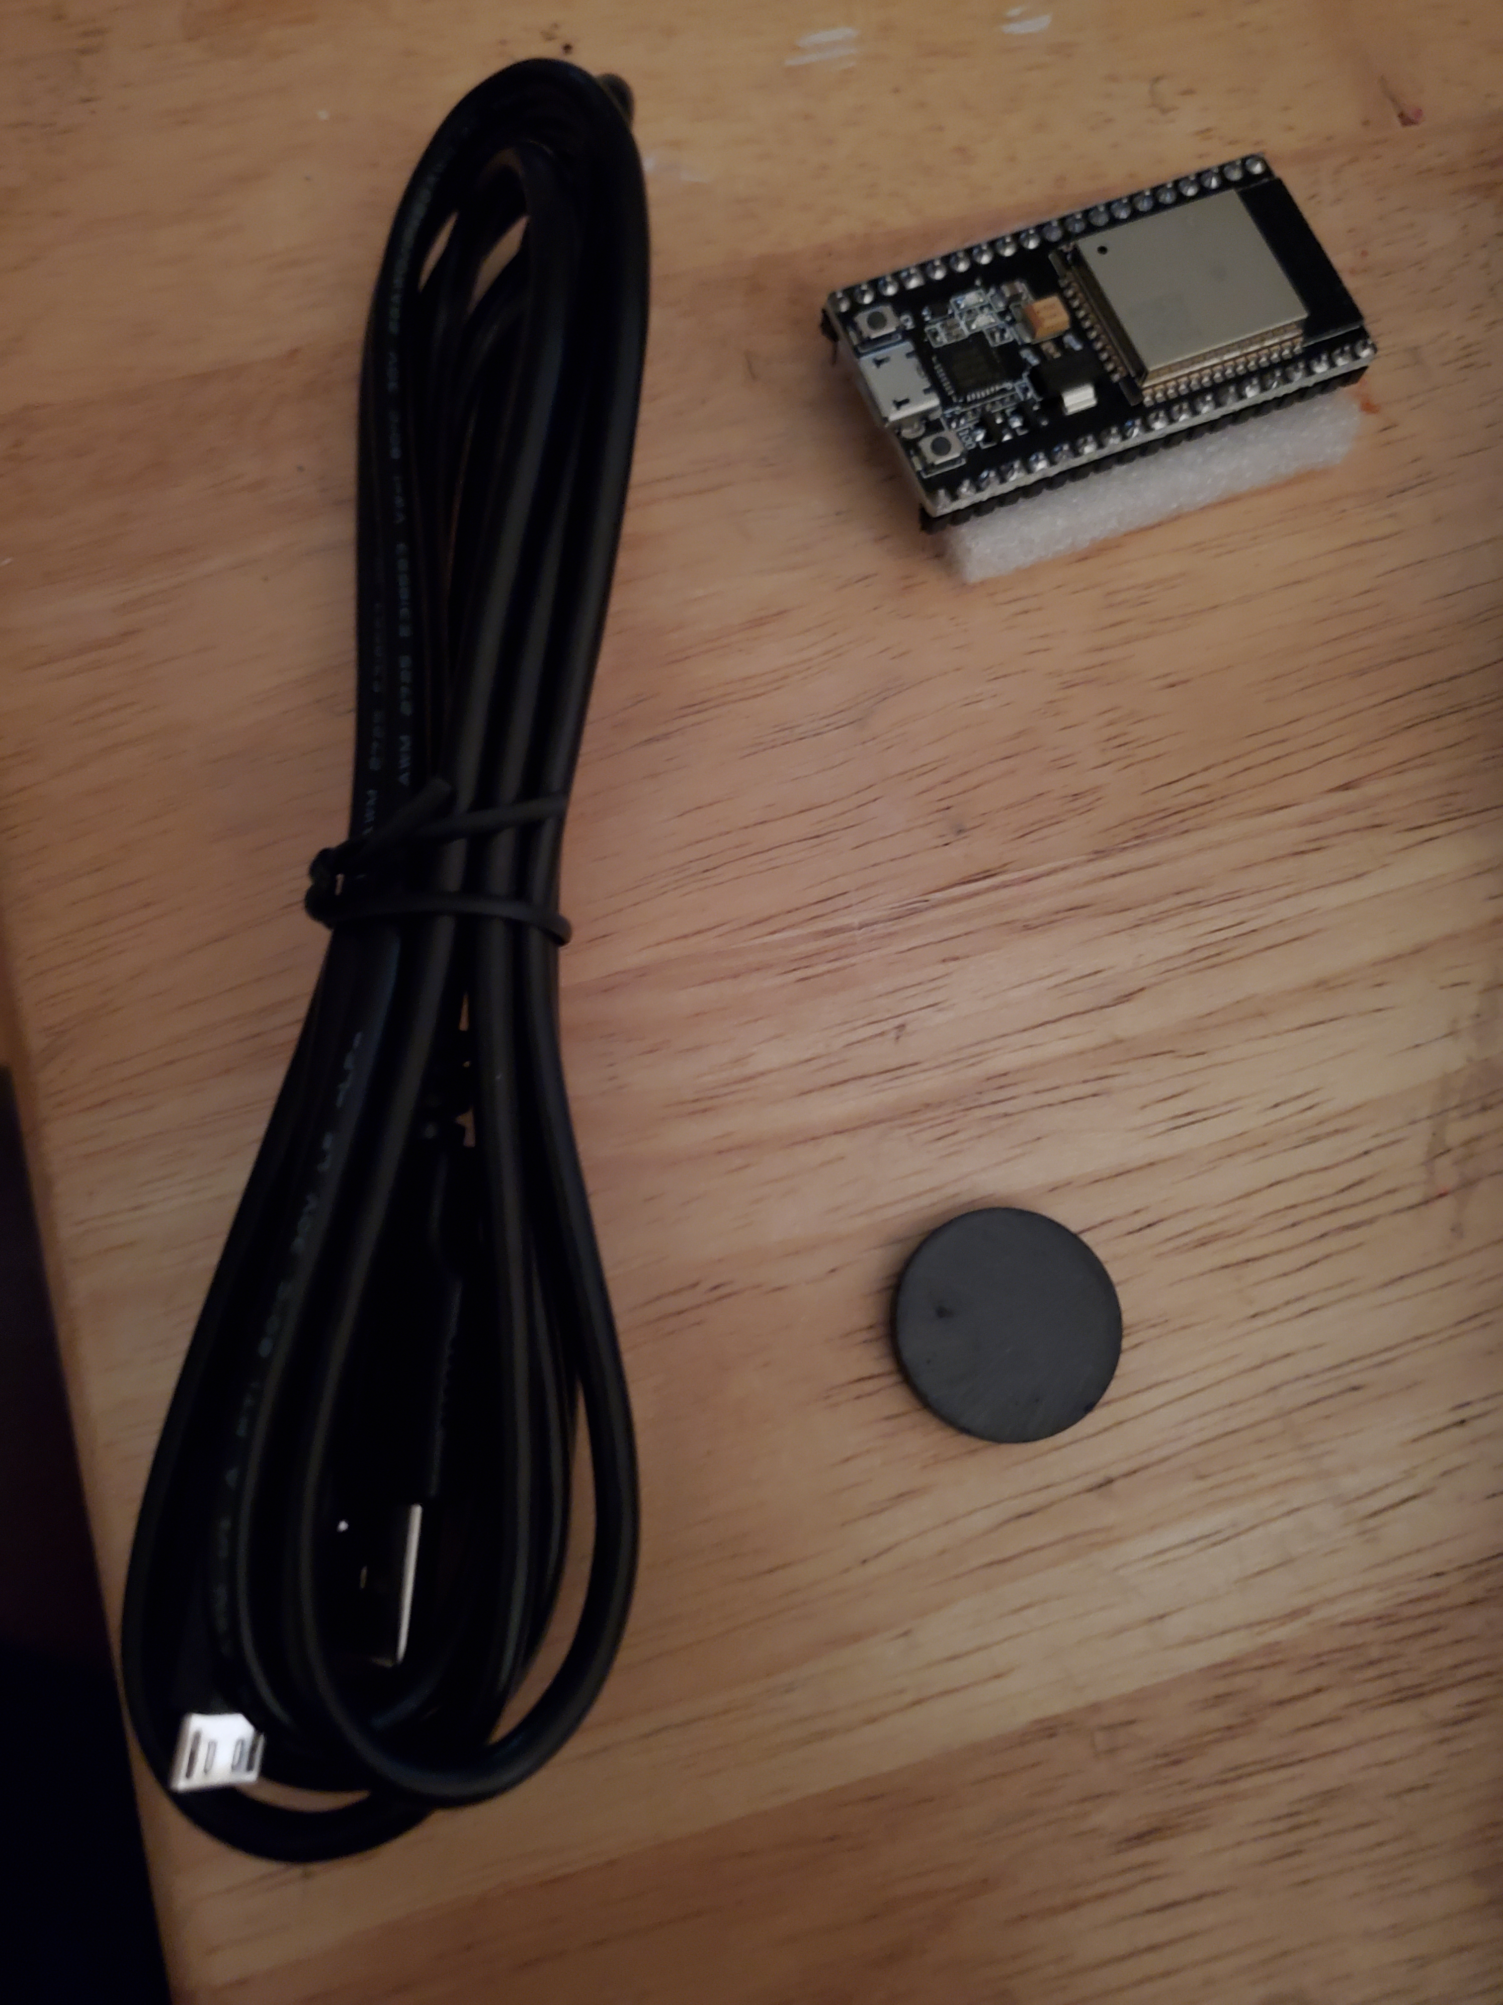
Materials List 3
ESP32 microprocessor
Micro-USB to USB cable
Magnet

Slide 7
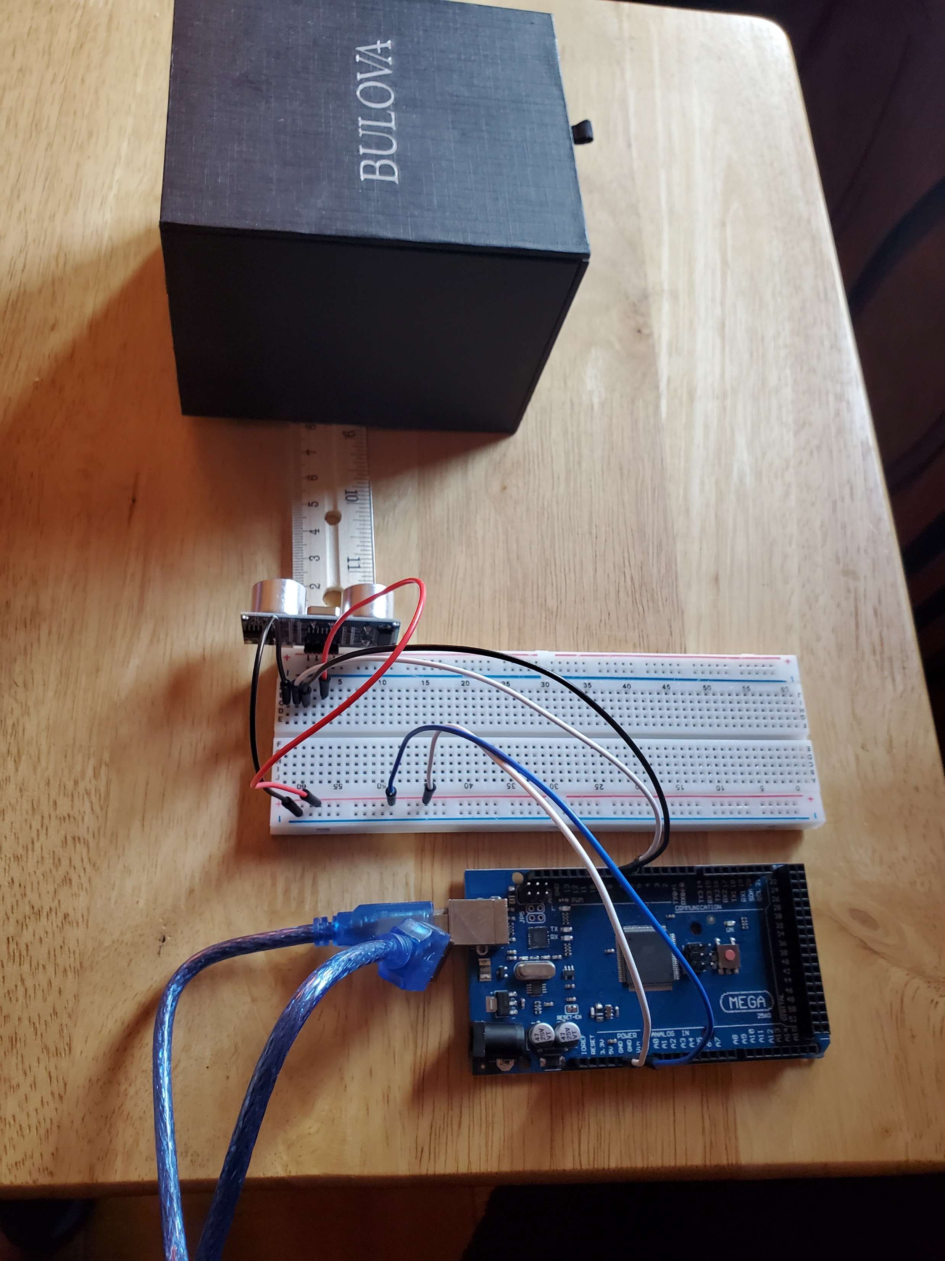
Experimental Set-up (Picture)
Materials List:
Mega 2560 Board
Ultrasonic sensor HC-SR04
Male to Male Wires
Breadboard
Ruler or tape measurer
Object to act as obstacle

Slide 8
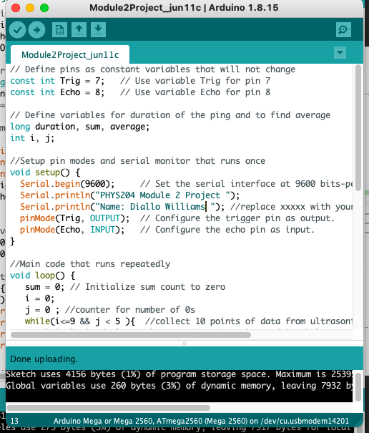
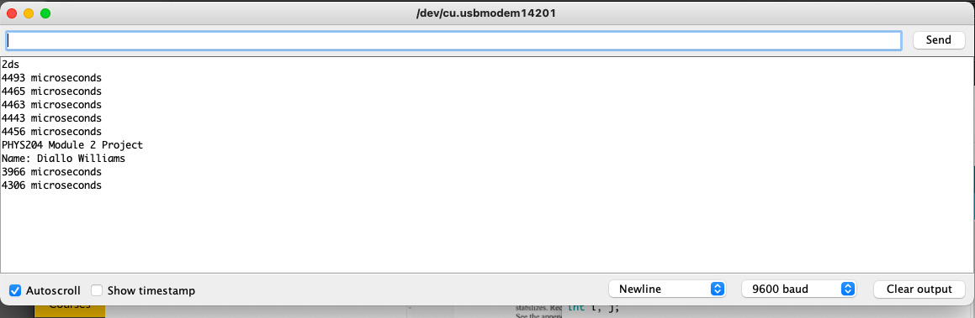
Raw Data (Screenshot)
Screenshot of Serial Monitor from Arduino IDE showing raw data.

Slide 9
Data Collection
Trial | Ruler Distance (cm) | Total Roundtrip Distance (m) | Time from Serial Monitor (microseconds) | Roundtrip time (s) | Velocity = distance/time (m/s)
1 | 2 | 0.04 | 4028 | 4.028e-4 | 9.930e-4
2 | 4 | 0.08 | 4015 | 4.015e-4 | 1.992e-4
3 | 6 | 0.12 | 4058 | 4.058e-4 | 2.957e-4
4 | 8 | 0.16 | 4122 | 4.122e-4 | 3.891e-4
5 | 10 | 0.2 | 4162 | 4.162e-4 | 4.805e-4

Slide 10

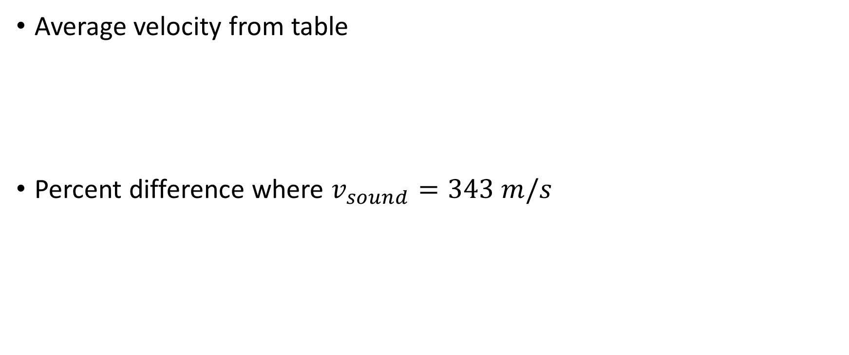

Data Analysis
Average velocity from table
Percent difference where $v_{sound}=343 m/s$
$v_{avg}= \frac{v_{1}+v_{2}+v_{3}+v_{4}+v_{5}}{5}=$1.973e-4
$Percent difference = \frac{\left|v_{avg}−v_{sound}\right|}{v_{sound}}×100\%=$9.998e-4

Slide 11
Conclusion
: The speed varies depending on atmospheric conditions; the most important factor is the temperature. Humidity has little effect on the speed of sound, nor does air pressure by itself. Air pressure has no effect at all in an ideal gas approximation

Slide 12
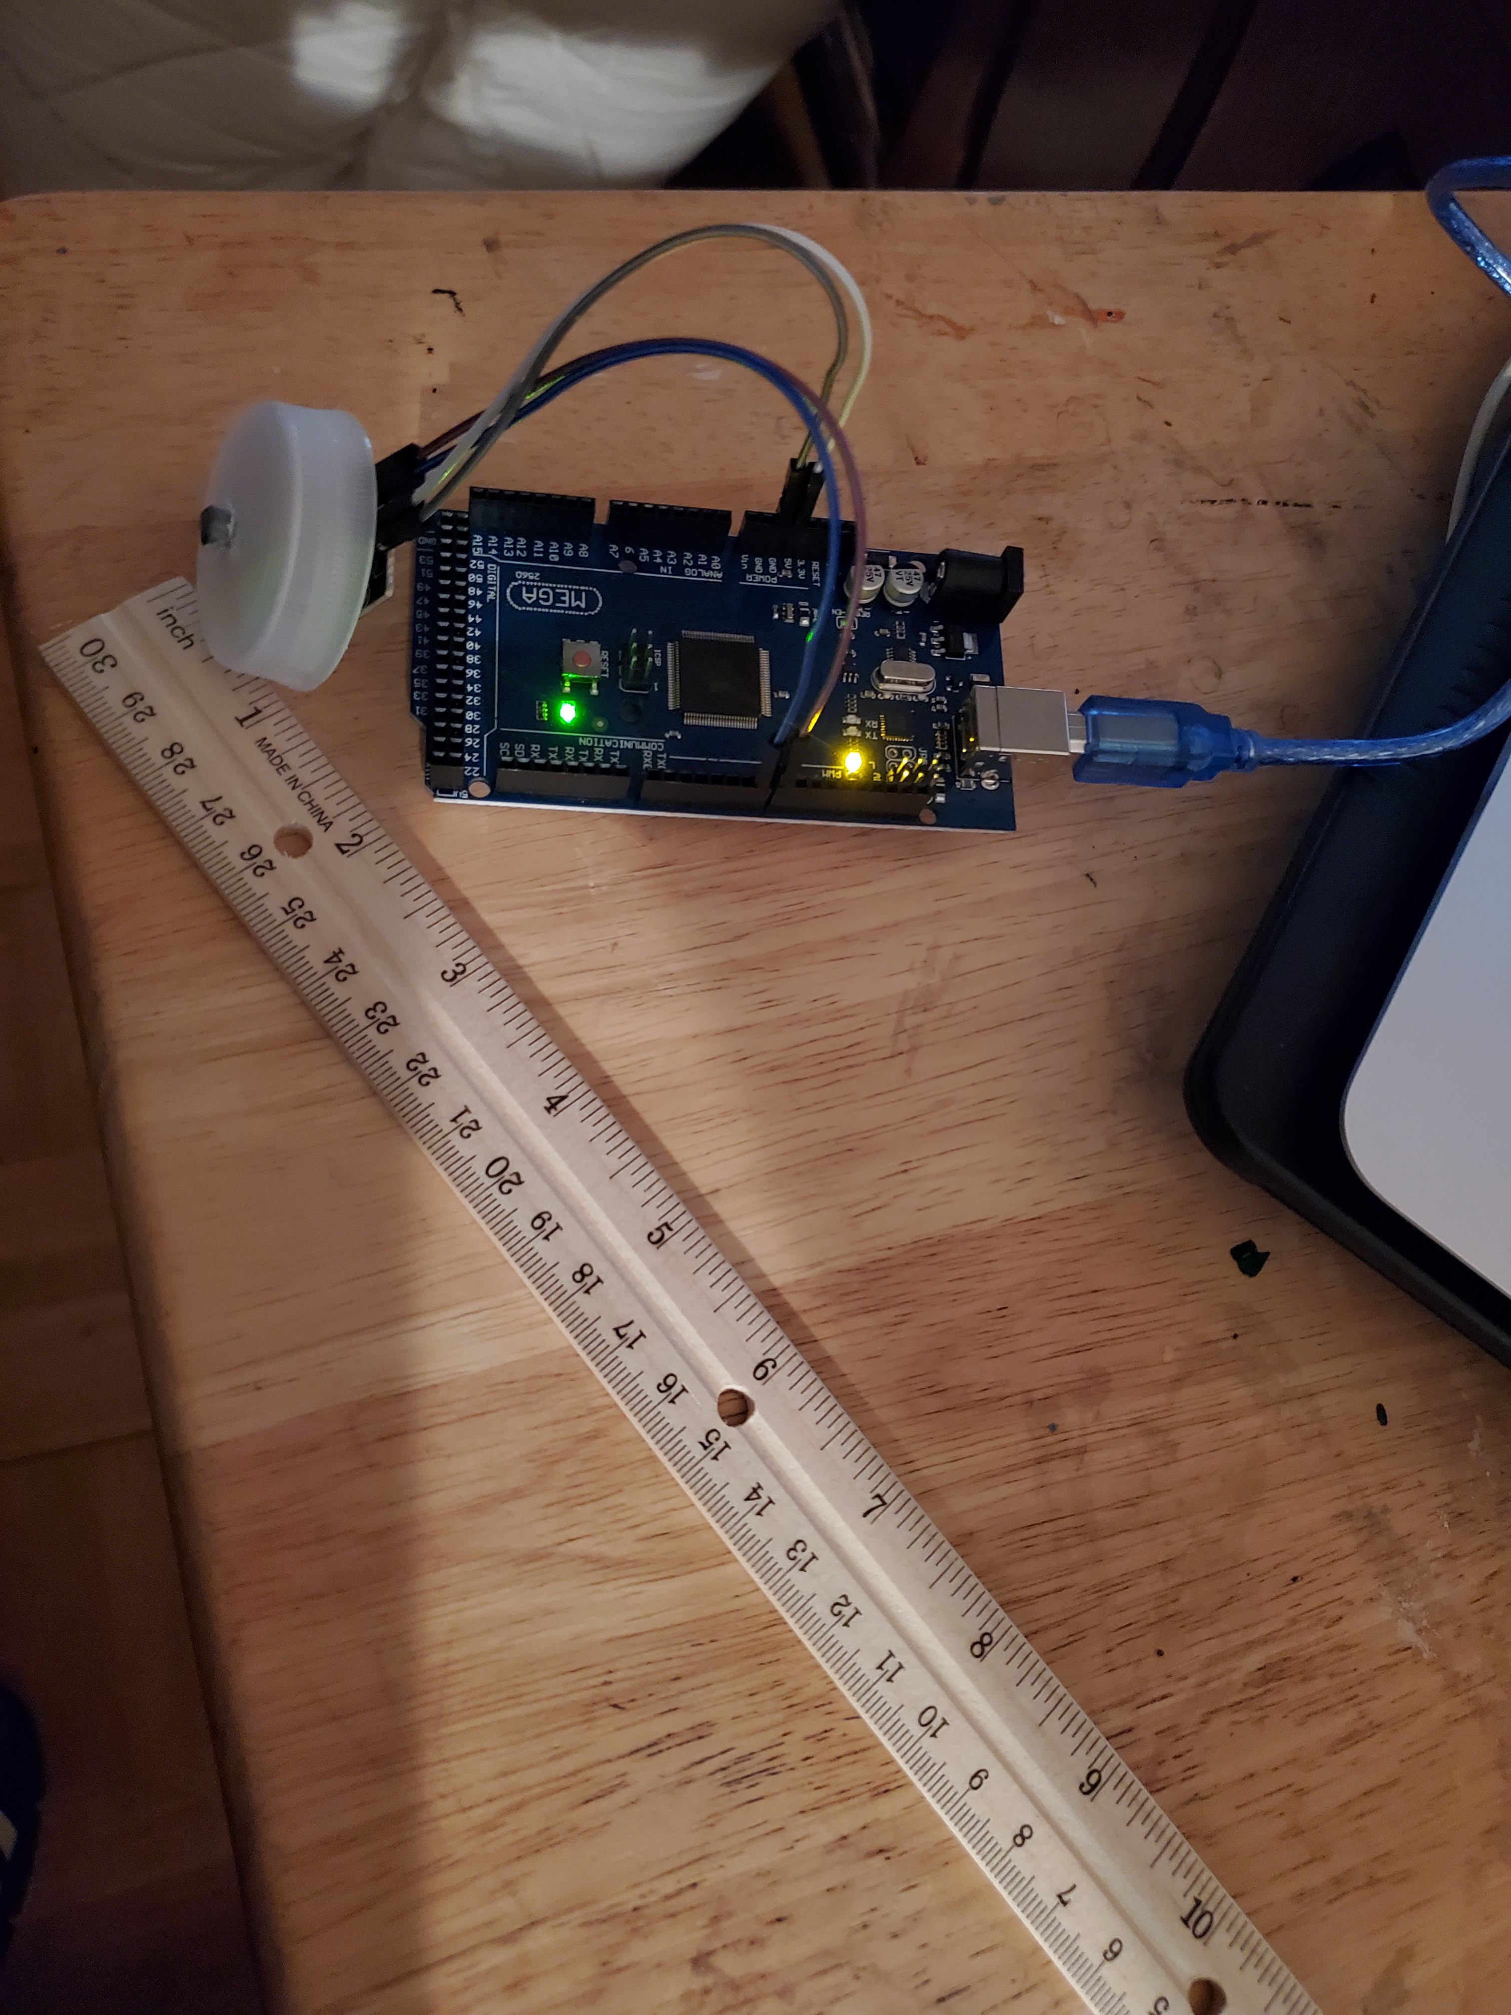
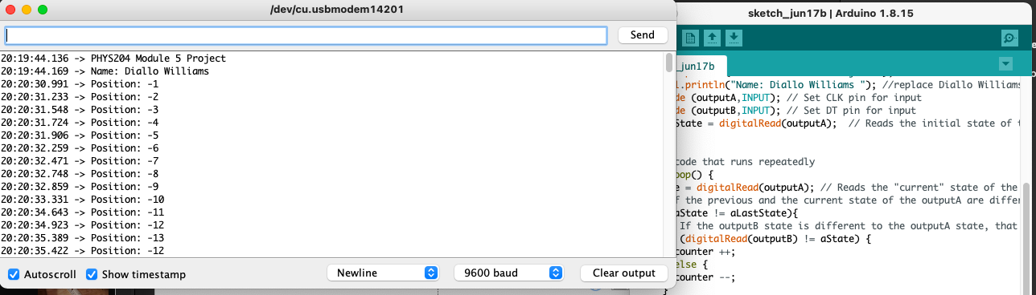
Convert Radial Displacement To Linear Displacement Using The Rotary Encoder

Slide 13
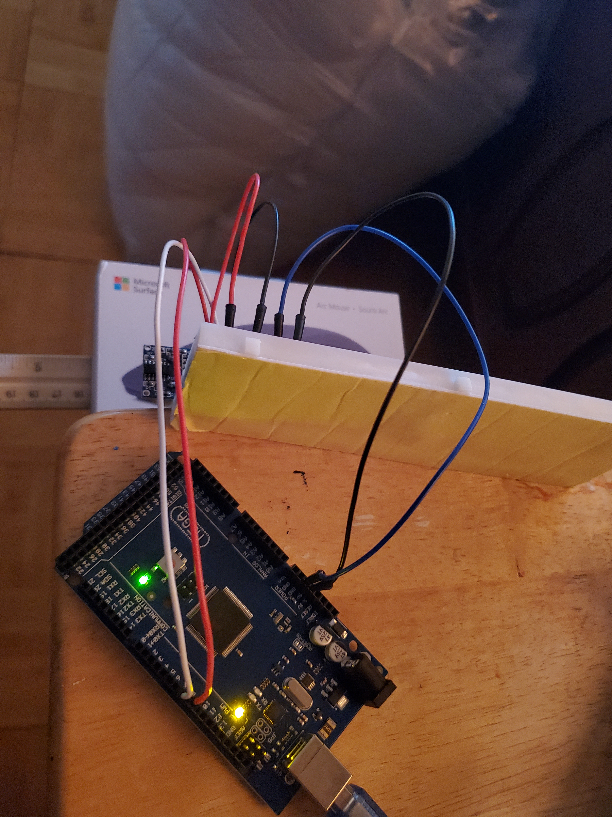
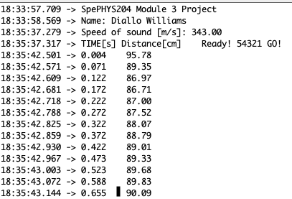
Find the Gravitational Acceleration of a Free-falling Object Using the Ultrasonic Sensor

Slide 14


Data Collection
Object diameter: d = 3cm
Object radius: r = 1.5cm
Number of pulses for one revolution: x = 29
Resolution = $\left(\frac{1 }{x } \frac{Revolution}{pulses}\right)∙\left(\frac{2∙π radians}{1 Revolution}\right)=$0.122rad/pulse

Slide 15
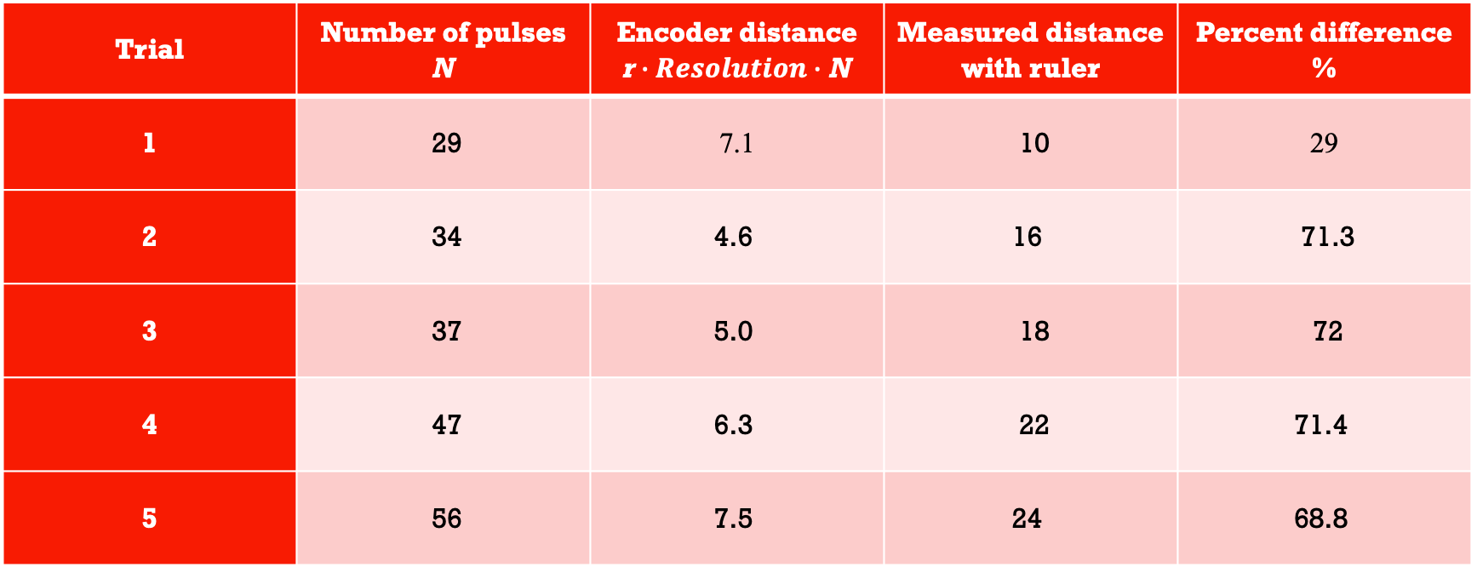
Data Analysis
Trial | Number of pulses N | Encoder distance r$∙Resolution∙$ N | Measured distance with ruler | Percent difference %
1 | 29 | 7.1 | 10 | 29
2 | 34 | 4.6 | 16 | 71.3
3 | 37 | 5.0 | 18 | 72
4 | 47 | 6.3 | 22 | 71.4
5 | 56 | 7.5 | 24 | 68.8

Slide 16
Conclusions
Discuss the results and comment on the reasons for errors.
Answer:
Errors resulted in the negative when the rotation was misplaced and turned in the wrong direction.
What are some applications of this measuring technique? Could this measuring system be used to measure surfaces that are not flat?
Answer: The accuracy of the measurements on a non-flat surface can be compromised and inaccurate.

Slide 17
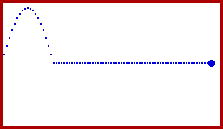
The End
This Photo by Unknown Author is licensed under CC BY-SA-NC

