Slide 1


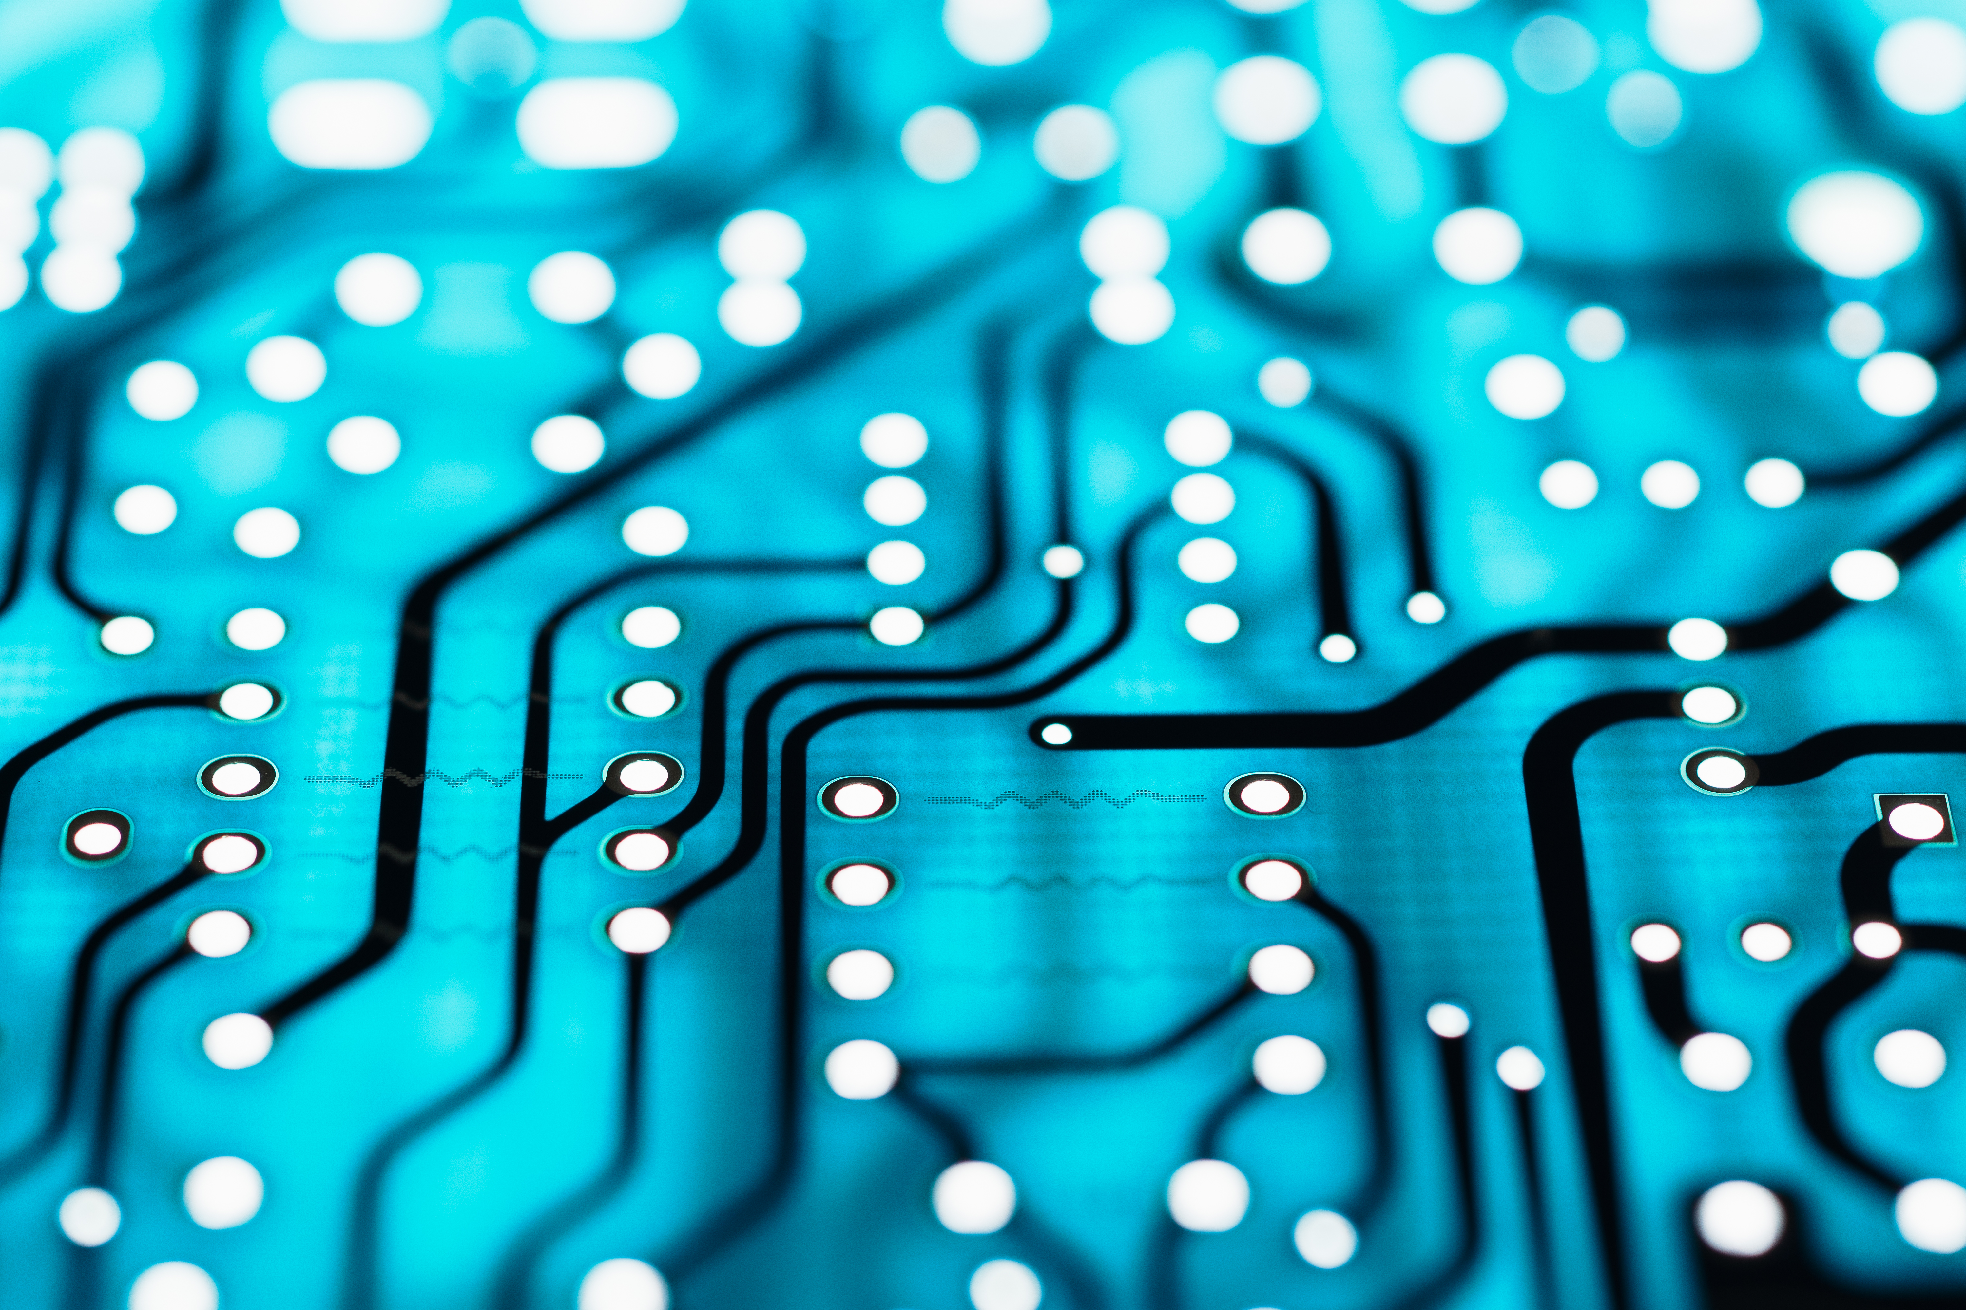
Introduction to Digital Devices
CEIS114
By Diallo Williams

Slide 2
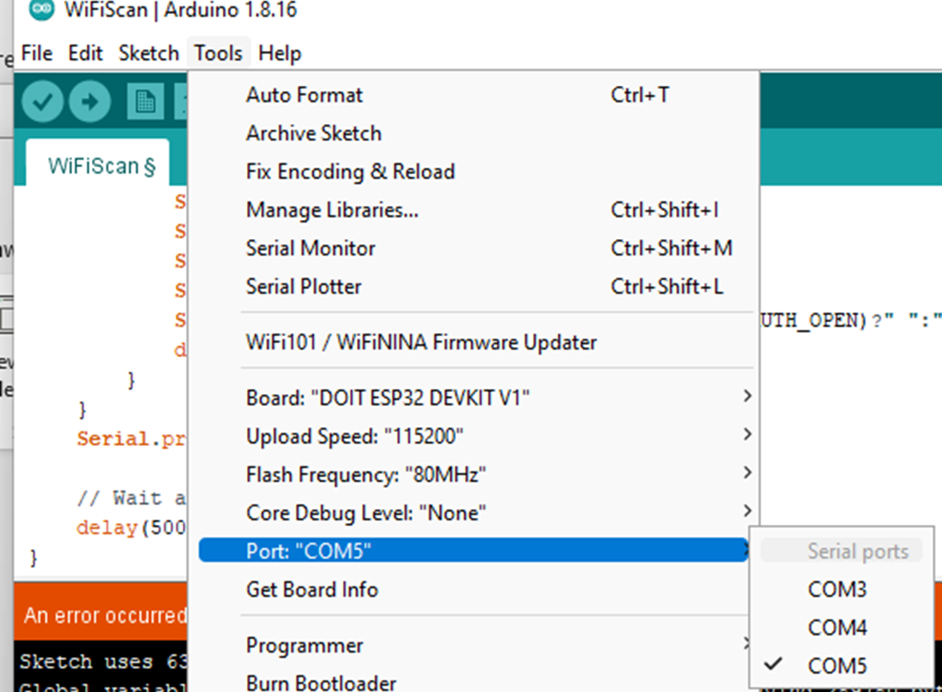
Installation of Arduino IDE
Arduino IDE with Port selected

Slide 3
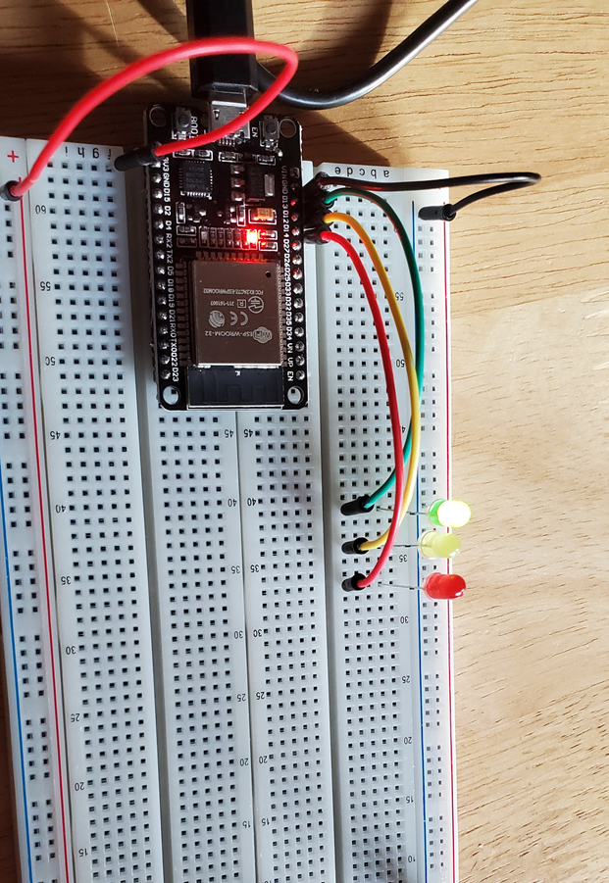
Creating the Traffic Controller
ESP 32 Board
Colored LEDs: Red, Yellow and Green
220 Ohm Resistors
Wires
Breadboard

Slide 4
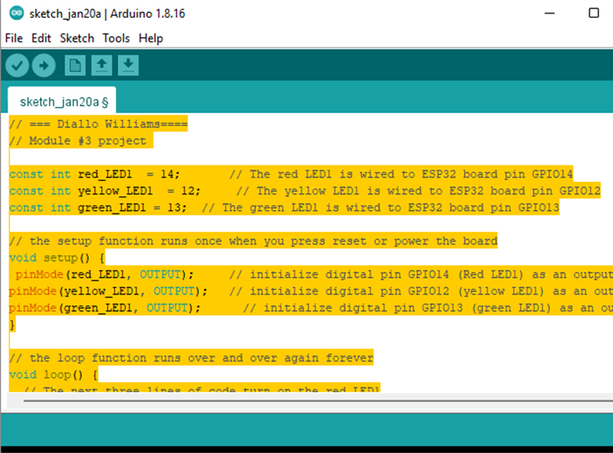
Traffic Controller code in Arduino IDE

Slide 5
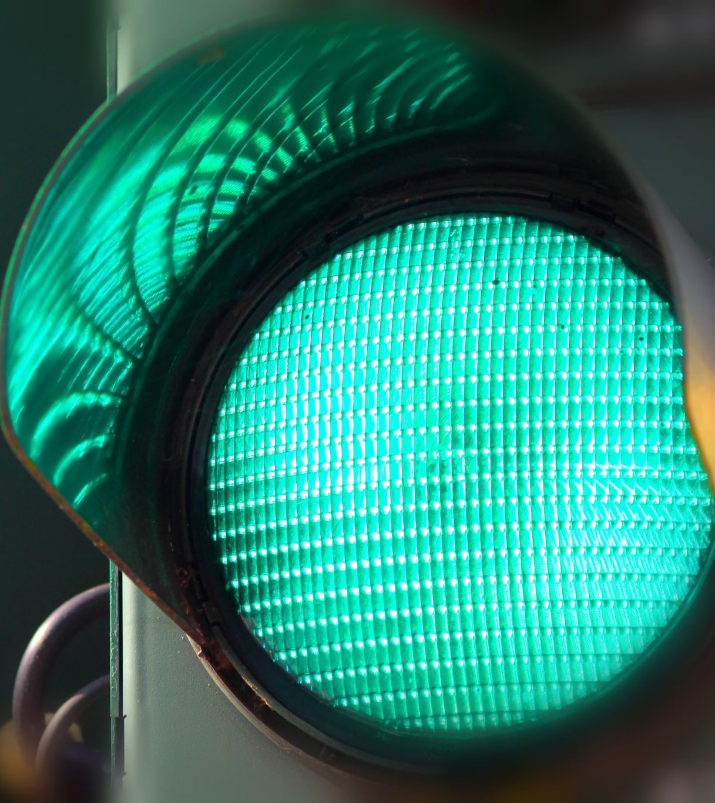
Creating a Multiple Traffic Light Controller & the components
ESP 32 Board
Colored LEDs: Red, Yellow and Green (two sets)
220 Ohm Resistors
Wires
Breadboard

Slide 6
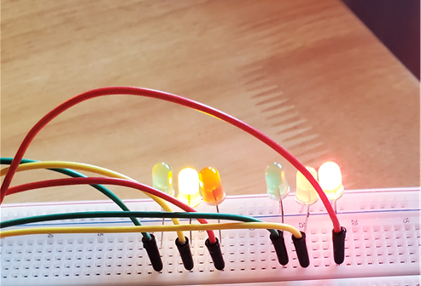
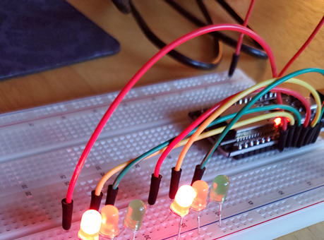
circuit with working LEDs on the multiple light traffic controller
ESP 32 Board
Colored LEDs: Red, Yellow and Green (two sets)
220 Ohm Resistors
Wires
Breadboard

Slide 7
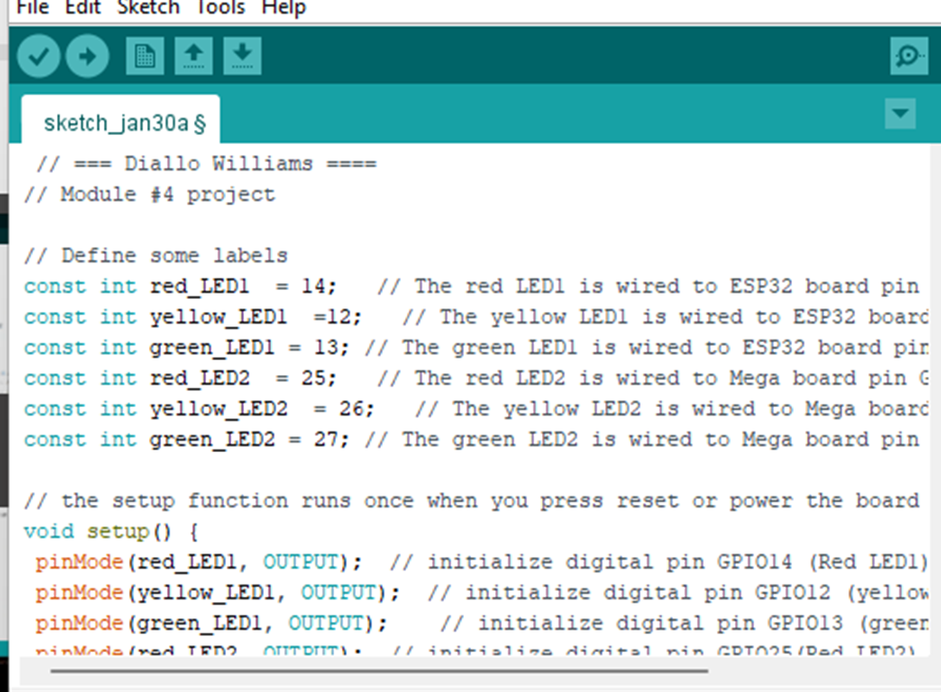
Multiple Light Traffic Controller code in Arduino IDE

Slide 8
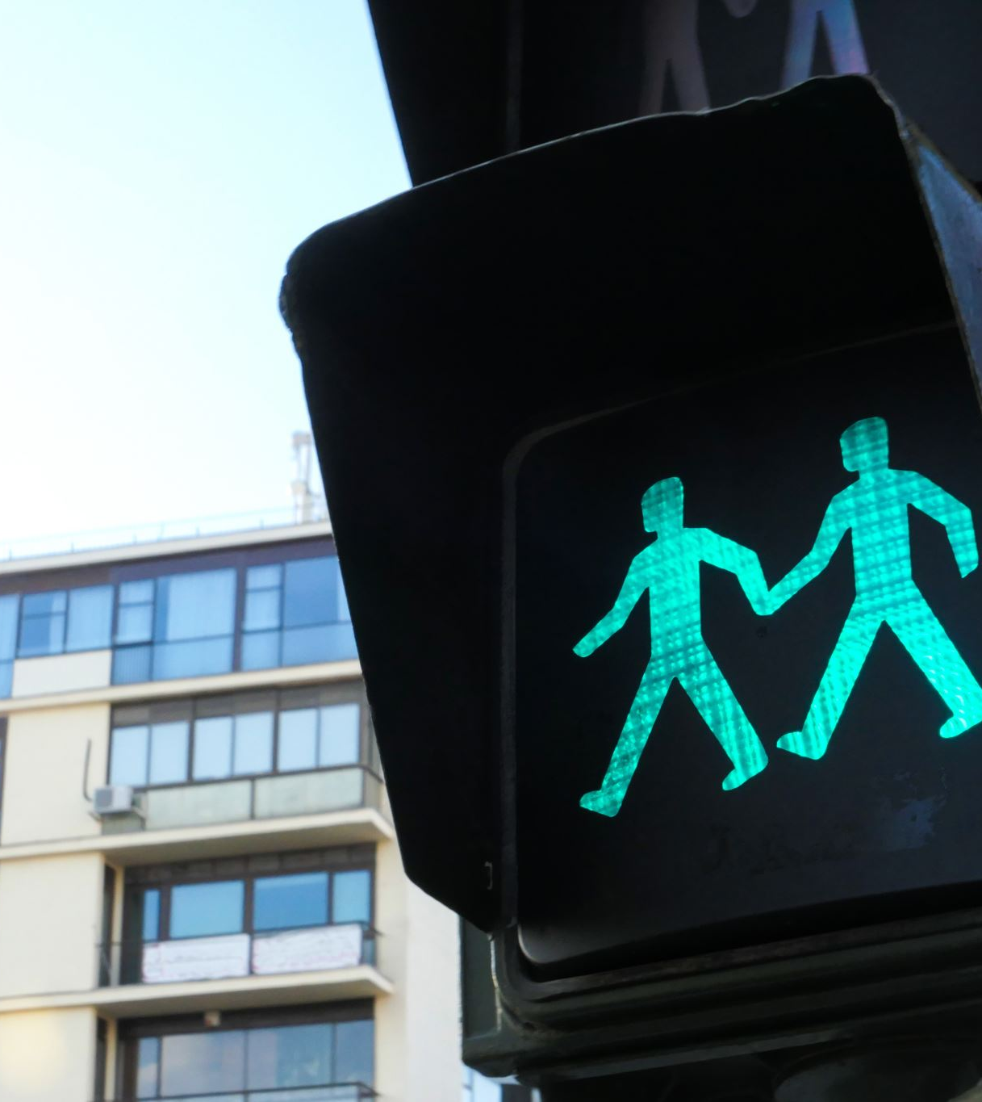
Creating a Multiple Traffic Light Controller with a Cross Walk

Slide 9
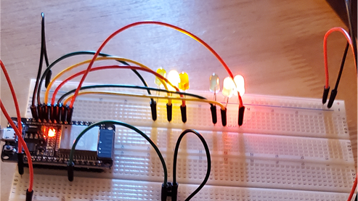
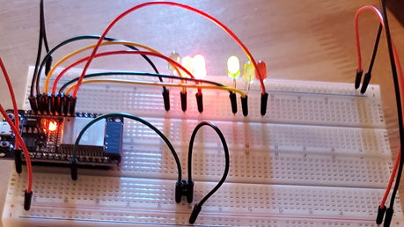
circuit with working LEDs
ESP 32 Board
Colored LEDs: Red, Yellow and Green (two sets)
220 Ohm Resistors (optional)
Push Button
Wires
Breadboard

Slide 10
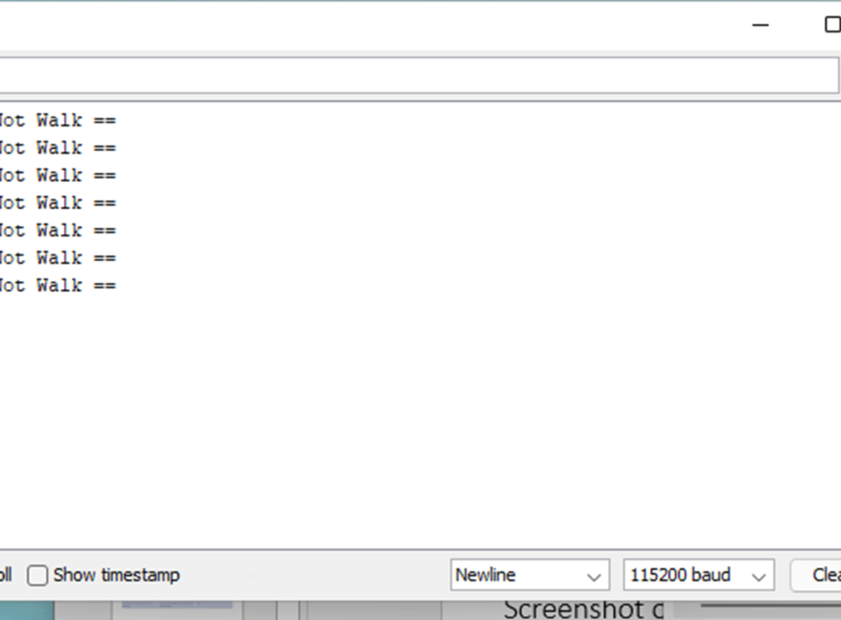
Cross Walk output in Serial Monitor in Arduino IDE

Slide 11
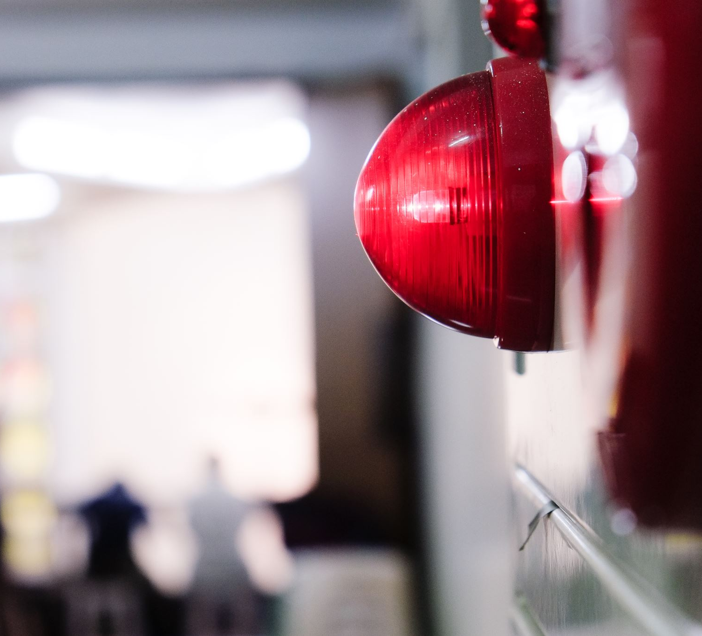
Multiple Traffic Light Controller with a Cross Walk and an Emergency Buzzer

Slide 12
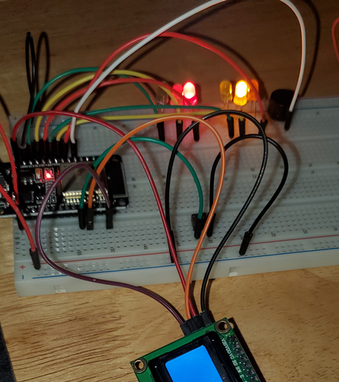
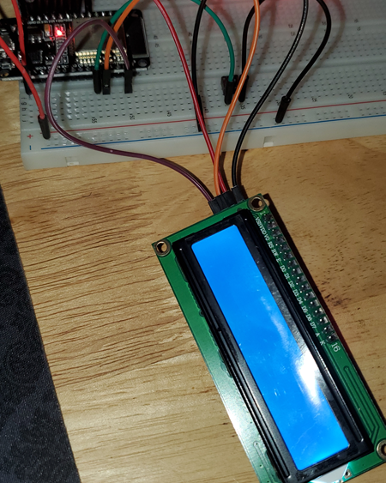
Multiple Traffic Light Controller with a Cross Walk and an Emergency Buzzer components
ESP 32 Board
Colored LEDs: Red, Yellow and Green (two sets)
220 Ohm Resistors
Push Button
LCD Unit
Wires
Breadboard

Slide 13
Career skills acquired
Describe practical digital devices and systems found in the IoT.
Name the various electronic components needed to create an electronic device.
Recognize the need for numbering systems and Boolean logic in digital devices.
Identify the basic logic circuit building blocks utilized in digital systems.
Identify each system block of an integrated digital device.
Explain the considerations for networking and securing a digital device in the IoT.
Produce a basic digital device that could be integrated into the IoT.

Slide 14
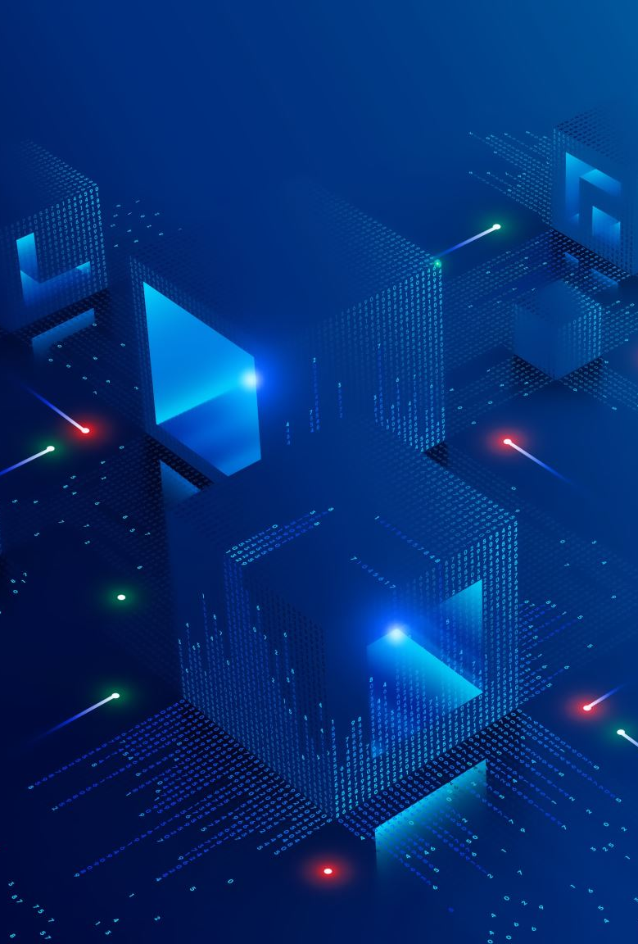
conclusion
This Project was an enriching experience rewarding me with a greater understanding in foundational electronic, digital, and system integration concepts common in modern computing devices.
I gained a new set of skills producing an electronic module designed for a specific function in a digital electronic system install and configure Operating Systems in a Personal Computer.

