Slide 1



The fundamentals of linux operations
By: Diallo williams

Slide 2

Obectives:
Introduction
Linux Filesystem Hierarchy
Linux Shell Scripts
User and Group Management
Network Configuration
Career / Softskills
Conclusion
This Photo by Unknown Author is licensed under CC BY-SA-NC

Slide 3
introduction
This Photo by Unknown Author is licensed under CC BY-SA-NC
Linux is an operating system (OS) used to run a variety of applications on a variety of different hardware components.
Linux began in 1991 as a personal project by Finnish student Linus Torvalds: to create a new free operating system kernel.
Linux is an Open Source Software (OSS) that is freely developed and continuously improved by a large community of software developers.

Slide 4
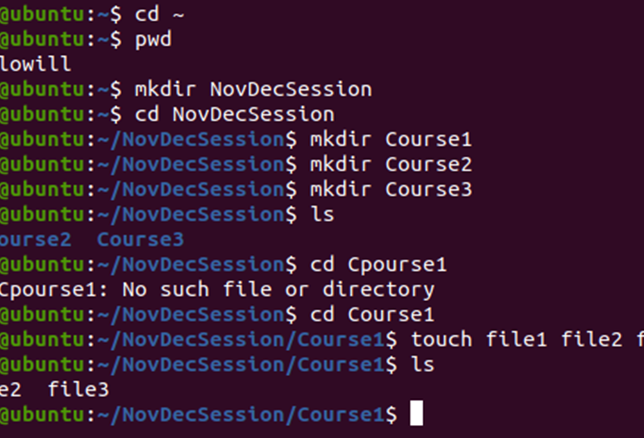
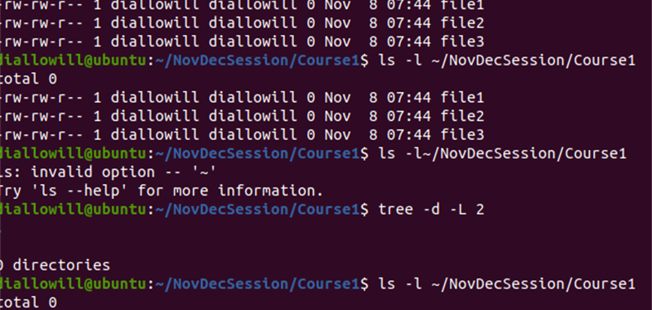
Create Directories and Files

Slide 5
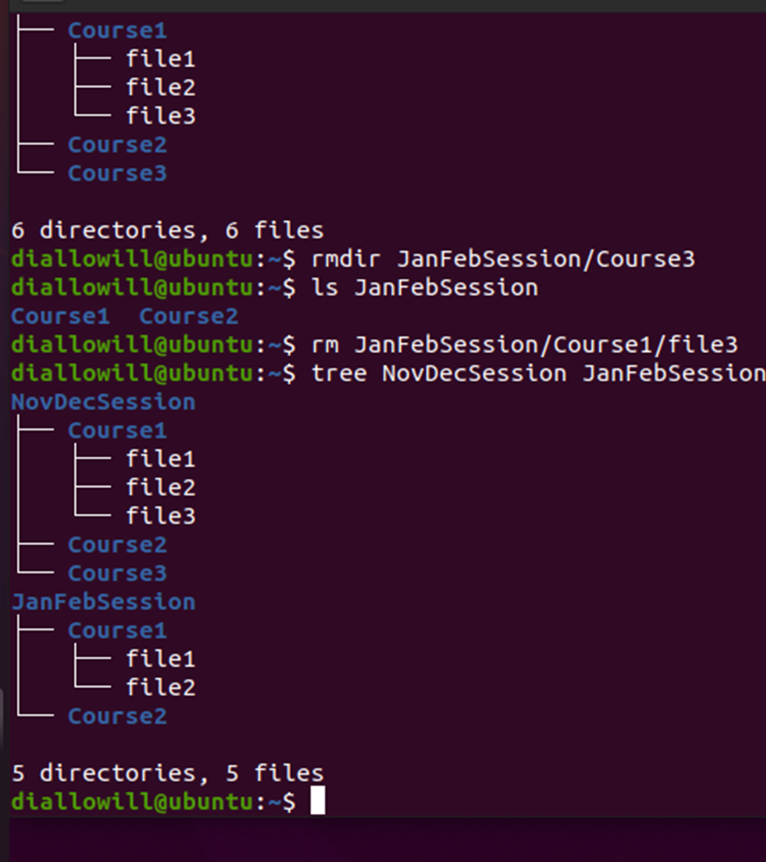
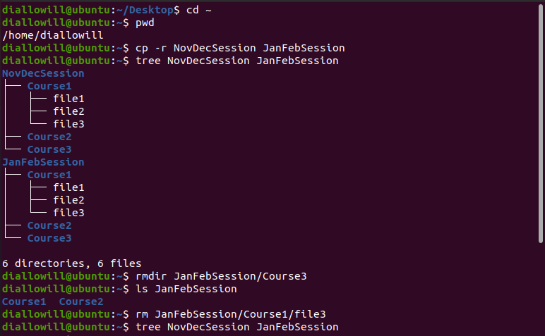
Copy and remove directories and files

Slide 6
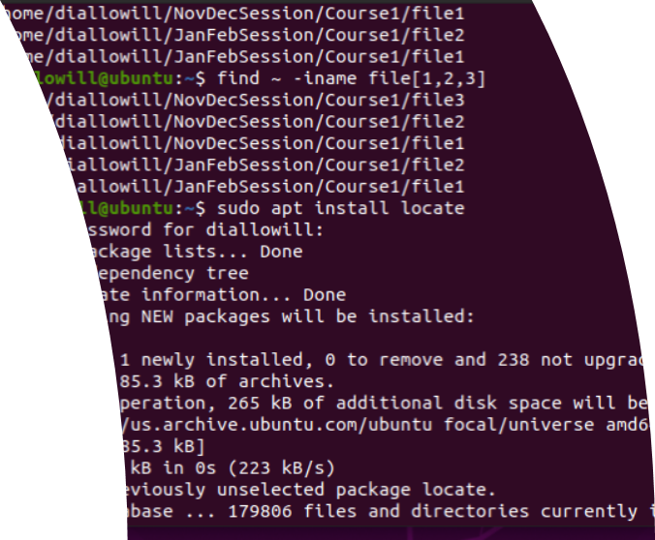
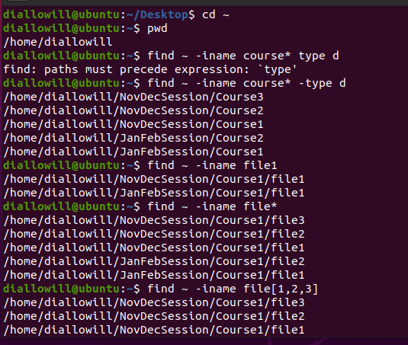
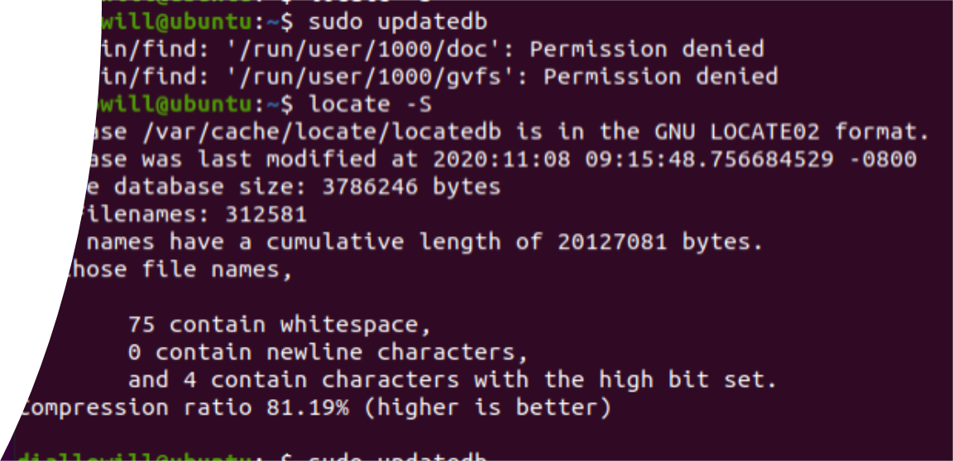
Locate directories and files

Slide 7
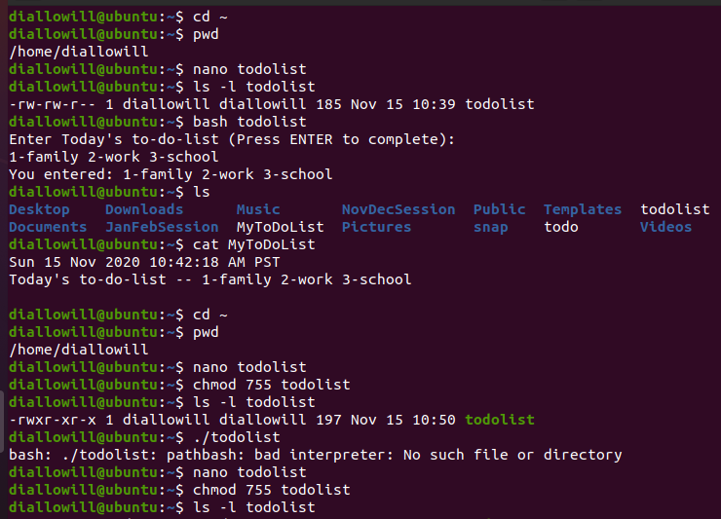
Change script file permission

Slide 8
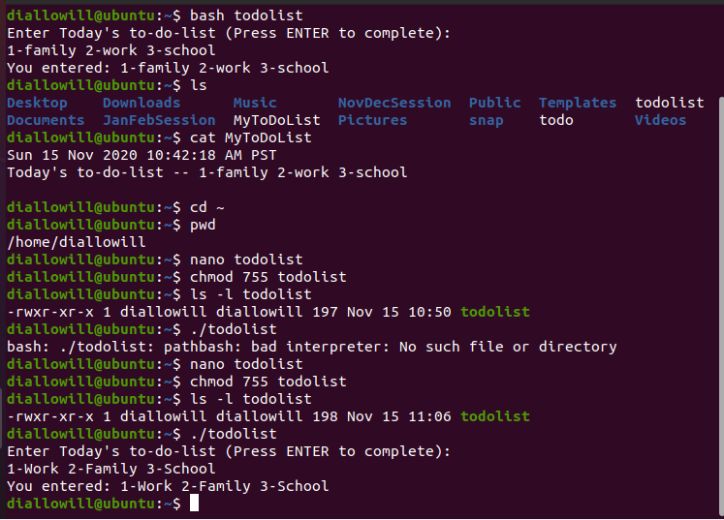
Change script file permission continued..

Slide 9
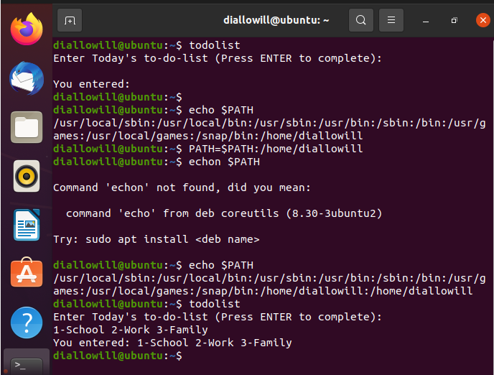
Set path variable

Slide 10
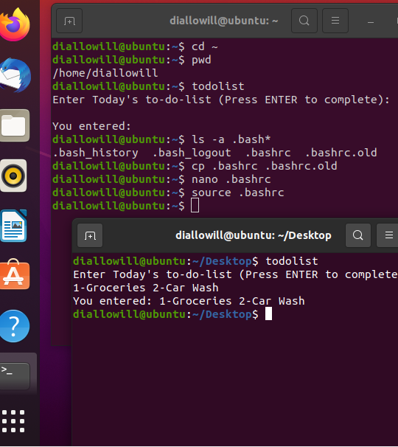
Make path variable permanent

Slide 11
Add users and groups using the command line interface (c.l.i.)
1. What does the –m option in the useradd command do?
Answer here:The –m option creates a home folder
2. What does the -3 option in the tail command do?
Answer here: the -3 option in the tail command is Three lines
3. Which line of the /etc/group file lists members of the “students” group? Copy it here.
Answer here: Line 3 sudo tail -3 /etc/group
systemd-coredump:x:999:
mary:x:1001:
students:x:1002:diallowill,mary

Slide 12
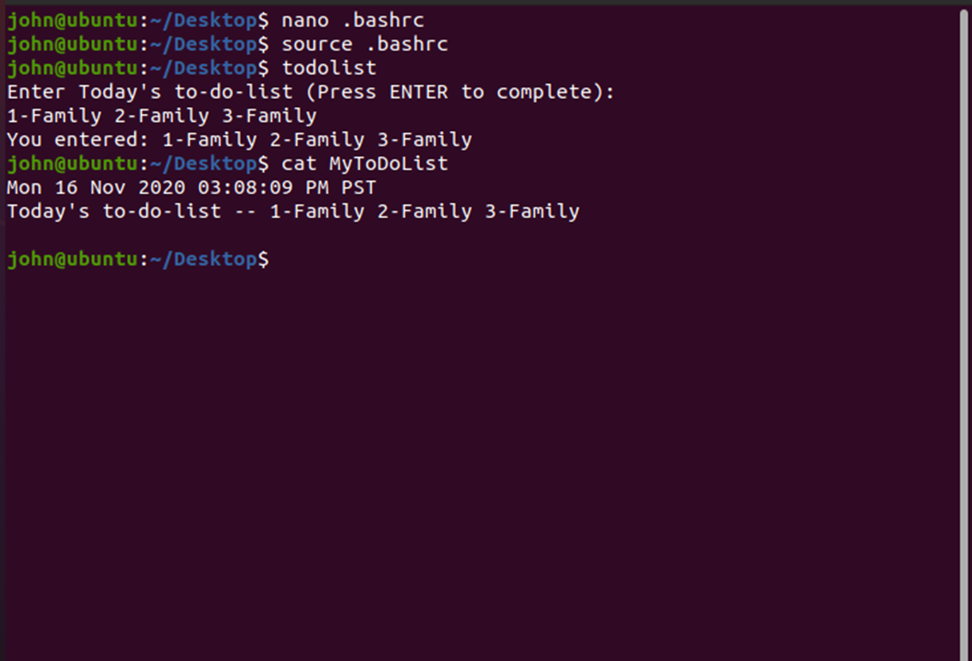
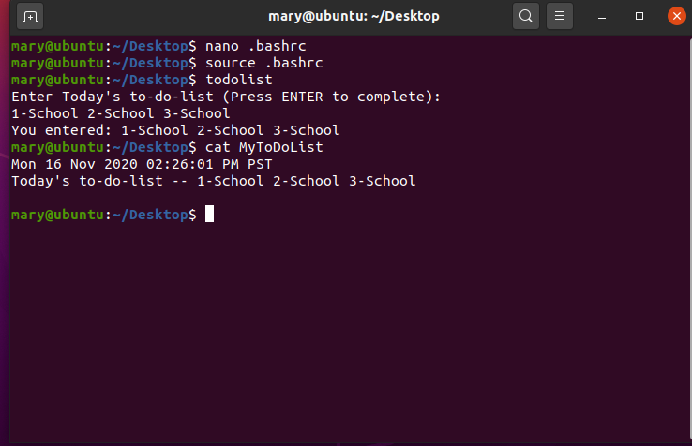
Test user & group settings

Slide 13
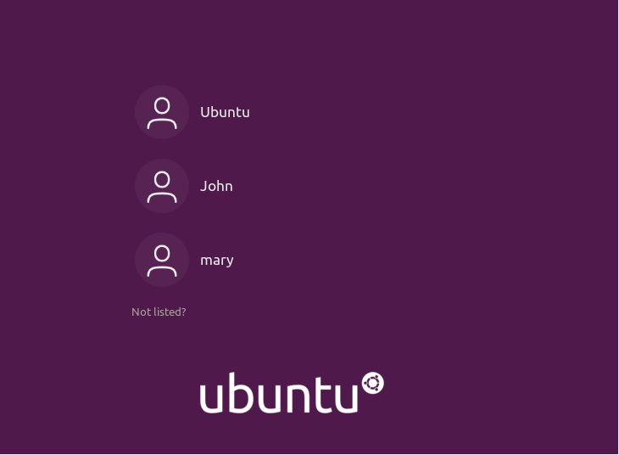
Add users in gui

Slide 14
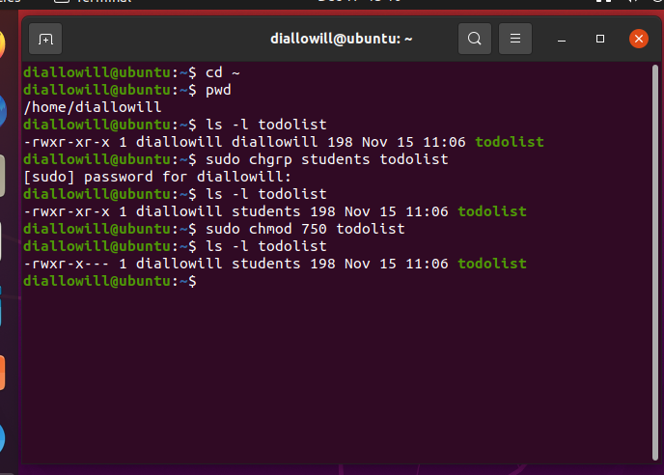
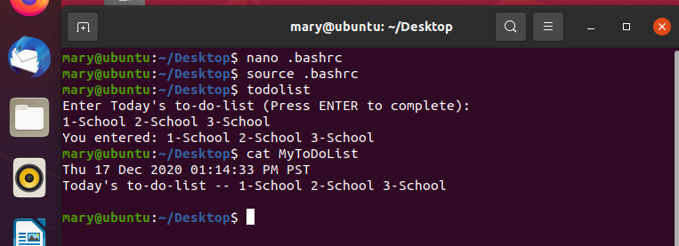
remove users & groups

Slide 15
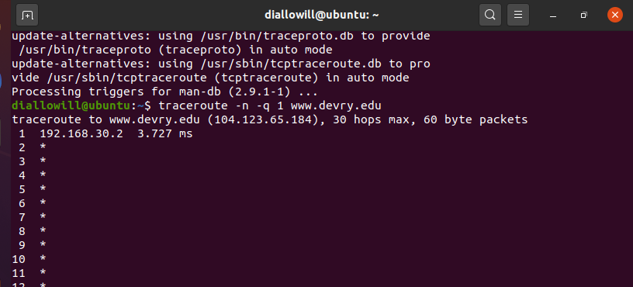
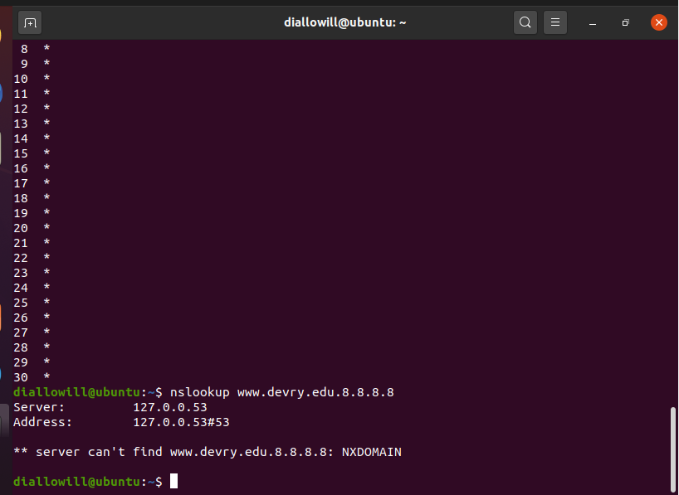
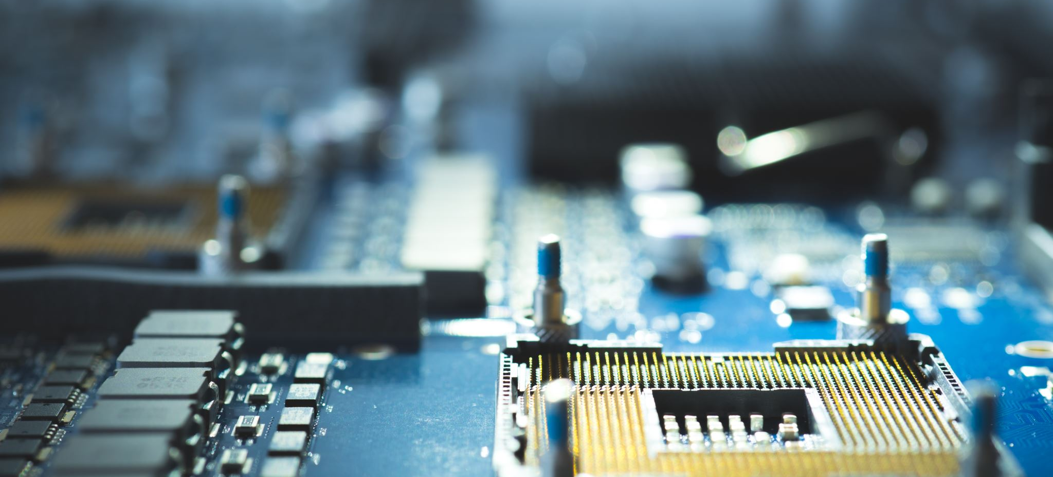
Use network utilities

Slide 16
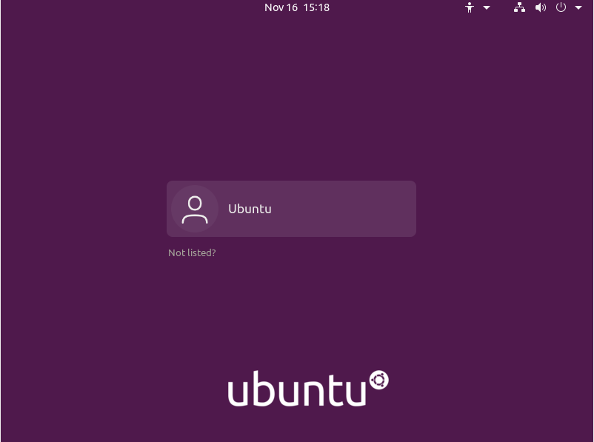
Remove users and groups continued…

Slide 17
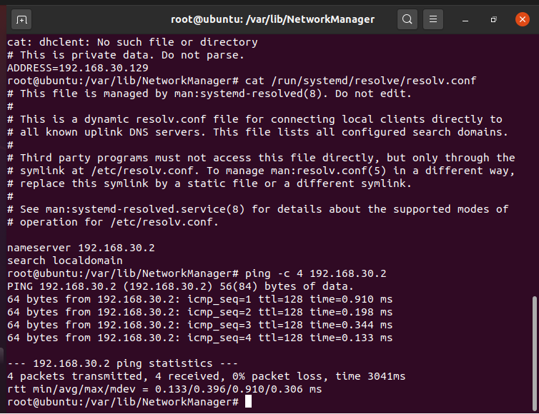
Discover host ip configurations
1. What is the IP address of your Ubuntu machine?
Answer here: 192.168.30.129
2. What is the IP address of its default gateway?
Answer here:192.168.30.2
3. What is the IP address of its DHCP server?
Answer here:
4. What is the IP address of its DNS server?
Answer here192.168.30.2:

Slide 18
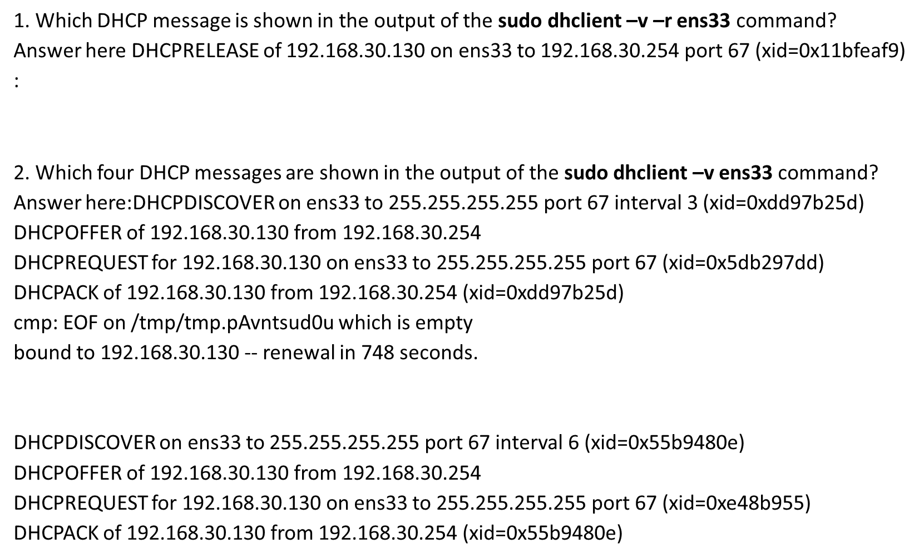
Manage network interfaces

Slide 19
Monitor linux processes
1. What is the default action of the 15 SIGTERM kill signal?
Answer here: Closes the application.
2. In the System Monitor window, click on % CPU to sort the processes by CPU load. Which process shows the highest percentage of CPU usage?
Answer here:Gnome Shell/ Gnome-system-Monitor

Slide 20
Monitor user activities
Issue the sudo accton on command to turn on GNC accounting. Enter lastcomm apt to check if the apt command was executed before. Remember to turn off GNC accounting (sudo accton off) after answering the questions.
1. What flag value is displayed in the output?
Answer here:S for the Suoer user, pts0 for the terminal name and the number of seconds each process ran.
2. Why is the name of the user who ran the processes shown as root, not your username?
Answer here: Root ,by default, has access to all commands and files on a Linux

Slide 21
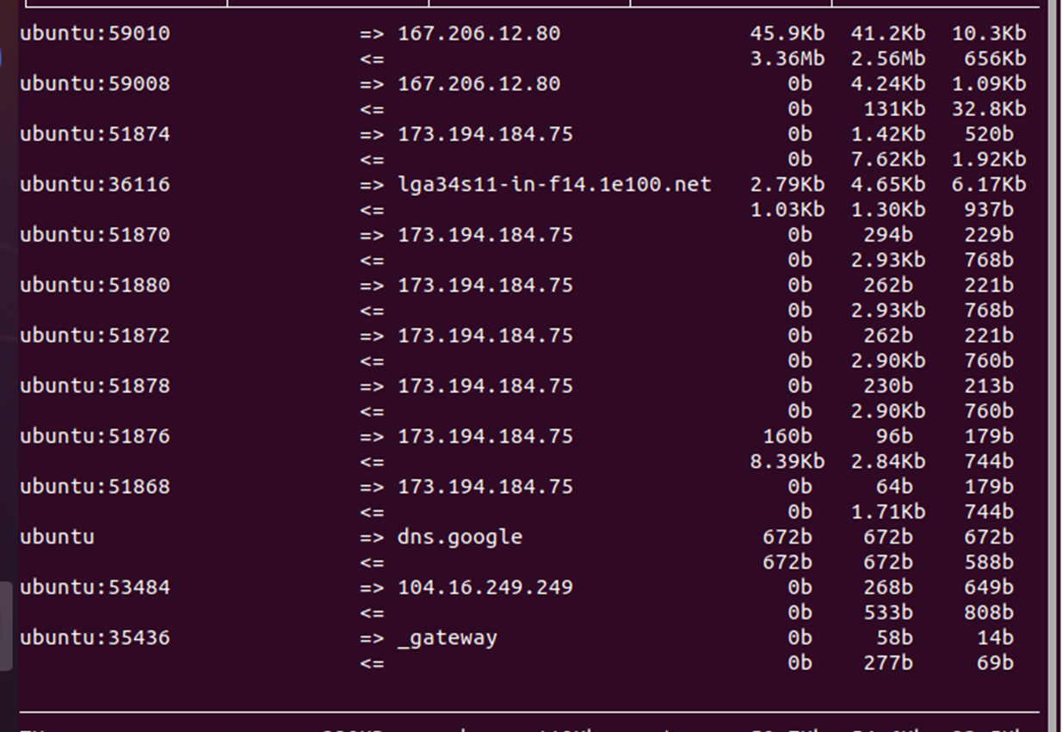
Monitor network bandwidth usage

Slide 22

Career/softskills
Communication - Having strong communication skills is the most important soft skill you can have.
Teamwork - knowing how to be a team player is a key skillset
Problem Solver – A person who is quick on their feet and can work well under pressure and are adaptable.
Ability to follow instructions
Strong Drive to Learn
This Photo by Unknown Author is licensed under CC BY-SA-NC

Slide 23

conclusion
This Photo by Unknown Author is licensed under CC BY-SA

