Slide 1


Ceis101 course project smart home automation & security system
Presented By DIALLO WILLIAMS

Slide 2
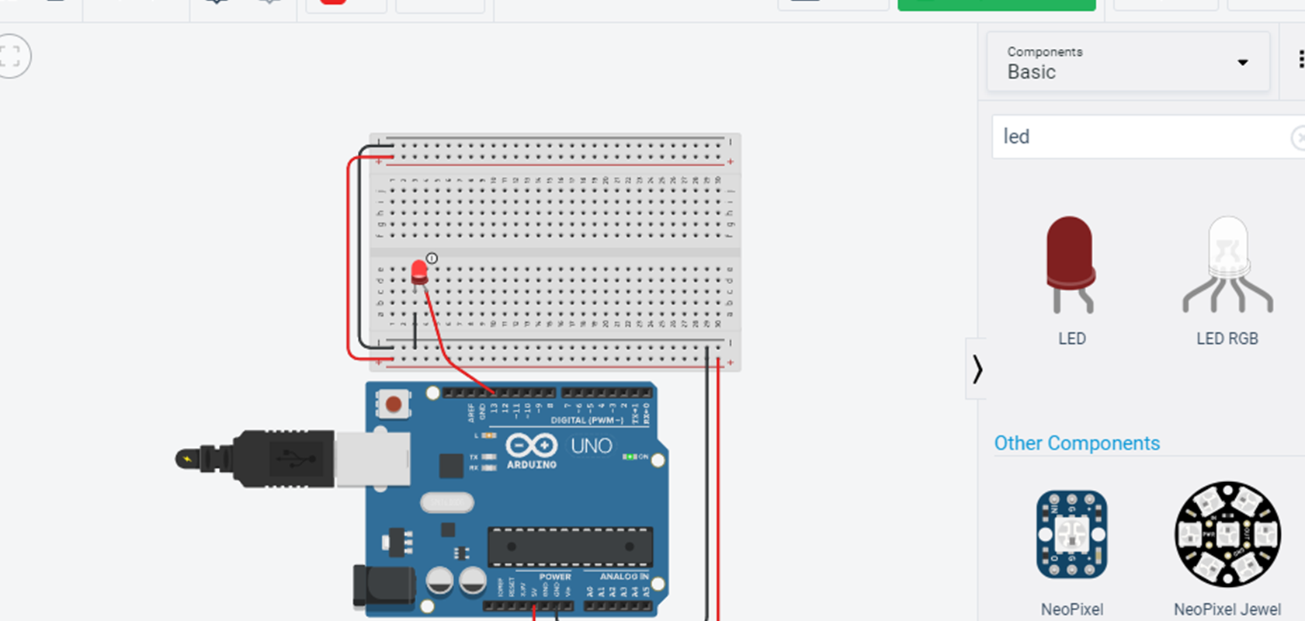
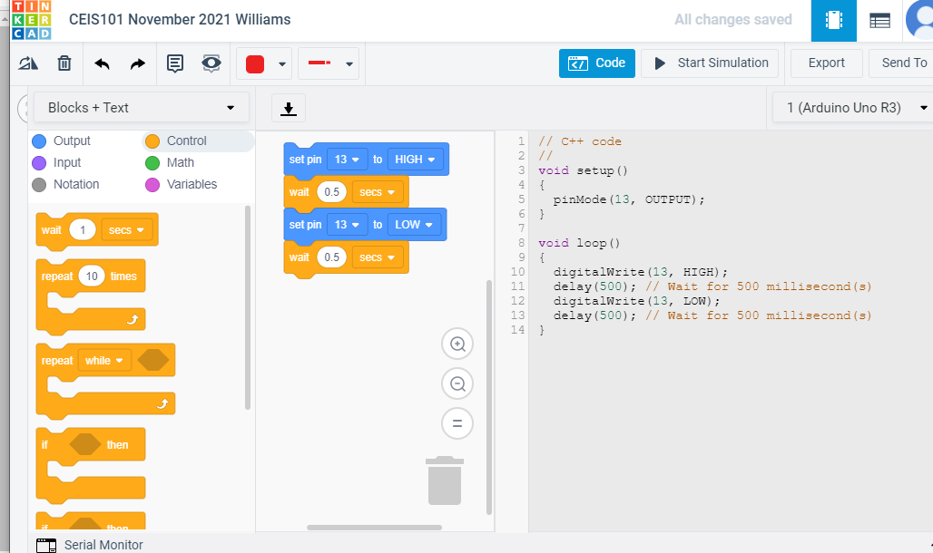
Circuit along with code completed in tinkercard

Slide 3
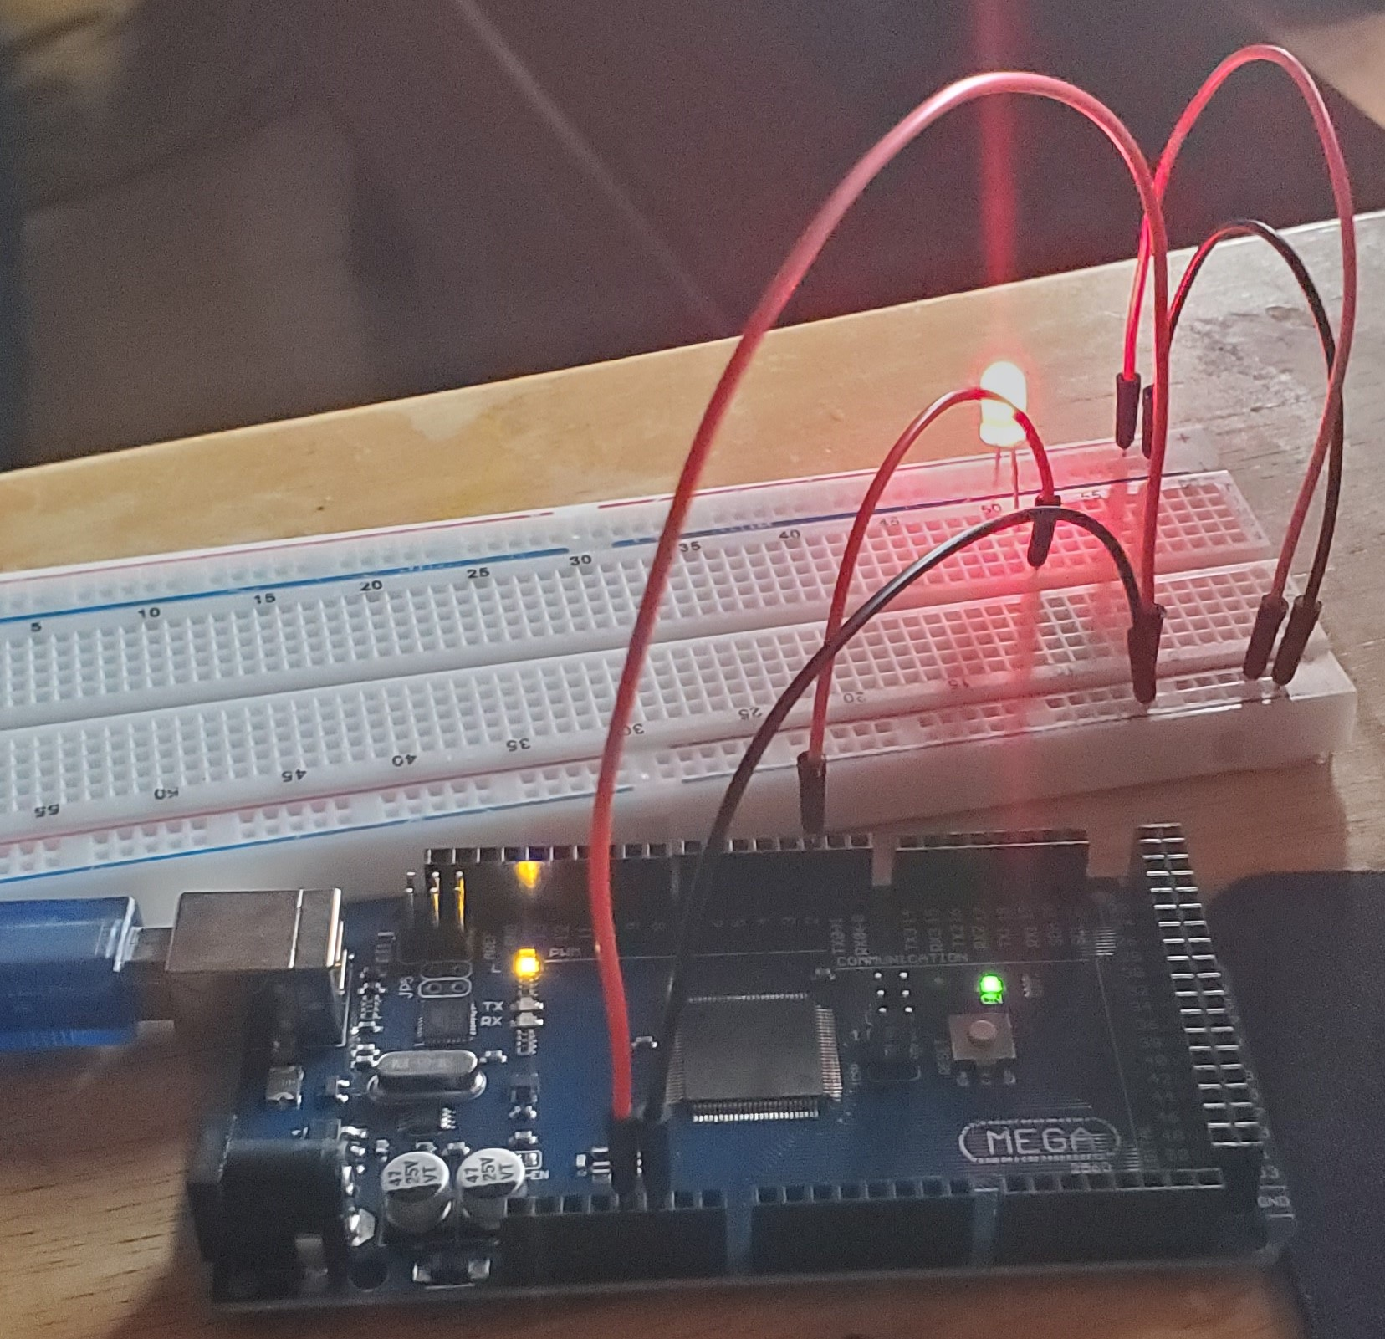
Components:
Arduino Mega 2560
Breadboard
Resistor 10kΩ
LEDs
Ultrasonic Sensor
Active Buzzer
Photoresistor
Wires
USB Type B cable
Complete Circuit with Red LED light ON.
Inventory of Parts, Circuit Building, and Displaying Messages

Slide 4
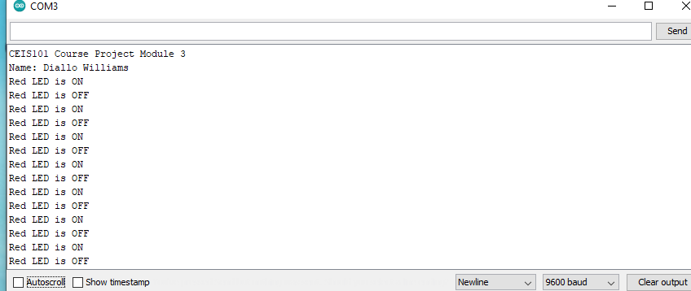
Inventory of Parts, Circuit Building, and Displaying Messages
Serial Monitor Displaying name and LED on/off messages

Slide 5
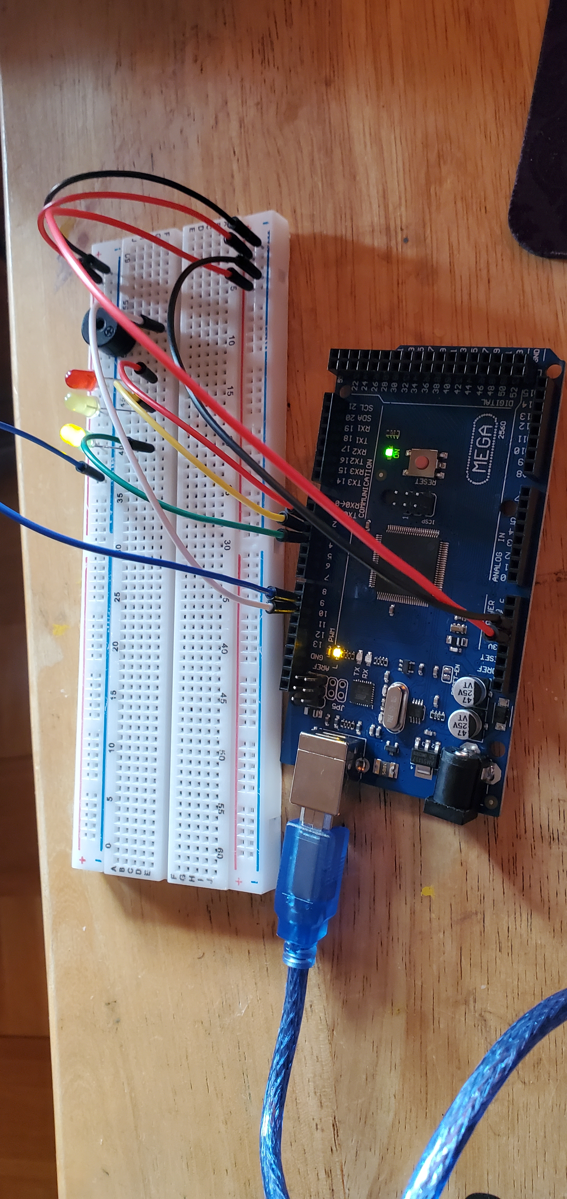
Adding Door Sensor to Smart Home System
Circuit of door closed with Green LED on.

Slide 6
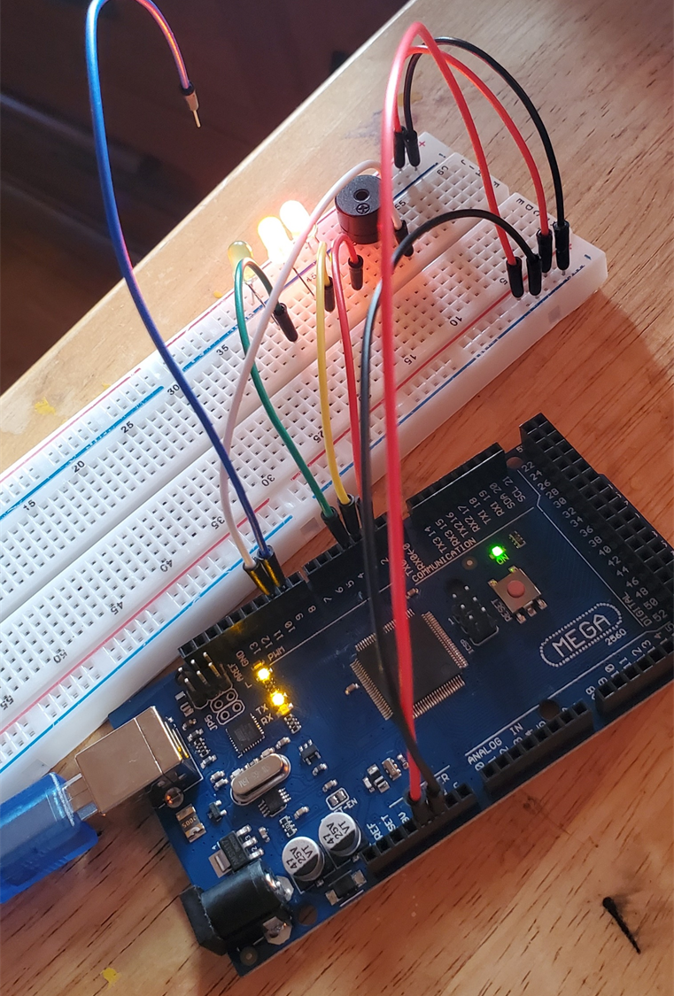
Adding Door Sensor to Smart Home System
Circuit of door open with green LED off

Slide 7
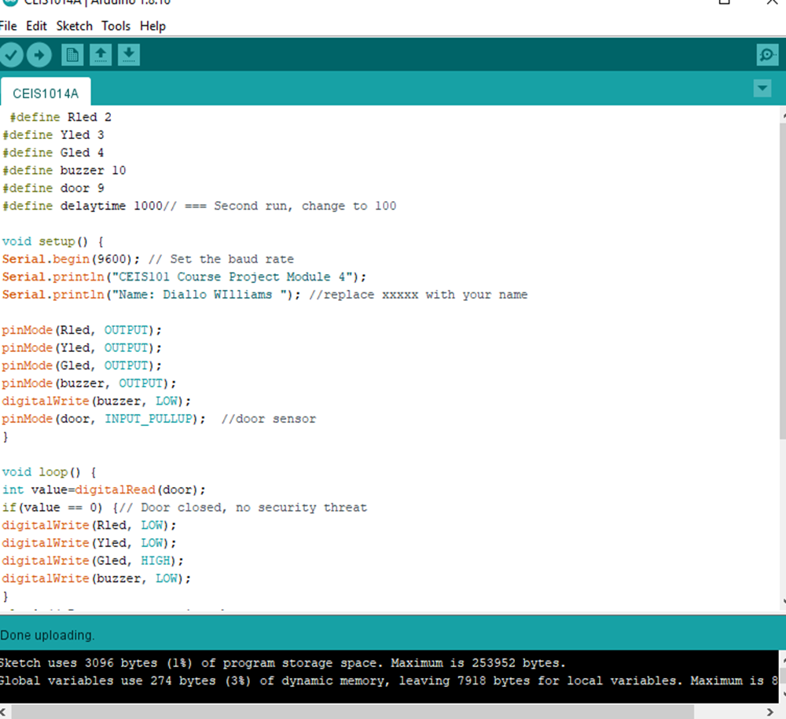
Adding Door Sensor to Smart Home System
Arduino Code

Slide 8
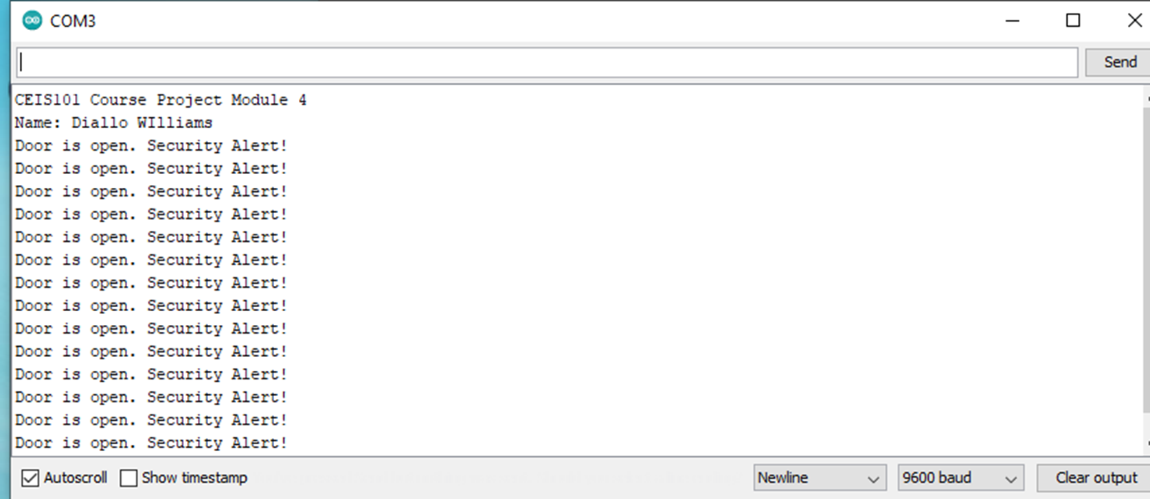
Adding Door Sensor to Smart Home System
Serial Monitor

Slide 9
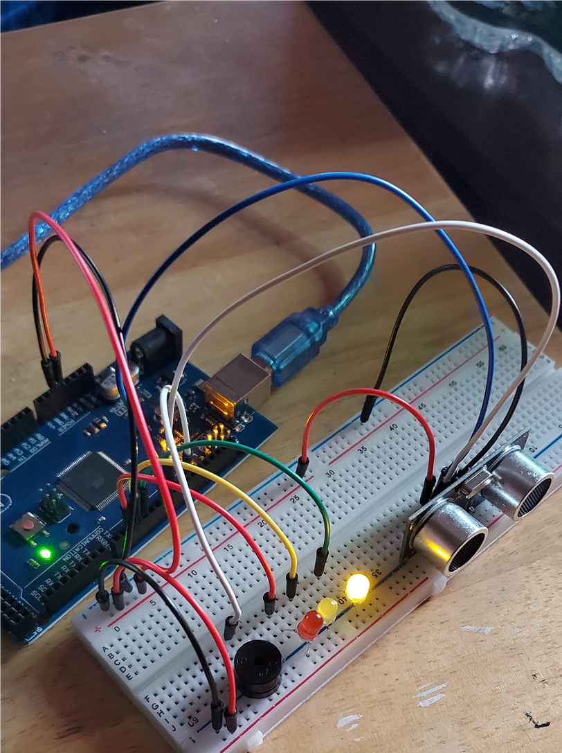
Adding Distance Sensor to Smart Home System and Conducting Data Analysis
Circuit with green LED on

Slide 10
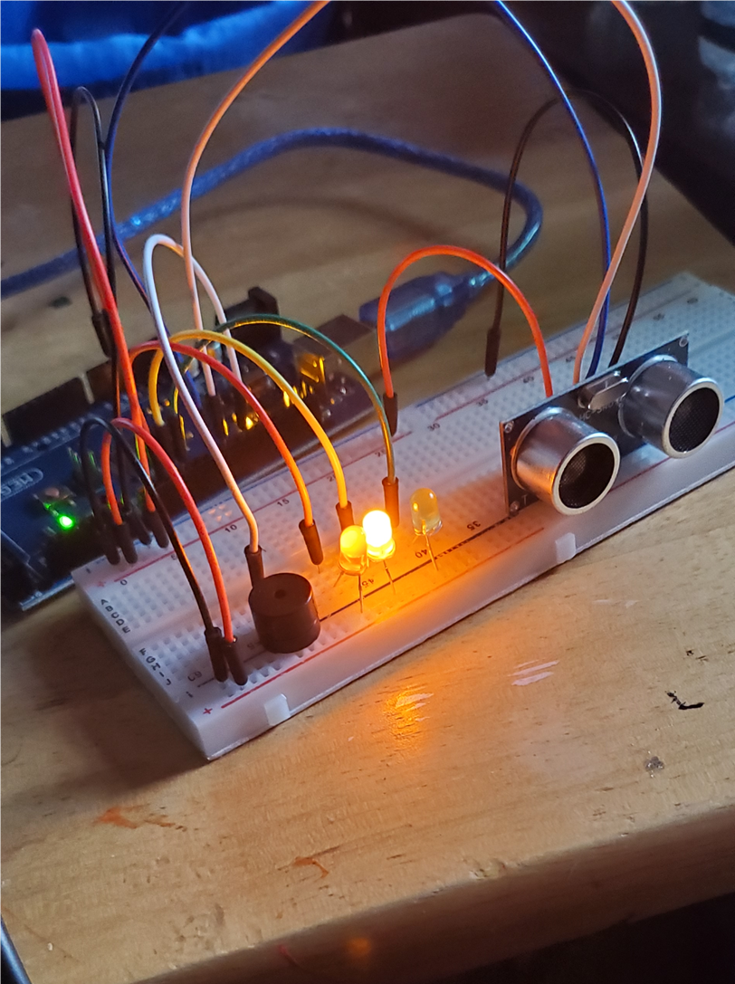
Adding Distance Sensor to Smart Home System and Conducting Data Analysis
Circuit with yellow LED on

Slide 11
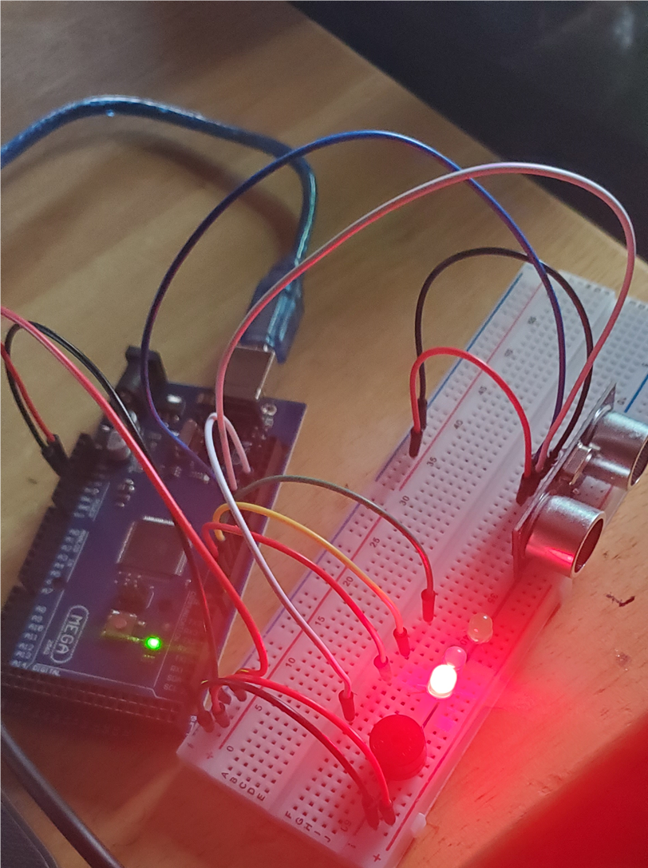
Adding Distance Sensor to Smart Home System and Conducting Data Analysis
Circuit with red LED on

Slide 12
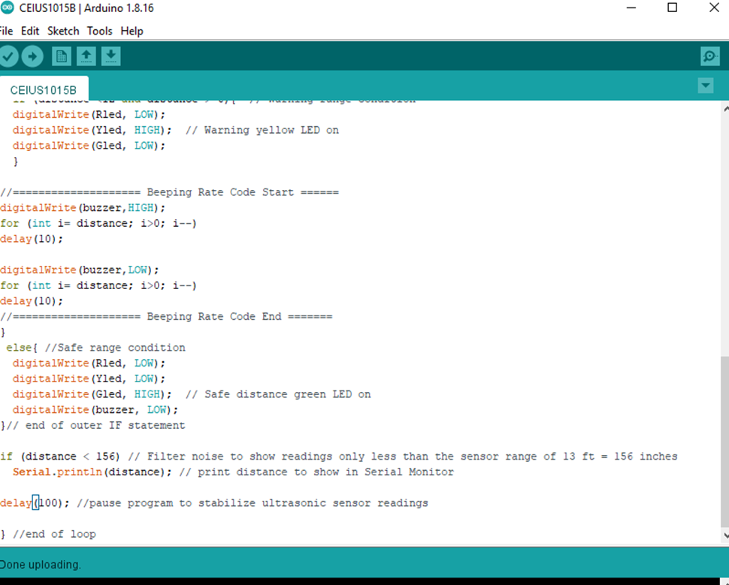
Adding Distance Sensor to Smart Home System and Conducting Data Analysis
Arduino code

Slide 13
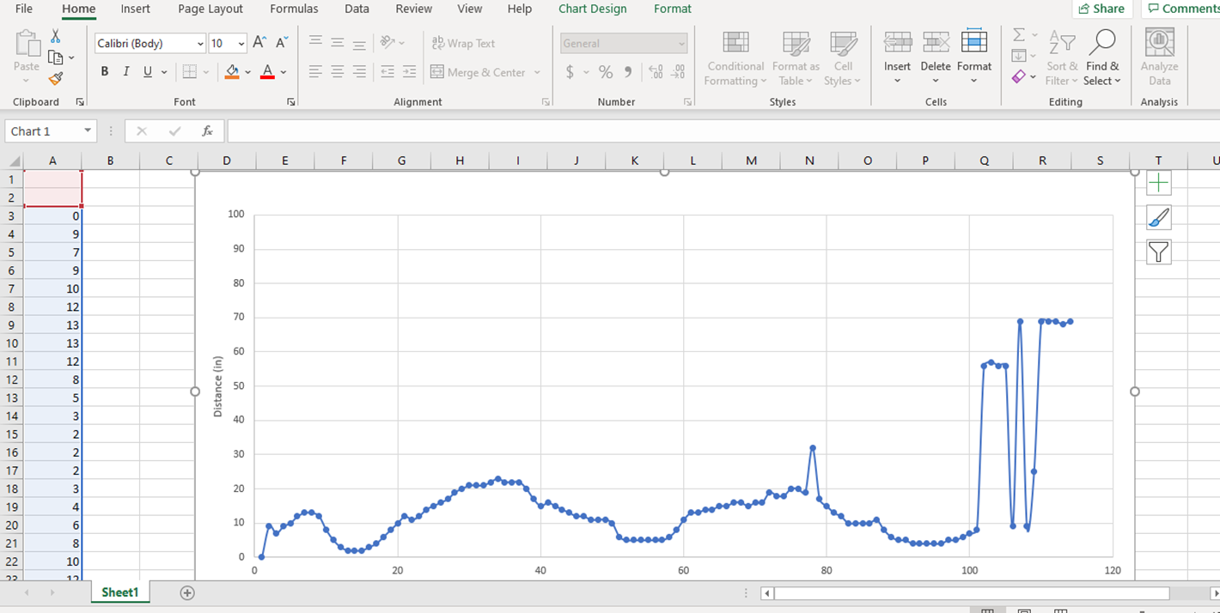
Adding Distance Sensor to Smart Home System and Conducting Data Analysis
Plot of data (Graph from Excel)

Slide 14
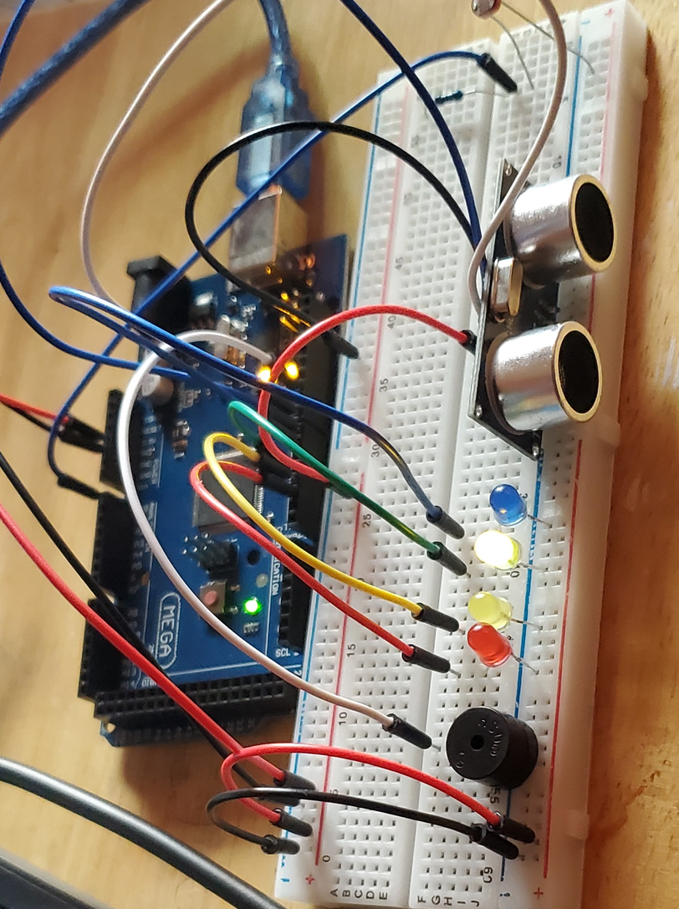
Adding Automated Light to Smart Home System
Circuit with automated LED off

Slide 15
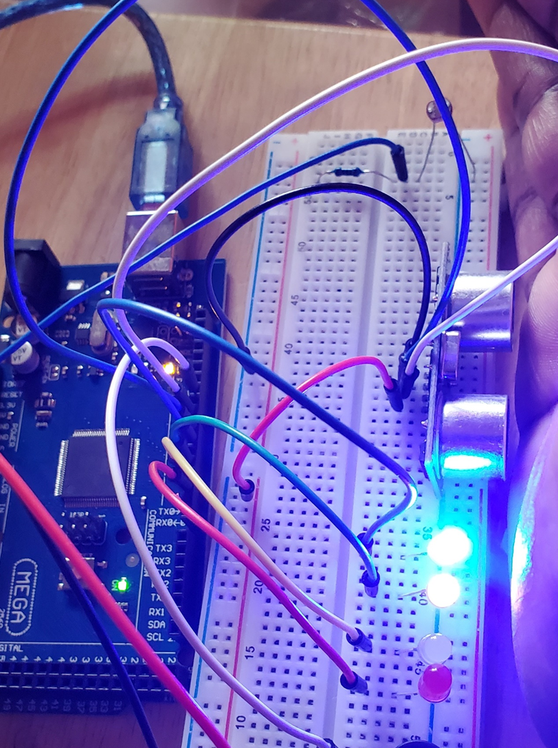
Adding Automated Light to Smart Home System
Circuit with automated LED on

Slide 16
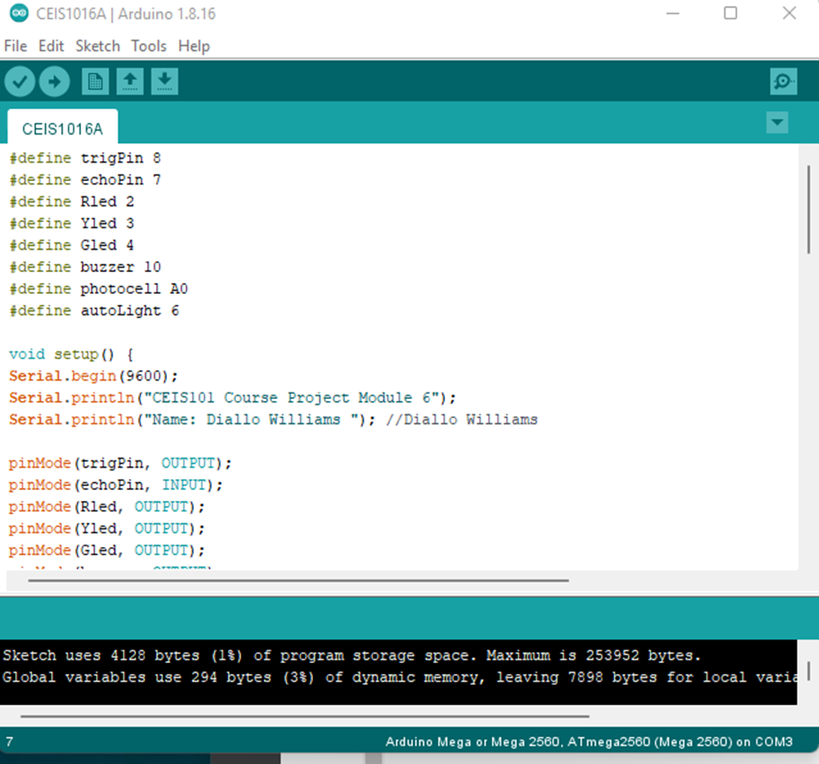
Adding Automated Light to Smart Home System
Arduino Code

Slide 17
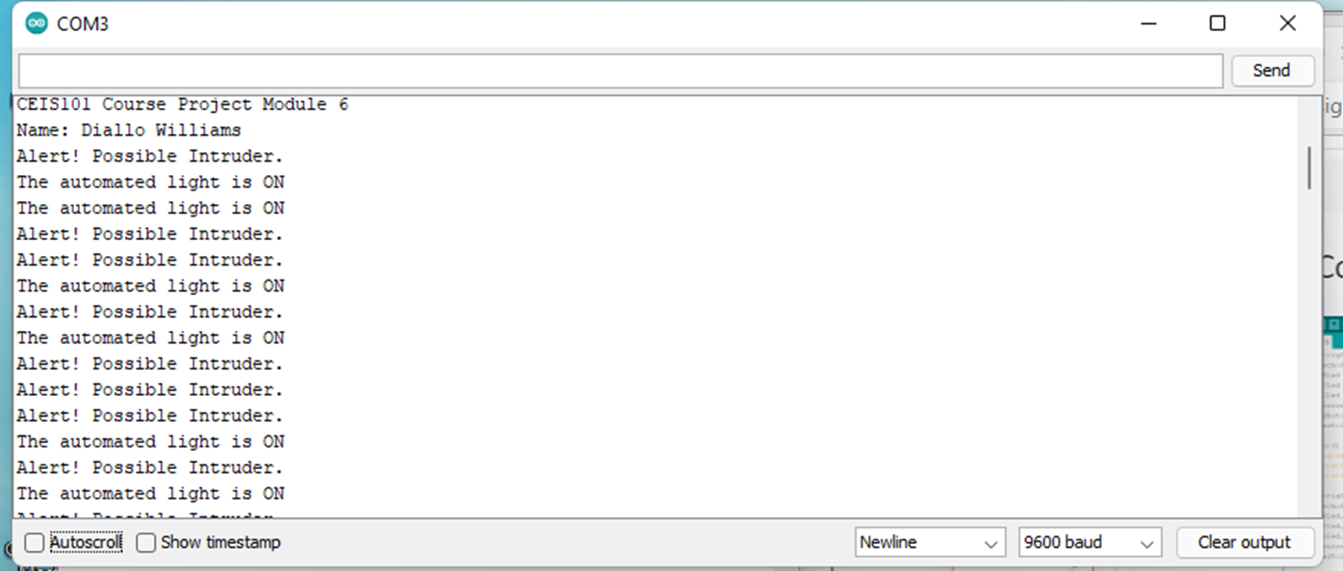
Adding Automated Light to Smart Home System
Serial Monitor

Slide 18


Challenges
Some of the challenges that came up are:
The alarm (buzzer) did not make a sound due to my pin placement which was not correctly lined.

Slide 19
Career Skills Acquired
Hardware/ Device Knowledge
Networking/ connectivity ability
Coding/ Programming
Understanding of the IOT
Operating System Fundamentals
Basic Business Intelligence & Data Analytical Knowledge
Automation
Security Awareness

Slide 20
Conclusion
This Project was an enriching experience rewarding me with a greater understanding in the world of IOT.
The IOT is a big industry expanding at a very fast pace.
In this project I had to follow many steps to create a Home Security System.
I gained a new set of skills and a greater understanding of the pin on the Arduino Mega board and the ESP32 board.
I learned what the outputs and the inputs are how to connect them the right way and now I’m one step closer to my career in IOT.

