Slide 1



Fundamentals of cloud computing
By Diallo williams

Slide 2
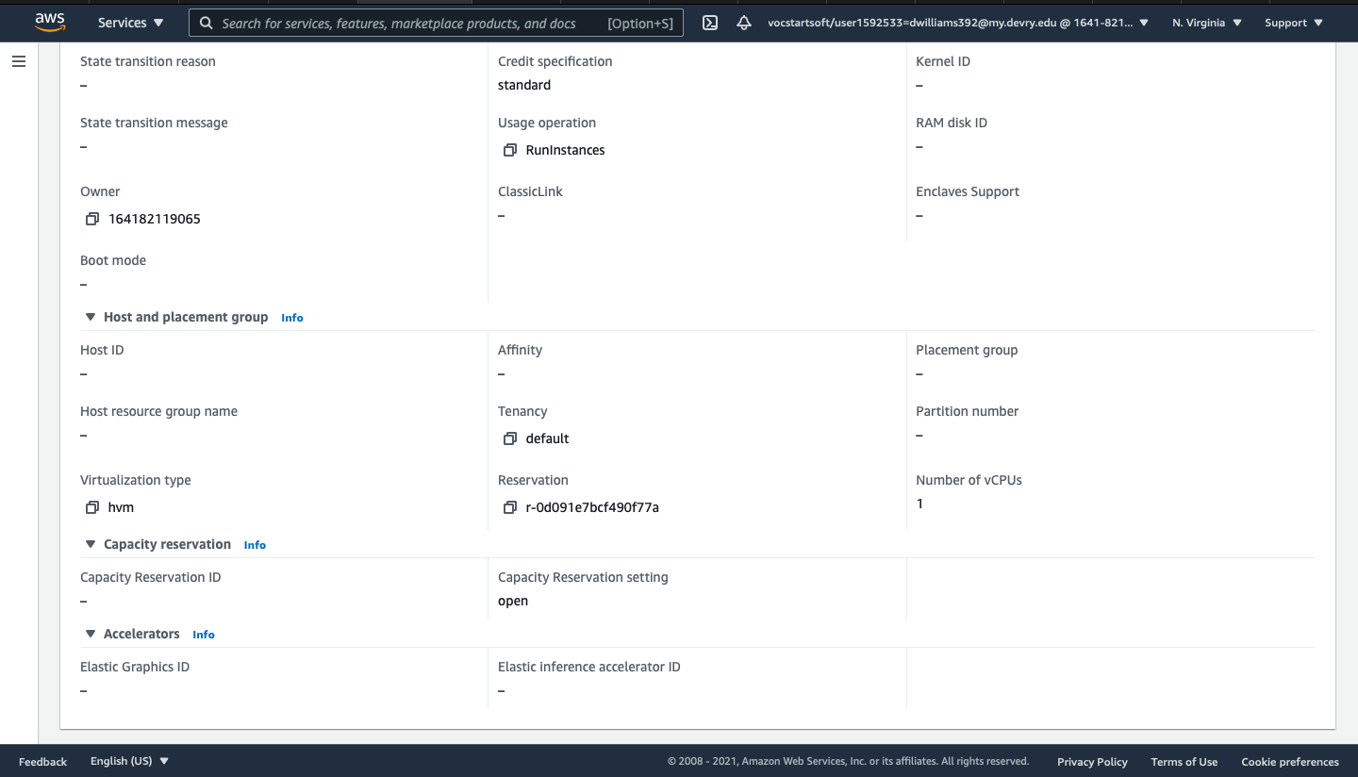
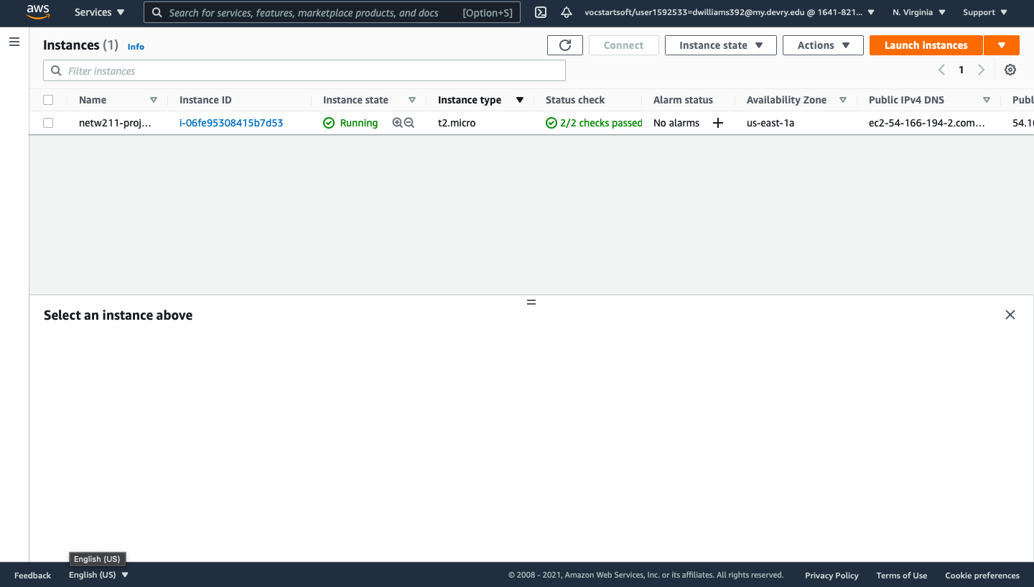
Launching an EC2 instance

Slide 3
Terminating the Instance

Slide 4
Challenge Questions
Challenge question: on the EC2 Dashboard, view options under the Instances section in the left navigation pane. Could you locate the details of the t2.micro instance you used in this module? How many vCPUs does it have? How much memory does it have? How much does it cost per hour?
1)The t2.micro has 1 Vcpu
2)Memory is 1 GIB
3)On Demand Linux Pricing = 0.0116 USD per hour/On Demand Window Pricing = 0.0162 USD per hour

Slide 5
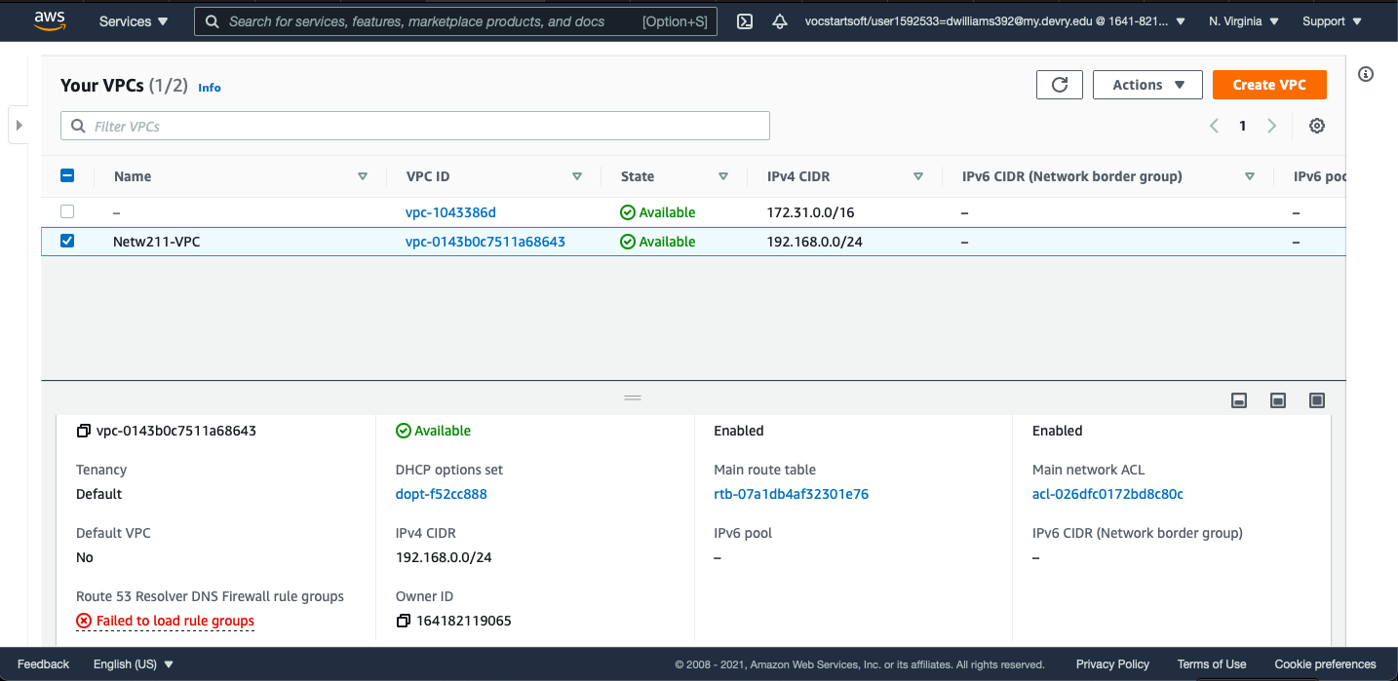

Launching a VPC with a single subnet

Slide 6
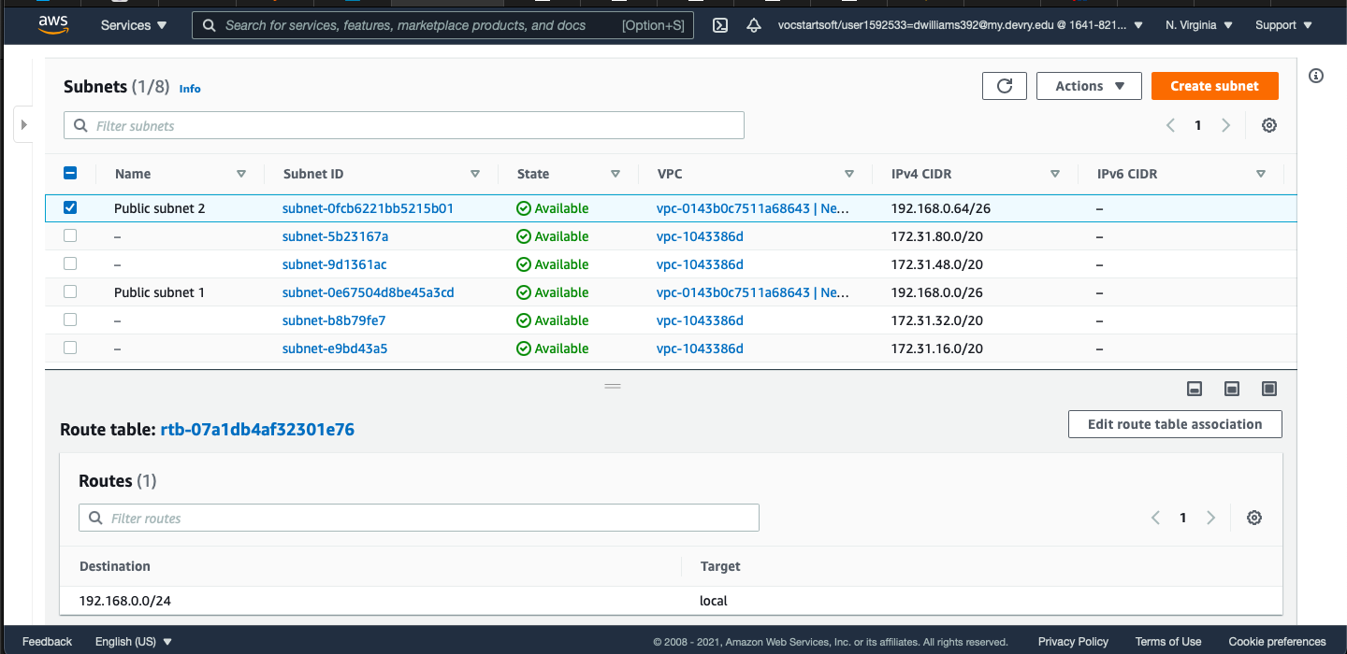
Adding another subnet

Slide 7

Question
. What’s the role of an Internet Gateway?
Answer here:”An internet gateway serves two purposes: to provide a target in your VPC route tables for internet-routable traffic, and to perform network address translation (NAT) for instances that have been assigned public IPv4 addresses.”-(AWS website)
References:
.https://docs.aws.amazon.com/vpc/latest/userguide/VPC_Internet_Gateway.html

Slide 8
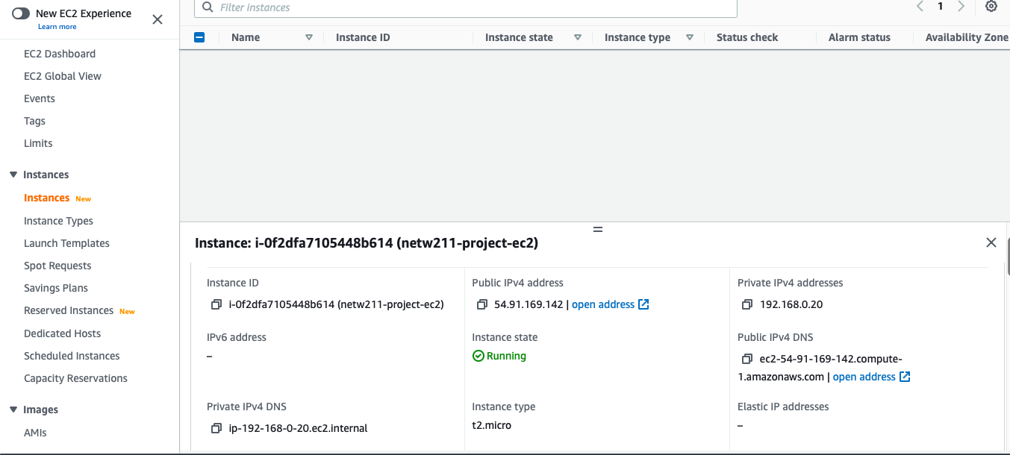
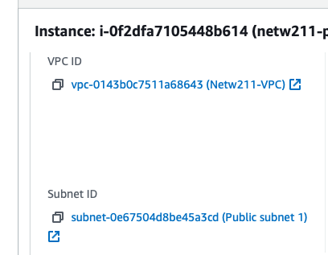
Launching an EC2 instance

Slide 9
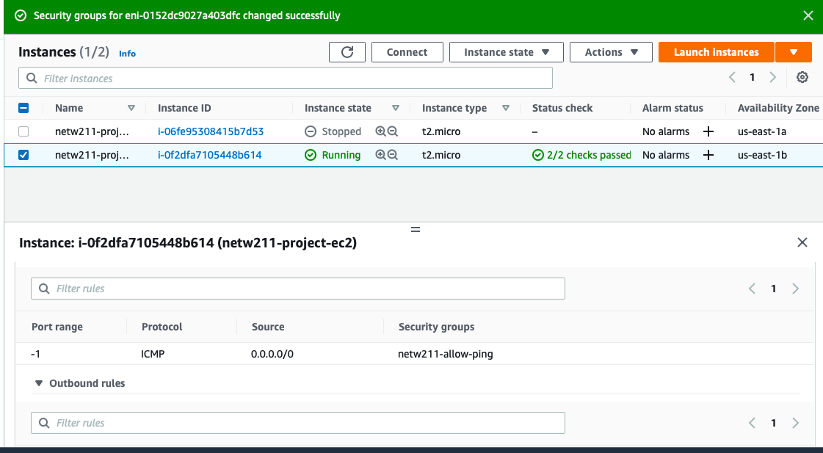
Setting up a security group

Slide 10
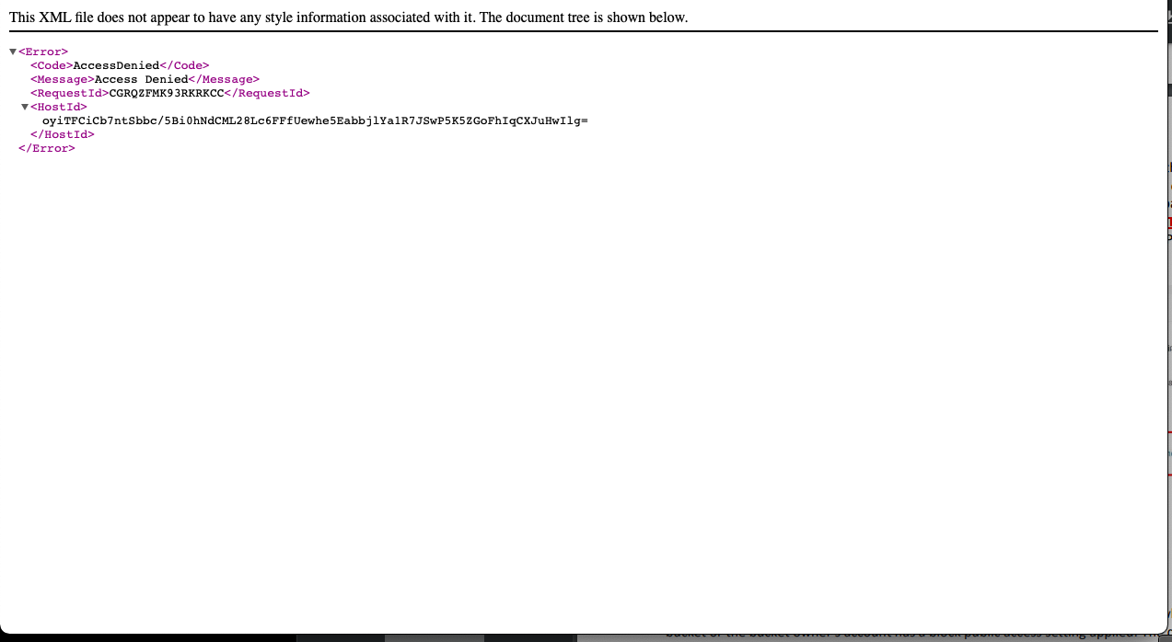
Uploading a file

Slide 11
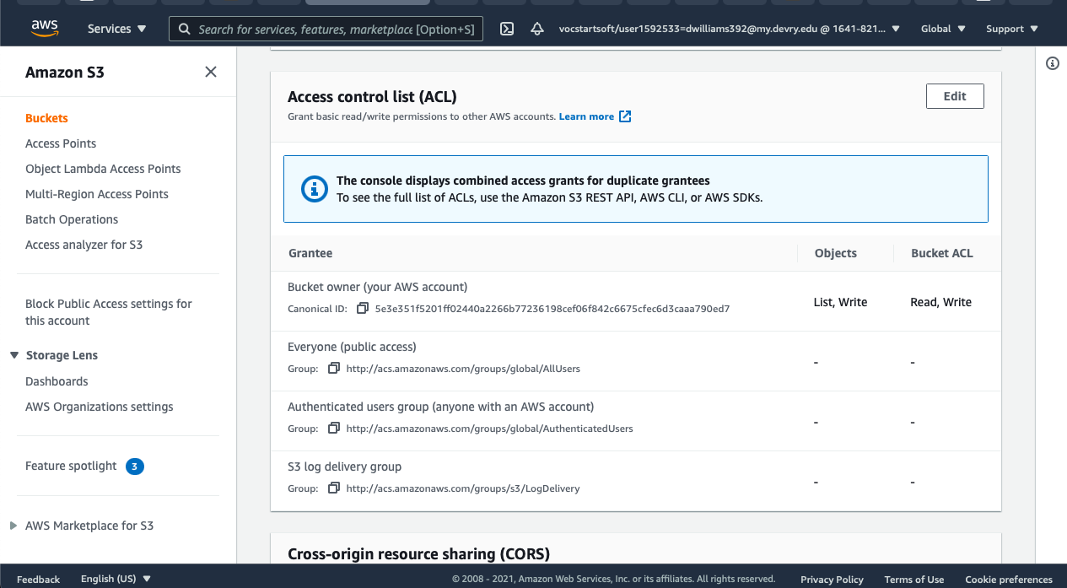
Changing permissions

Slide 12
question
What does the default encryption do?
Answer here: The Default Encryption allows “new objects to be encrypted when they are stored in the bucket. The objects are encrypted using server-side encryption with either Amazon s3-managed keys (SSE-S3) or AWS KMS keys stored in AWS Key Management Service (AWS KMS) (SSE-KMS).
You can also enable s# Bucket Keys to decrease request traffic from Amazon S3 to AWS Key Management Service (AWS KMS) and reduce the cost of encryption.”
References:
1.https://aws.amazon.com/kms/faqs/

Slide 13
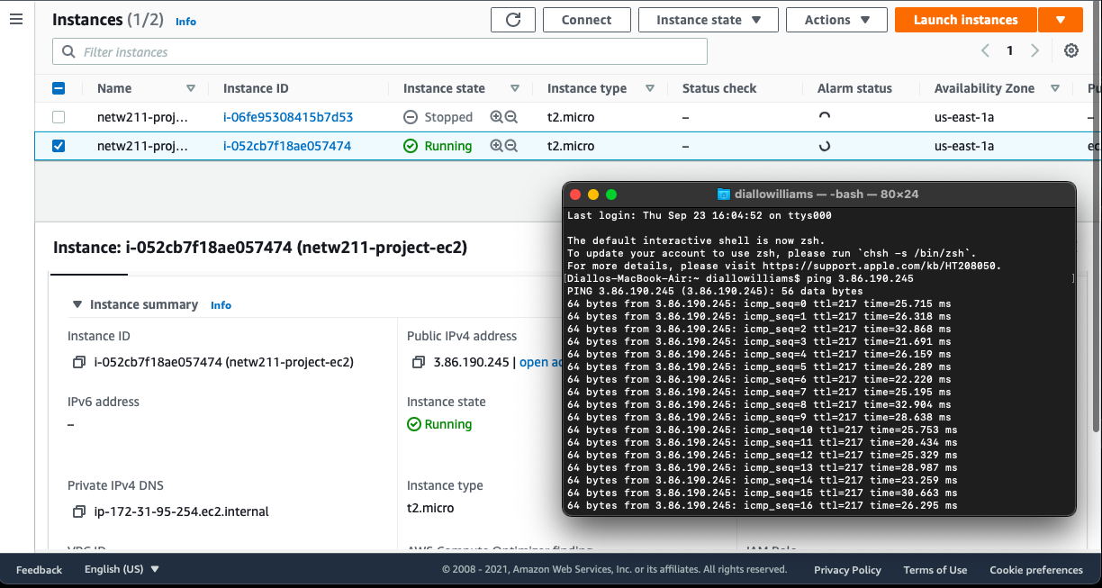
Launching an EC2 instance

Slide 14
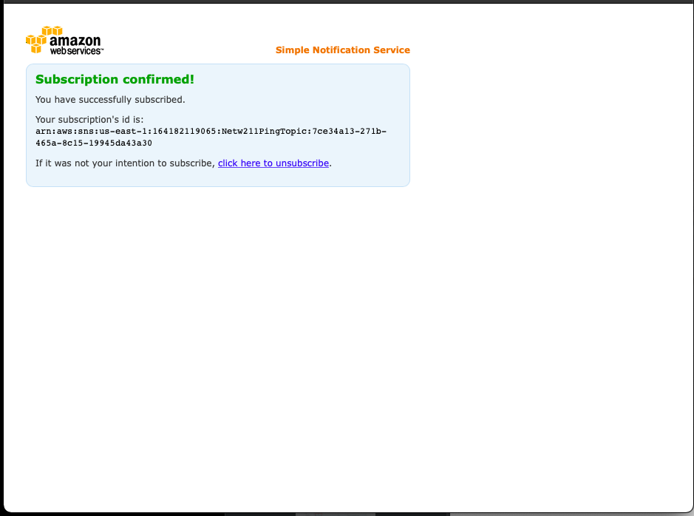
Setting up SNS notification and subscription

Slide 15
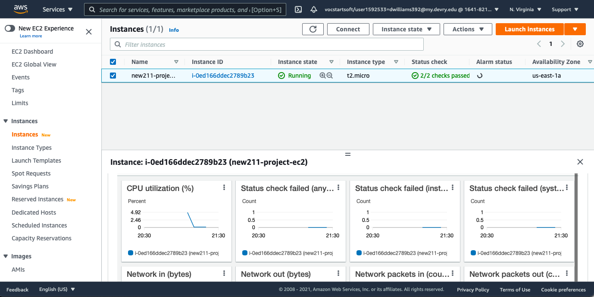
Setting up a CloudWatch alarm

Slide 16


The end
This Photo by Unknown Author is licensed under CC BY-SA-NC

